Slide 1
Taking Care of You!!
WELLNESS AND SELF-CARE
Alicia Bisaha, NCC, LPC
Gabriela Schilling, LPC

Slide 2
Mindfulness
Sensory Grounding Skills Exercise
Notes:
We are going to start out with a simple exercise to allow for some groundedness

Slide 3
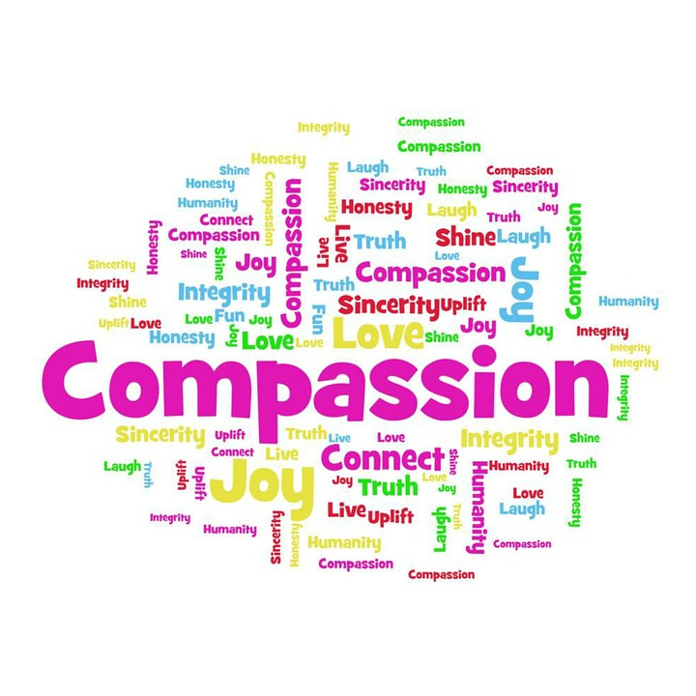
Compassion Satisfaction
Notes:
So when we look at taking care of ourself we want to check in and determine if our job is providing us with compassion satisfaction. This is All that is rewarding, all that makes us happy. How are we finding joy, pleasure, satisfaction, connectedness, a sense of humanity when we are on our jobs. If we are not experiencing Compassion Satisfaction then we may be experiencing either Ex: little 87 yr old, with daughter-in-law, cussing, thankful, funny, resilient, grateful.

Slide 4
Compassion Fatigue/Burnout
Compassion Fatigue- the cumulative physical, emotional, and psychological effects of exposure to traumatic stories or events when working in a helping capacity, combined with the strain and stress of everyday life. Also know as vicarious trauma, secondary traumatic stress and secondary stress reaction. Symptoms mimic PTSD.
Burnout- “A syndrome of emotional exhaustion, depersonalization, and a reduced sense of personal accomplishment. Develops because of general occupational stress. Symptoms: insomnia, fatigue, headaches, physical complaints.
National Child Traumatic Stress Network, Secondary Stress Committee. (2011).
Notes:
If we are not experiencing Compassion Satisfaction then we will experience one of these.

Slide 5
"Instead of asking, ‘Have I worked hard enough to deserve rest?’
I've started asking, 'Have I rested enough to do my most loving, meaningful work?”
Nicola Jane Hobbs
Notes:
Time to reflect on this quote and how it relates to self-care/burnout

Slide 6
The Social Readjustment Rating Scale (SRRS)
Measures life stressors.
Designed to reflect the cumulative stress to which an individual has been exposed over a period of time.
Looks at past 12 months.
http://www.dartmouth.edu/eap/library/lifechangestresstest.pdf

Slide 7
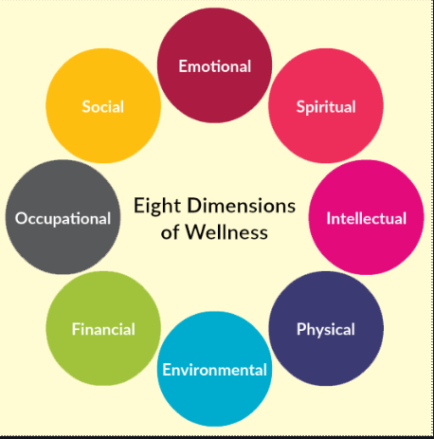
Eight Dimensions of Wellness Model
Notes:
Used to be 6 then 7 and now 8 areas. Ex of Environmental

Slide 8
Evaluate your coping skills
Healthy
Exercising
Meditation
Reading
Taking a bath
Socializing with friends
Engaging in a hobby
Listening to music
Unhealthy
Overeating
Drinking alcohol excessively
Smoking
Substance use
Yelling
Skipping meals
Withdrawing/isolating from others

Slide 9
What is Mindfulness?
“Mindfulness is awareness that arises through paying attention, on purpose, in the present moment, non-judgmentally”
Jon Kabat-Zinn
Notes:
Mindfulness suggests that the mind is fully attending to what’s happening, to what you’re doing, to the space you’re moving through, all from a place of curiosity and kindness rather than judgment. Mindfulness is a quality that every human being already possesses, it’s not something you have to conjure up, you just have to learn how to access it. There are many benefits, including increased self-awareness, improved focus/attention, improved memory, lowering stress, improved self-regulation skills, and strengthening relationships.

Slide 10
Mindfulness Attention Awareness Scale (MAAS)

Slide 11
Mindfulness
Chair Yoga

