Slide 1
HIV & Aging
Sarah McBeth, MD MPH
Clinical Assistant Professor
University of Pittsburgh Medical Center

Slide 2
Acknowledgement
The MidAtlantic AIDS Education and Training Center (MAAETC) is supported by DHHS, Health Resources and Services Administration (HRSA) as part of a cooperative agreement of $2,917,621 and 0% financed with non-governmental sources. The program aims to provides HIV training and technical assistance to USPHS Region 3 (Pennsylvania, Maryland, Delaware, the District of Columbia, Virginia, and West Virginia).
The contents in this presentation are those of the author(s) and do not necessarily represent the official views of, nor an endorsement, by HRSA, HHS, or the U.S. Government. For more information, please visit HRSA.gov.

Slide 3
Planning Disclosure
The staff and faculty involved with the planning of today’s event do not have any conflicts of interest to disclose.

Slide 4
Speaker Disclosure
Speaker has no conflicts of interest to disclose

Slide 5
Needs
We have attempted to make this presentation compliant with the Americans with Disabilities Act and Section 508 of the Rehabilitation Act.
If you find that you need further accommodation, or alternate means to utilize this presentation, please contact us and we will attempt to further accommodate your needs.

Slide 6
Today’s Objectives
Understand the epidemiology of HIV & Aging
Review life expectancy for people with HIV
Understand increased co-morbidities & disease risk in people with HIV
Discuss the 5 (or 6!) M framework for aging
Learn about Project IMPACT

Slide 7
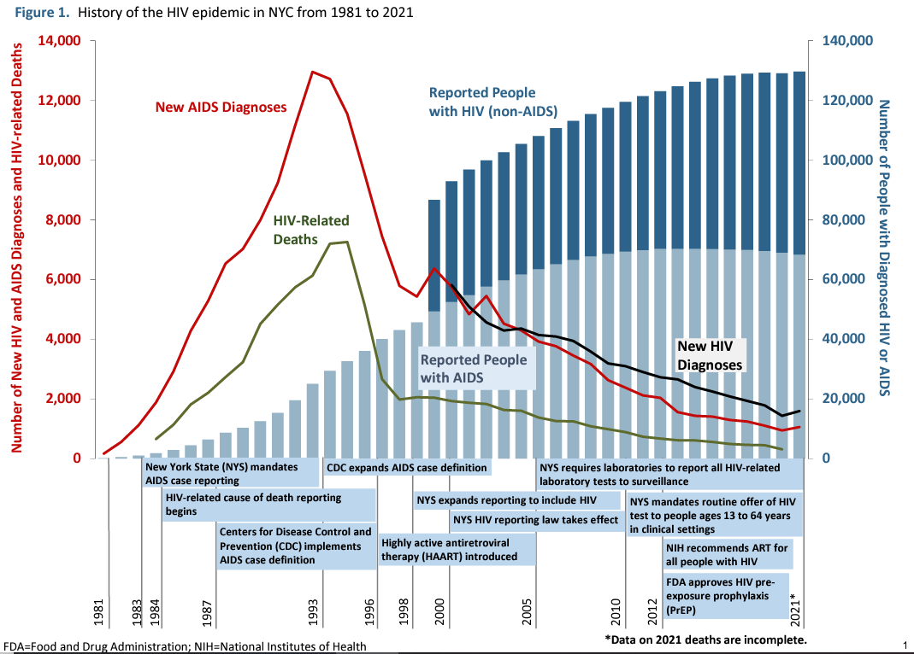

Slide 8
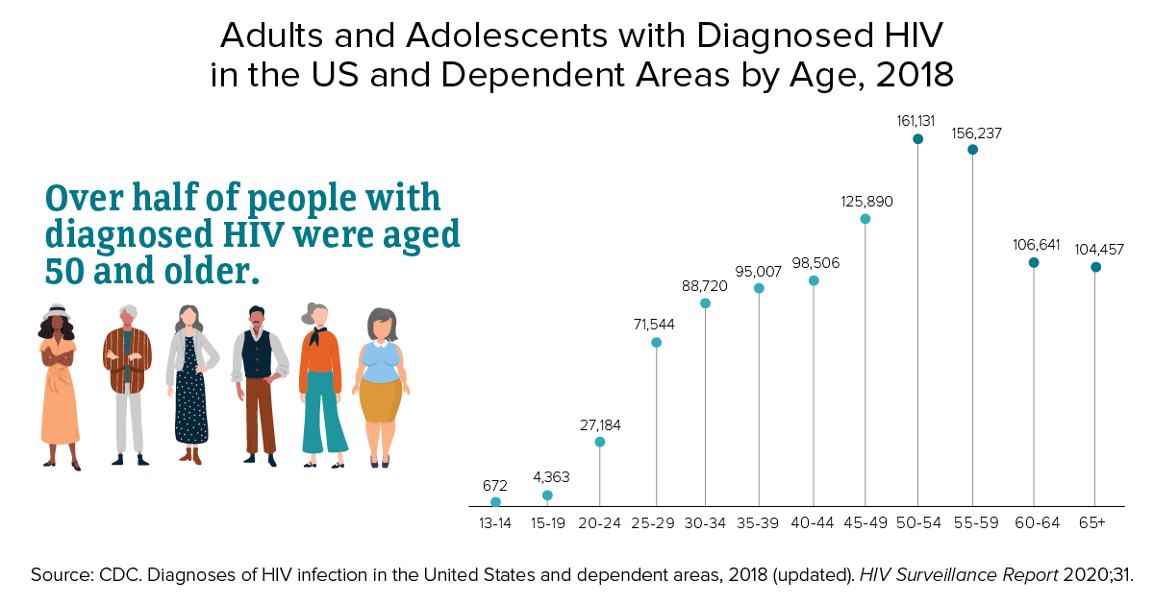

Slide 9
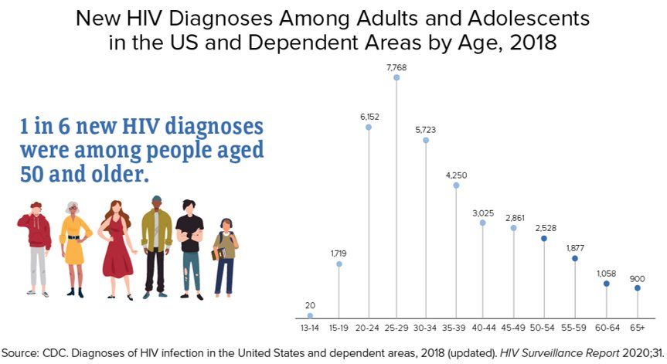

Slide 10
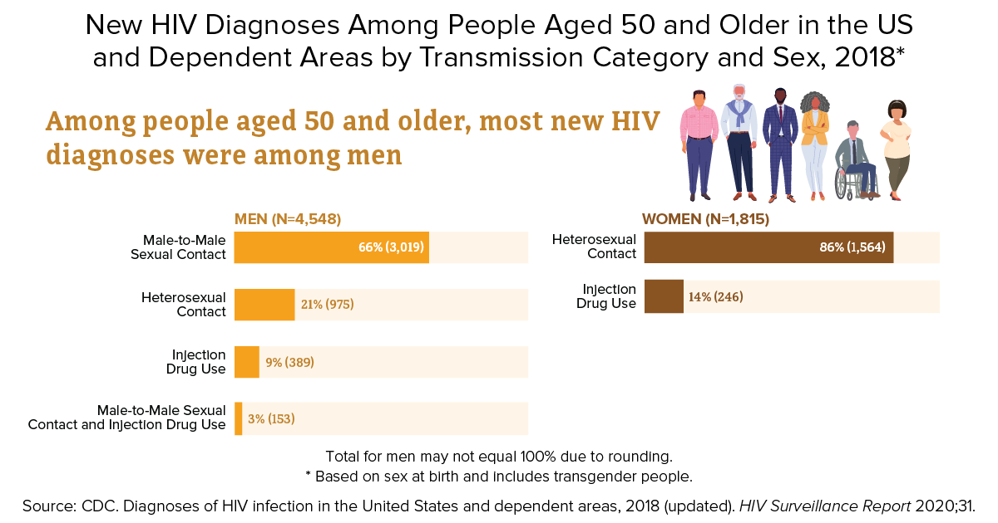

Slide 12
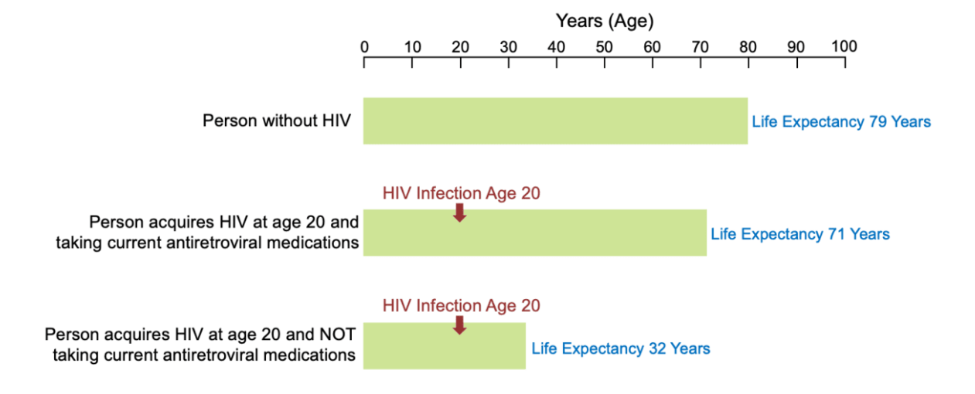
HIV & Lifespan

Slide 13
The Lifespan Gap is Closing

Slide 14
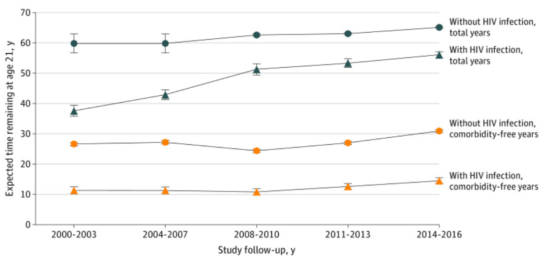
Comparable Lifespans, More Morbidity
Marcus JL, Leyden WA, Alexeeff SE, Anderson AN, Hechter RC, Hu H, Lam JO, Towner WJ, Yuan Q, Horberg MA, Silverberg MJ. Comparison of Overall and Comorbidity-Free Life Expectancy Between Insured Adults With and Without HIV Infection, 2000-2016. JAMA Netw Open. 2020 Jun 1;3(6):e207954. doi: 10.1001/jamanetworkopen.2020.7954. PMID: 32539152; PMCID: PMC7296391.
Notes:
life expectancy of adults with HIV infection may be near that of life expectancy of individuals without HIV infection, but greater attention is needed to prevention of comorbidities among individuals with HIV infection.

Slide 15
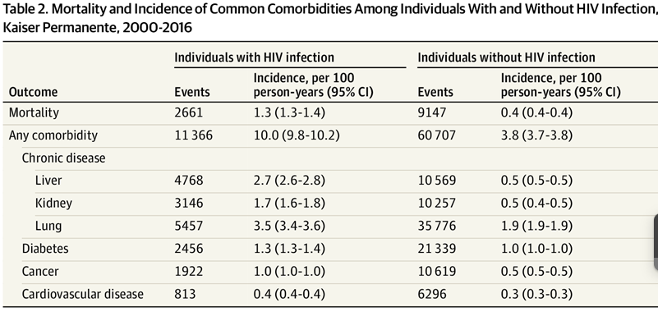
Marcus JL, Leyden WA, Alexeeff SE, Anderson AN, Hechter RC, Hu H, Lam JO, Towner WJ, Yuan Q, Horberg MA, Silverberg MJ. Comparison of Overall and Comorbidity-Free Life Expectancy Between Insured Adults With and Without HIV Infection, 2000-2016. JAMA Netw Open. 2020 Jun 1;3(6):e207954. doi: 10.1001/jamanetworkopen.2020.7954. PMID: 32539152; PMCID: PMC7296391.

Slide 16
Polypharmacy
More comorbidities often means more medications
Generally, “the concurrent use of multiple medications” although no consensus definition
World Health Organization (WHO) defines polypharmacy as…
Routine use of 5 or more medications
Including OTC, Rx, and complementary medicines
(Dovjak et al, 2022)
Notes:
**What is polypharmacy?
Not well-defined. No consensus definition. One review with 24 different definitions
WHO 5+ - doesn’t define hospital vs ambulatory.

Slide 17
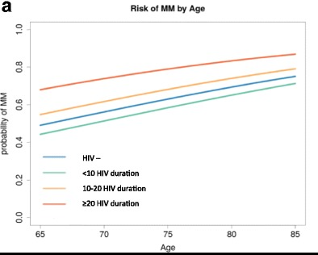
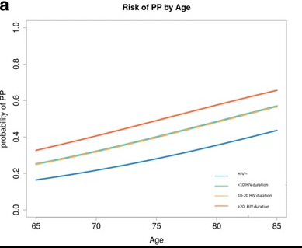
Increased Rates of Multimorbidity, Polypharmacy by Age and Duration of HIV
Risk of Multimorbidity
(2+ NCD diagnoses )
Risk of Polypharmacy
(5 non-ART meds)
HIV >20 yrs
HIV
10-20yrs
HIV <10yrs
HIV negative
Guaraldi BMC Geriatrics 2018. 18:99 https://doi.org/10.1186/s12877-018-0789-0
Notes:
(GEPPO) is a new prospective observational multicentre cohort consisting of all the HIV-positive geriatric patients being treated at 10 clinics in Italy (1200+) patients
MM= 2 or more NCD diagnosis
PP = 5 or more meds (not ART)

Slide 19
Accelerated or Accentuated Aging?
Untreated HIV infection may be associated with high levels of persistent inflammation
HIV may accelerate or accentuate the aging process (ongoing discussion in research)
Chronic illnesses may occur at rates greater than expected for age
Chronic inflammation and immune activation occur in both HIV infection and normal aging

Slide 20
Other contributing factors
ARTs contribute to bone loss, kidney damage, fat redistribution
People with HIV more likely to also have Hep B and C, HPV
People with HIV 3 times more likely to smoke
People with HIV have higher rates of mental illness and substance use

Slide 21
Geriatric Syndromes
Falls
Frailty
A syndrome of weakness, weight loss, and low activity
Associated with adverse health outcomes
Functional impairment (mobility)
Sensory Impairment
Cognitive decline / dementia
Sarcopenia
Malnutrition
Incontinence

Slide 22
The 5 M’s of geriatics
Mobility
Mind
Medications
Multi-complexity / Multi-morbidity
Matters Most

Slide 24
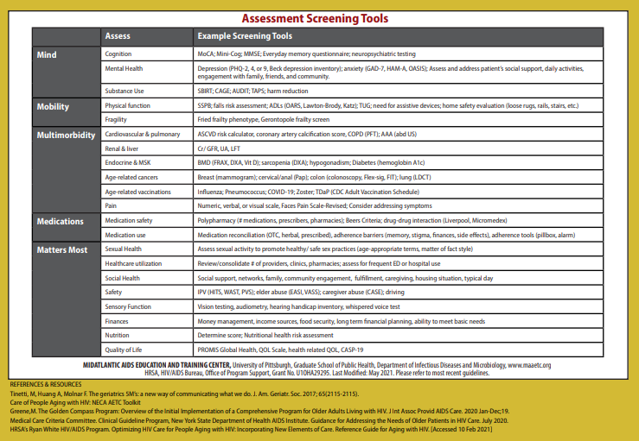

Slide 25
The 5M Framework
 | Description (modified from Molnar, 2019) | Relevant Questions for Clinicians
 | Impaired gait and balance Fall injury prevention | Does the patient have gait impairment? Are they at risk for falls?
 | Mentation Dementia Delirium Depression | Is the patient experiencing cognitive decline? Do they have depression or another mood disorder?
 | Polypharmacy, Deprescribing Optimal prescribing Adverse effects Medication Burden | Does the patient have polypharmacy; can we safely deprescribe? Is the patient experiencing medication side effects?
 | Multimorbidity Complex biopsychosocial situations | Is the patient safe at home? Do they need help with activities of daily living (ADLs)?
 | Individual’s health outcome goals Care preferences | Has the patient identified a healthcare surrogate decision maker? Do they have an Advanced Directive?
^{[1]} Molnar, F., & Frank, C. C. (2019). Optimizing geriatric care with the GERIATRIC 5Ms. Canadian family physician Medecin de famille canadien, 65(1), 39.

Slide 26
The 6th M
Erlandson and Karris (2019) proposed a sixth M – “Modifiable”
Can the patient be more physically active?
How can we help them eat healthier?
Do they need resources to avoid alcohol, tobacco, or drug use?

Slide 27
Keeping Aging HIV Patients Healthy
Adhere to HIV medications
Quit smoking
Refine diet and maintain normal weight
For obese individuals, hypocaloric diet can reduce inflammation^{[1]}
Exercise
Study of sedentary HIV-infected patients on ART (N = 49) found that 60 mins brisk walking ± 30 mins strength training 3 times/wk for 12 wks improved functional status and reduced inflammatory markers/immune activation^{[2]}
Reduce alcohol intake; avoid drugs
Provide hepatitis and HPV vaccinations
Advise sunscreen and avoidance of sun overexposure
Screening:
Yearly cervical and anal Pap tests as indicated^{[3]}
Colon cancer screening at age 50^{[3]}
Breast cancer screening every other yr at age 50^{[4,5]}
Prostate screening risks and benefits discussed at age 50^{[4,6]}
If HBV+ or HCV+, screen for liver cancer^{[3]}
1. Hermsdorff HH, et al. Endocrine. 2009;36:445-451. 2. Bonato M, et al. BMC Infect Dis. 2017;17:61. 3. Sigel K, et al. Curr HIV/AIDS Rep. 2011;8:142-152. 4. NCI. HIV infection and cancer risk. 5. USPSTF. Breast cancer: screening. January 2016. 6. Mani D, et al. Curr Opin Oncol. 2013;25:518-525.
Slide credit: clinicaloptions.com
Notes:
HBV, hepatitis B virus; HCV, hepatitis C virus; HPV, human papillomavirus.
Beyond selecting the most appropriate antiretroviral regimen, there are many other health maintenance/management practices that are necessary for your older patients with HIV. You have to develop strategies to help your patients adhere to their HIV medications, although older patients with HIV tend to adhere to antiretroviral therapy better than younger patients. Advising patients on smoking cessation, maintaining normal weight, exercise, reducing alcohol intake—these are all common sense recommendations for everyone, with HIV or without HIV.
You have to provide hepatitis and HPV vaccinations, as indicated. Advise patients on preventing sun exposure because of increased risk of skin cancers. Periodic screening is also necessary, including annual cervical and anal Pap smears as indicated, colonoscopy at and after 50 years of age, and breast cancer screening for women. Prostate cancer screening risks and benefits also should be discussed with men 50 years of age or older.
If the patient is hepatitis B virus positive or hepatitis C virus positive with advanced liver disease, even if they have been cured of the hepatitis C, they need to be screened periodically for liver cancer.

Slide 28
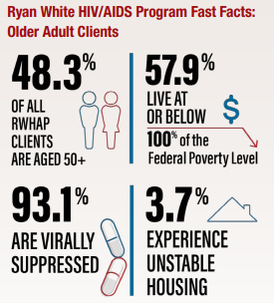
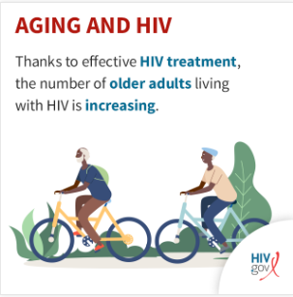
The National HIV/AIDS Strategy adds a new focus on the needs of the growing population of people with HIV who are aging

Slide 29
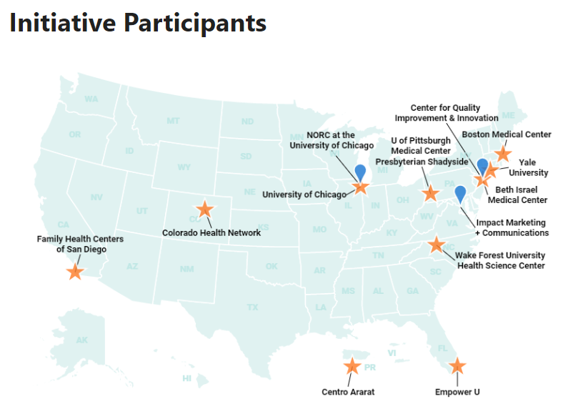
Goal: Implement emerging strategies that comprehensively screen and manage comorbidities, geriatric conditions, behavioral health, and psychosocial needs of people 50 years and older with HIV.

Slide 30
Improving the 6M’s at Pittsburgh Area Center for Treatment (IMPACT)

Slide 31
IMPACT
We aim to enhance care for our aging patients by:
Improving the skill set of our providers through HIV Conferences
Restructuring our EMR visit template
Special questions for those over 50 aimed at addressing the 6M’s
Improving relevant workflows within our clinic
Connecting patients with appropriate healthcare and community resources

Slide 32
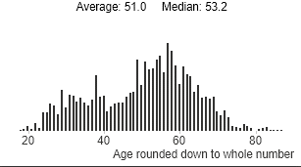
Rationale and Background for IMPACT
59% of PACT patients are age 50+
Diverse group with variable needs
Screening tool in EMR will allow providers to tailor interventions to the patient’s needs
Multi-faceted approach will strengthen the skill sets and workflows throughout our clinic (providers, nurses, pharmacy, behavioral health, social work nutrition)
Long-standing weekly conference will be utilized for provider trainings
Ages of PACT patients in 2021

Slide 33
IMPACT: Key Partners
Partner | Role/Responsibilities | Support Provided
University of Pittsburgh Dept of Geriatrics | Geriatric consultant Educator | Providers, staff education Guide implementation for ‘M’s Consultant for challenging pts
University of Pittsburgh MAAETC | Training support, tools, coordination | Training regarding ‘M’s’ Training evaluation
Allegheny County Area Agency on Aging | Front door to services for those 60 yrs of age, older | Assist our MCMs link PWH to available resources as they age
Benedum Geriatric Center, UPMC | Specialty referral resource | Medical and behavioral health care for complex older PWH

Slide 34
Mobility
Provider education re: mobility assessment at an HIV conference
Gait speed assessed at visits
PACT nurses and providers refine referral workflow and ordering process for durable medical equipment (DME; i.e canes, walkers, powerchairs)

Slide 35
Mind
Education provided re: neurocognitive assessment at a weekly HIV conference
BHA scores for Everyday Cognition, PHQ-9, GAD-7, are incorporated into IMPACT template in EMR used by providers and trainees
Visit screening: In the past year, have you or someone close to you noticed problems with your memory or thinking skills?
If yes, consider testing with the International HIV Dementia Scale
PACT providers and psychologist refine referral workflow for those needing further assessment (i.e. neurocognitive assessment, psychology, psychiatry, occupational therapy)

Slide 36
Medications
PACT pharmacist and trainees provide education re: polypharmacy and other geriatric medication considerations at a weekly HIV conference
Pharmacist, pharmacy trainees, and clinicians develop and refine workflow to review medication list for those age 50+ prior to their appointment and incorporate recommendations for safe prescribing

Slide 37
Multi-complexity
Provide education re: home safety, activities of daily living (ADL) at a weekly HIV conference
Visit screening: “Were you able to get to clinic on your own today?” Screening for ADL (Activities of Daily living) completion
Medical case managers and clinicians refine referral process for community programs including Area Agency on Aging (transportation, caregivers, home safety, et al)

Slide 38
Matters Most
Provide education re: quality of life, Advanced Directives discussion at a weekly HIV conference
Visit screening: “Do you feel lonely?”
Surrogate decision maker is incorporated visit template used by our providers and trainees
Peer advocate compiled community resources (Social Resources List) and provides outreach, restarted monthly patient luncheons

Slide 39
Modifiable
Provide education re: osteoporosis, RSV vaccination during a weekly HIV conference
Screening for food insecurity: Within the past year, did the food you buy just not last and you didn’t have money to buy more?
If patients answer yes, refer to our Food Assistance Program
PACT dietician enhanced Calcium / Vitamin D assessments for those aged 50+ osteopenia / osteoporosis

Slide 40
Key Points
The population of people with HIV is aging
Life expectancy is nearly the same as the general population
People with HIV have higher rates of comorbidity
The 6M framework helps us think about the issues associated with aging
The needs of our aging patients are complex – it takes a team!

Slide 41
MidAtlantic AIDS Education and Training Center - Contact Information
Headquarters:
MidAtlantic AIDS Education and Training Center
Department of Infectious Diseases and Microbiology,
Graduate School of Public Health,
University of Pittsburgh
412-624-1895
maaetc@pitt.edu
www.maaetc.org
Linda Rose Frank, PHD, MSN, ACRN, FAAN
Principal Investigator and Program Director
Professor of Public Health, Medicine & Nursing
University of Pittsburgh
Regional Partner:
Kimberly Sabolcik, MSW
Regional Coordinator
MidAtlantic AIDS Education and Training Center
Department of Infectious Diseases and Microbiology
School of Public Health, University of Pittsburgh
412-624-1896
Kjs198@pitt.edu

