Slide 1
Annual AHN APP Conference 2023
Medical Weight Management
Melissa Schultz, PA-C
Comprehensive Weight Management Center
AHN Bariatric and Metabolic Institute

Slide 2
Disclosure
I have no financial disclosure or conflicts of interest with the presented material.

Slide 3
What is Obesity
Defined by the OMA as a “chronic, progressive, relapsing, and treatable multi-factorial, neurobehavioral disease, wherein an increase in body fat promotes adipose tissue dysfunction and abnormal fat mass physical forces, resulting in adverse metabolic, biomechanical, and psychosocial health consequences.”
BMI >30 kg/m2

Slide 4
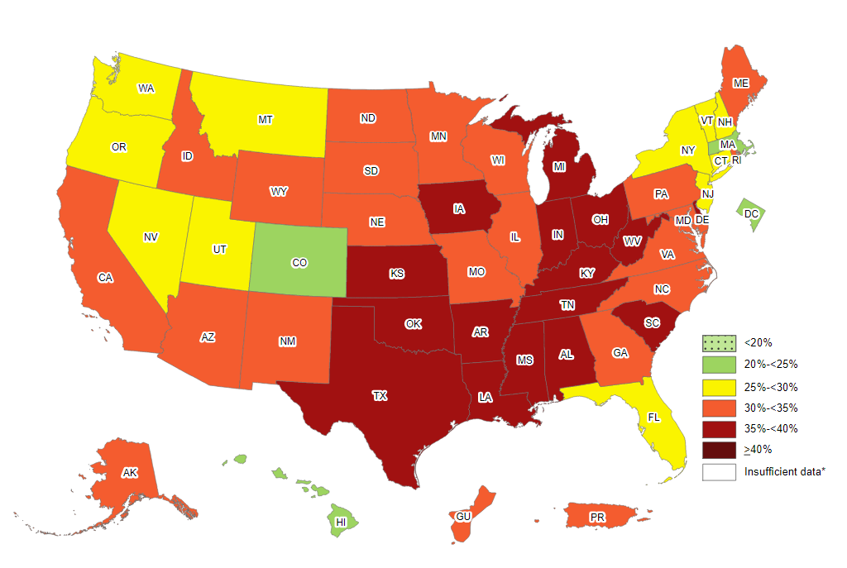
73% of adults 18-65 have BMI >25
42% are considered to have obesity (BMI>30)
500K people die every year from medical complications related to Obesity
CDC: Prevalence of Self-Reported Obesity Among U.S. Adults by State and Territory, BRFSS, 2020

Slide 5
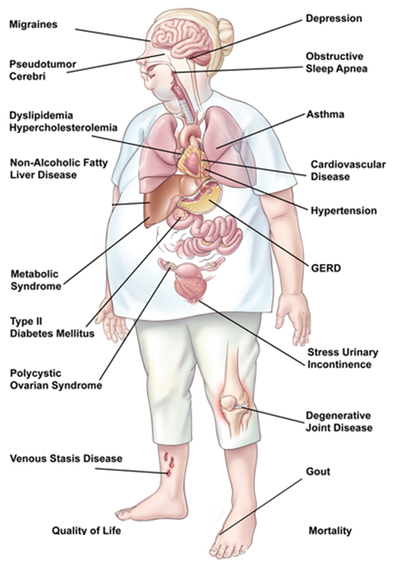
Obesity Related Health Conditions

Slide 6
Obesity Encounter
Assess insight and readiness to change
Motivational interviewing key
Avoid bias and leading questions
Ask permission to discuss weight!
Beware of stigmas, sensitive topic for most.
Patients want to be “heard”
Have you considered trying to lose weight before?
What positive changes do you think you would see?
What are your motivators?

Slide 7
Focus on Benefits of Weight Loss
Fewer Medical Problems
Less Prescription Medications
Better Mobility
Increased Life Expectancy
Better Quality of Life
Decreased Cancer Risk

Slide 8
Obesity Encounter
Medical/surgical history
Current Medications
Weight history/Previous attempts at weight loss
Diet history
Assess for disordered eating: BED/purging/restricting
Stress/depression
Sleep/Epworth Sleepiness Scale
Physical activity

Slide 9
Weight Effect of Medications

Slide 10
Physical Exam
Vitals
BMI
Waist/Neck circumference
Metabolic syndrome present?
Take note:
3 or more of the following:
Waist circumference >35 inches (F) or >40 in (M)
BP >130/85 or on treatment for HTN
Fasting glucose >100 or on treatment for DM/insulin resistance
TG >150 or on treatment for HLD/dyslipidemia
HDL <50 (F)/HDL <40 (M) or on treatment for HLD/dyslipidemia
DOE/labored breathing
Mobility Issues
Obvious psychiatric factors
Risk for OSA
Explain this tool
Ht, Wt, BP, pulse, temp

Slide 11
Work Up
CBC
Metabolic panel (including fasting plasma glucose)
Lipid profile
LFT’s
Endocrine (TSH, Vitamin D, HbA1c, fasting insulin, cortisol?)

Slide 12
Treatment Plan
Looks different for every patient
Should be individualized to meet patient where they are
Make small, but permanent changes to habits for long term success
Progressive and realistic goal setting
Share all available options (medical/surgical when appropriate)
Notes:
I like to mention they may be a candidate, feel out interest, reassure we don’t have to consider unless they want to, don’t bring it up again unless exhausted medical treatment options

Slide 13
Surgery
or
Medication
Behavior Modification
Healthy Eating

Slide 14
Diet Basics
Appropriate balance of meals:
Lean proteins and fiber (fruits/veg/whole grains)
Carbs/starches in moderation
Healthy Fats
Goal: ½ plate non-starchy veggies, ¼ plate protein, ¼ plate starch.
Aim for 3 meals per day with 1-2 snacks not exceeding ~100-200 kcal.
Aim for ~64 oz hydrating fluid (calorie and caffeine free).

Slide 15
Exercise
Guidelines change often
The best amount of exercise is the amount the patient is comfortable with AND capable of doing
Must be realistic AND sustainable

Slide 16
Pharmacotherapy for Obesity Management
Indications for Anti-Obesity Medications
BMI of 27 kg/m2 or greater with adiposity related co-morbidity (HTN, HLD/Dyslipidemia (including HDL<50 females, <40 males), CAD, DM2, OSA, symptomatic arthritis of lower extremities, or GERD)
BMI of 30 kg/m2 or greater
Not used to “kick start” weight loss
Obesity is considered to be a chronic disease that requires chronic treatment and when treatment is stopped, regain is likely
Used in combination with dietary changes, behavioral changes, and exercise
All Anti-Obesity Medications are contraindicated in pregnancy and when breastfeeding
Delay initiating pharmacotherapy when patients have active eating disorders or drug/alcohol abuse

Slide 17
Choosing an AOM: The 5 C’s
Coverage
Contraindications
Comorbidities
Cues
Combinations
Notes:
Tx may need to be extended/lifelong, just like with diabetes, depression, or thyroid disease
Complex disease, with mixture of contributing factors (diet/lifestyle/meds/genetics) and for success, have to change some habits for long-term success
Finding the right treatment/combination takes time
1-2 lb/week

Slide 18
FDA-approved* Options
Short term use:
Phentermine (Lomaira/Adipex) and other non-adrenergic agents
Long term use:
Phentermine/Topiramate ER (Qsymia)
Naltrexone/Bupropion (Contrave)
Liraglutide 3.0 mg (Saxenda)
Semaglutide 2.4 mg (Wegovy)
Plenity
Orlistat (Alli/Xenical)

Slide 19
Phentermine
-Approved in 1959 (brands Adipex and Lomaira)
-Schedule IV stimulant approved for short term use
-Mechanism of Action: Sympathomimetic. Upregulation of norepinephrine, weak upregulation of serotonin and dopamine. Increases satiety via activation of neurons in arcuate nucleus.
-Side Effects: Dry mouth, Increased blood pressure/heart rate, Palpitations, Anxiety, Agitation, Insomnia, Constipation, and Headache.
-Exclusion criteria: CAD, Arrhythmia, CHF, Stroke, Uncontrolled BP, hyperthyroidism, glaucoma, MAOI use within 14 days

Slide 20
Qsymia
-Phentermine HCL/Topiramate Extended Release
-Approved in 2012
-Schedule IV drug
-Mechanism of Action
Phentermine- sympathomimetic effect on the hypothalamus
Topiramate- GABA system
-Increased risk of congenital malformations (cleft lip and palate) in infants exposed in first trimester of pregnancy. Two forms of birth control recommended.
-Side Effects: Paresthesias, Changes the taste of certain foods and beverages, Brain fog, Word finding issues (in addition to those previously discussed with phentermine).
-Exclusion Criteria: Hx of Kidney stones (in addition to those previously discussed with phentermine).

Slide 21
Contrave
-Bupropion/Naltrexone ER
-Approved in 2014
-Mechanism of Action: Decreases cravings by blocking norepinephrine and dopamine reuptake in the appetite center and actions on the reward center
-Side Effects: Nausea, Dizziness, Insomnia, Increased blood pressure, Increased heart rate, Headache, Constipation, Diarrhea. Monitor for depression or suicidal thoughts.
-Exclusion Criteria: Concurrent opioid use, Seizure disorder, Uncontrolled Hypertension, Bulimia or Anorexia Nervosa, MAOI use within 14 days

Slide 22
GLP-Receptor Agonists
-Mechanism of Action: Glucagon-like Peptide-1 Receptor Agonist; slows gastric emptying, decreases appetite, increases satiety, and promotes glucose-dependent insulin secretion
-Side Effects: Nausea, Vomiting, Diarrhea, Constipation
-Exclusion Criteria: Personal or Family History of Medullary Thyroid Cancer or MEN Type 2 syndrome, History of Pancreatitis*, and Gastroparesis*
Saxenda (liraglutide)
Approved in 2015
Daily SQ injectable
Wegovy (semaglutide)
Approved in 2021
Weekly SQ injectable

Slide 23
Tirzepatide*
-Mounjaro approved for treatment of Type 2 Diabetes Mellitus in 2022
-Mechanism of Action: Dual hormone receptor agonist for GLP-1 and GIP (gastric inhibitory polypeptide receptor); GLP benefits plus increased glucose and lipid metabolism
-Currently being studied for weight loss indication (2024 release)
Secondary endpoint of weight loss in DM2 trials superior to Ozempic at 5, 10 and 15 mg doses
Weight loss trial showed mean loss of 21% on max dose vs placebo
-Side Effects: Nausea, Vomiting, Diarrhea, Constipation
-Exclusion Criteria: Personal or Family History of Medullary Thyroid Cancer or MEN Type 2 syndrome, History of Pancreatitis*, and Gastroparesis*

Slide 24
Setmelanotide
-Imcivree; weekly SubQ injectable, first in class-approved 2020; only for use in patients 6 years and older with Bardet Biedl Syndrome or monogenic conditions of pro-opiomelanocortin (POMC) deficiency, proprotein subtilisin/kexin type 1 (PCSK1) deficiency, and leptin receptor (LEPR) deficiency
-Mechanism of Action: melanocortin-4 receptor (MC4R) agonism reduces appetite and increases resting energy expenditure
-Side Effects: injection site reactions, skin hyperpigmentation, headache and GI related effects (nausea, diarrhea, and abdominal)
-Exclusion Criteria: None

Slide 25
Plenity
-Cellulose and Citric Acid
-Approved in 2019
-Considered a medical device since it is not systemically absorbed
-Indication for treatment is a BMI of 25-40 kg/m2
-Mechanism of Action: Non absorbent hydrogel
-Side effects: Comparable to placebo. Mild GI side effects.
-Exclusion Criteria: History of bariatric surgery due to volume restriction and stricturing bowel disease

Slide 26
Orlistat
-Alli and Xenical
-Approved in 1999
-Mechanism of Action: Gastrointestinal Lipase Inhibitor. Impairs digestion of dietary fat. Works primarily within the GI wall with minimal systemic absorption.
-Side Effects: Upset stomach, Bloating, Oily stools, Diarrhea, Fecal incontinence/leakage, Malabsorption of fat soluble vitamins (A, D, E, K). Increased side effects with high fat meals.
-Exclusion Criteria: Chronic Malabsorption (prior bariatric surgery)/GI issues (IBS-D), med induced diarrhea, cholestasis
-Multivitamin that contains fat soluble vitamins should be added 2 hours before or after taking orlistat.
-Attention to timing of concurrent medications
Levothyroxine (4 hours)
Cyclosporine (2 hours)

Slide 27
Current Pharmacotherapy Overview
Semaglutide
9.6–16%
Liraglutide
7%
Naltrexone/bupropion sustained release
5.4%
Phentermine/topiramate extended release
7.8–9.8%
Orlistat
6.1%*†
Phentermine
7%
0
5
10
15
20
Average weight loss (%)
The data supporting these tables are derived from the Prescribing Information labeling approved by the U.S. Food and Drug Administration. *Data from randomized controlled trials >52 weeks in duration; †Assuming the average patient in the orlistat and placebo groups weighed 100 kg at baseline. Adapted from Bray GA et al. Lancet 2016;387:1947–56. Additional references in slide notes.
Notes:
It’s important to note that the Mean % Weight Loss provided in this slide are derived from the largest clinical trial listed in their respective Prescribing Information.
Slide references
Bray GA et al. Lancet 2016;387:1947–56.
Phentermine hydrochloride. Dosing and Indications. Micromedex Solutions. Truven Health Analytics, Inc. Ann Arbor, MI. Available at: http://www.micromedexsolutions.com. Accessed September 6, 2019.
FDA. Adipex-P® (phentermine) prescribing information. Last revised Jan 2012. Available at: https://www.accessdata.fda.gov/drugsatfda_docs/label/2012/088023s037lbl.pdf (accessed Jul 2019).
Medline Plus. 2011. Available at: https://medlineplus.gov/druginfo/meds/a682187.html#side-effects (accessed Jul 2019).
FDA. LomairaTM (phentermine) prescribing information. Last revised Sept 2016. Available at https://lomaira.com/Prescribing_Information.pdf (accessed Sept 2019).
Orlistat. Dosing and Indications. Micromedex Solutions. Truven Health Analytics, Inc. Ann Arbor, MI. Available at: http://www.micromedexsolutions.com. Accessed September 6, 2019.

Slide 28
Follow Up
Very much provider and patient-dependent
Monitoring for higher risk meds (phentermine)
Mindful of insurance authorization timelines
More frequent at the beginning improves patient outcomes!

Slide 29
When/Why to Consider Bariatric Surgery?
Dieting and exercise alone have very high failure rates.
Pharmacotherapy trial isn’t a mandatory, but if failed, surgery may be best option
Health consequences increase with BMI
Comorbid Conditions
Bariatric surgery is statistically the most effective approach for long-term weight loss among severely obese patients.

Slide 30
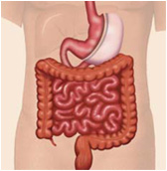
Most Common Surgical Options
Gastric Bypass (GBP)
Sleeve Gastrectomy
Restrictive and Malabsorptive
Restrictive
30
Notes:
30

Slide 31
Efficacy of Existing Weight Loss Interventions
Lifestyle intervention¹
3–5%
Lifestyle intervention
Very low calorie diet^{2,3}
AOM
6–10%
Surgery
IBT^{4,5}
4–6%
AOM⁶⁻⁸
3–17%*
Gastric band⁹
7–23%
Gastric sleeve¹⁰
25–35%
Gastric bypass⁹
24–38%
0
5
10
15
20
25
30
Weight loss (%)
*Based on mean weight loss achieved by the completer populations in the largest phase 3 clinical trial of each respective product’s clinical development program as reported in the AACE Guidelines (2016).
AACE, American Association of Clinical Endocrinology; AOM, anti-obesity medications; IBT, intensive behavioral therapy. 1. le Roux CW et al. Lancet 2017;389:1399–409; 2. Lean ME et al. Lancet 2018;391:541–51; 3. Tsai AG and Wadden TA. Obesity 2006;14:1283–93; 4. Wadden TA et al. Obesity 2011;19:1987–98; 5. Wadden TA et al. Obesity 2019;27:75–86; 6. Garvey WT et al. Endocr Pract 2016;22(Suppl 3):1–203; 7. Tak YJ and Lee SY. Curr Obes Rep 2021;10:14–30; 8. 10. Novo Nordisk. Wegovy (semaglutide). Package Insert. Available at: https://www.novo-pi.com/wegovy.pdf. Accessed August 2022; 9. Courcoulas AP et al. JAMA 2013;310:2416–25; 10. IFSO Sleeve Gastrectomy. Available at: https://ifso.com/patient-sleeve-gastrectomy/. Accessed August 2022;

Slide 32
Tips to Remember and Relay
Obesity is a chronic disease
It is not the patient’s “fault”
It takes time
Manage expectations
Notes:
Tx may need to be extended/lifelong, just like with diabetes, depression, or thyroid disease
Complex disease, with mixture of contributing factors (diet/lifestyle/meds/genetics) and for success, have to change some habits for long-term success
Finding the right treatment/combination takes time
1-2 lb/week

Slide 33
AHN Bariatric and Metabolic Institute
Comprehensive Weight Management Center
Director Dr. Fahad Zubair
Kelly McArdle, PA-C
Melissa Schultz, PA-C
Ph: 412-235-5900
West Penn Hospital Mellon Pavilion
4815 Liberty Ave, Ste 215
Pittsburgh, PA 15224
Wexford Health and Wellness Pavilion
12311 Perry Hwy
Med/Surg Specialties Suite (2nd Floor North Wing)
Wexford, PA 15090
North Fayette Health and Wellness Pavilion (New Location)
200 Quinn Drive
Pittsburgh, PA 15275
Notes:
Referral BMI 30+

Slide 34
Visit our website at:
www.ahn.org/weightloss
Bariatric and Metabolic Institute at AHN

