Slide 1
How Art Making Builds Resilience
Lakin McSorley, ATR-BC, LPC & Melinda Massella, ATR-BC, LPC

Slide 2
What‘s the Difference?
Art Therapy
Art Class
Facilitated by a professionally trained Art Therapist.
Involves a non-judgmental, therapeutic relationship.
Main goal is for self expression.
The focus is on the creative process rather than the final product.
There is not right or wrong way to create or use any art materials.
You do not have to have any skill in art or consider yourself an artist.
Artwork is seen as a reflection of the creator and used for communication.
Facilitated by an Art Teacher.
Involves a teacher – student relationship.
Main goal is to learn a technique and make something.
The focus is on the end product for a grade.
There are specific techniques and correct ways to use art materials.
Artwork is evaluated based on technique and overall quality of artistic element, styles, and principles of design.

Slide 3
How Art Helps
Decreases stress – tap into the state of flow
Healthy coping skill
Outlet for emotions – encourages self-expression
Builds self-esteem and improves self-worth
Self-care strategy

Slide 4
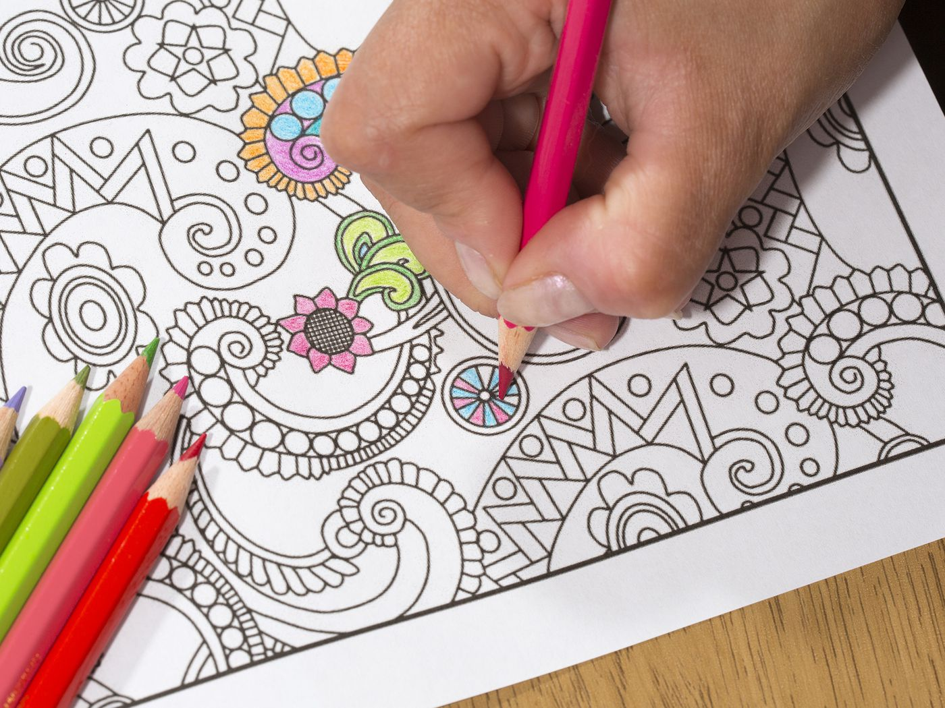
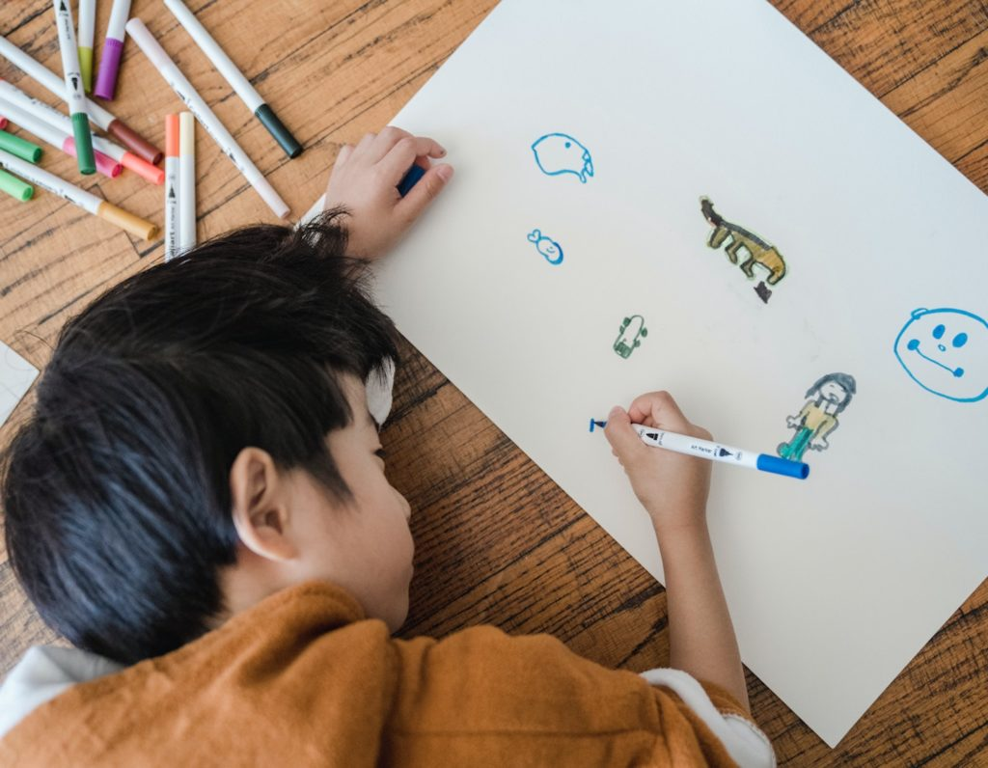
How You Can Use It
Provide art making as a tool to relax and reduce stress.
Encourage emotional expression
Foster creativity

Slide 5
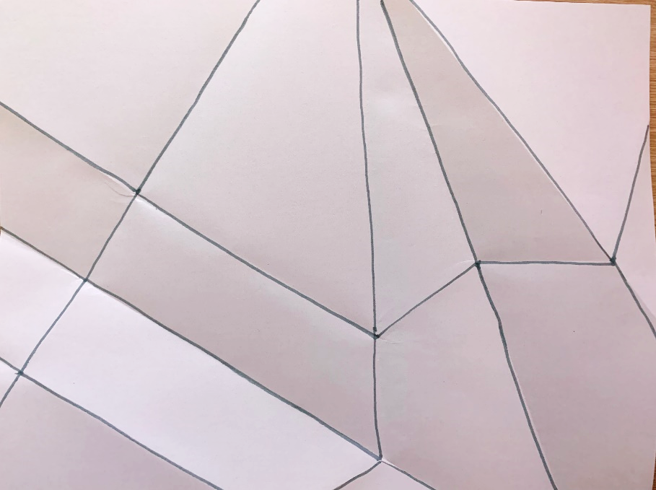
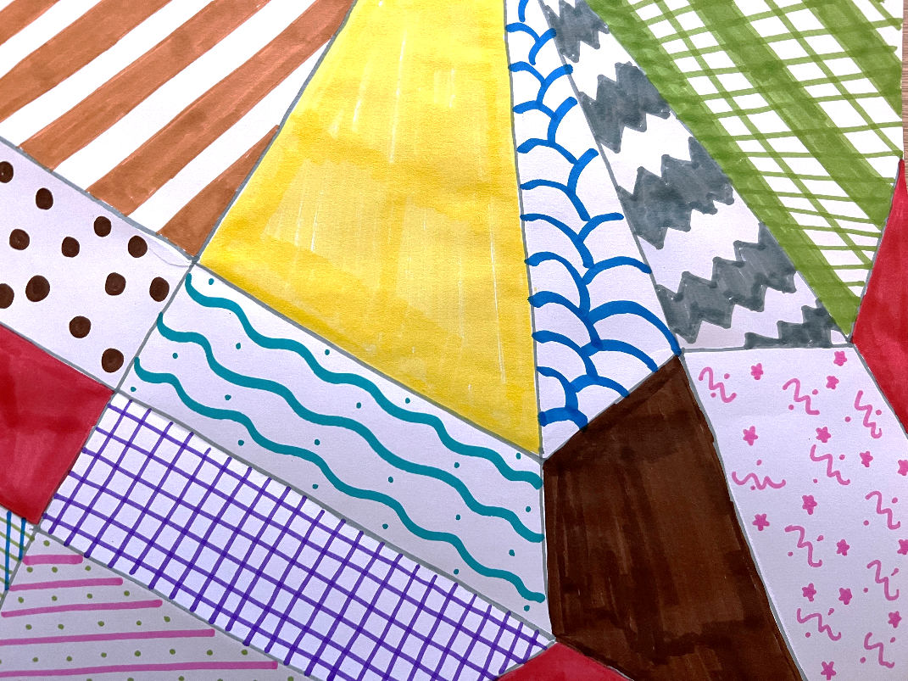
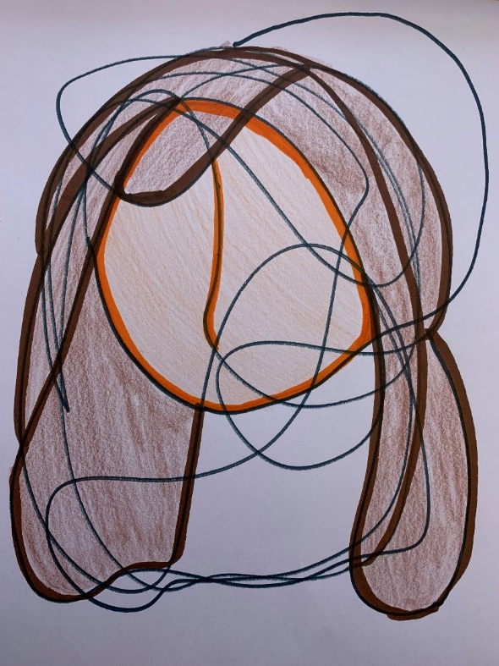
How You Can Use It

Slide 6
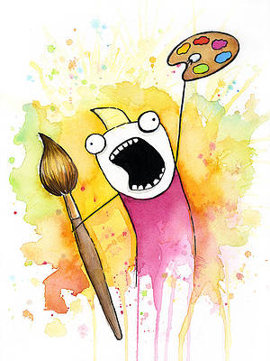
Let’s Try It!

Slide 7
Resources
https://art4healing.org/reports/special-report-art-and-the-brain/?gad=1&gclid=EAIaIQobChMIp57akemsgQMVLiSzAB2hUgYrEAAYAiAAEgIzXPD_BwE
https://www.ncbi.nlm.nih.gov/pmc/articles/PMC9472646/#:~:text=Individuals%20can%20increase%20their%20sense,their%20social%20networks%20%5B7%5D.
https://www.psychiatry.org/news-room/apa-blogs/healing-through-art

