Slide 1
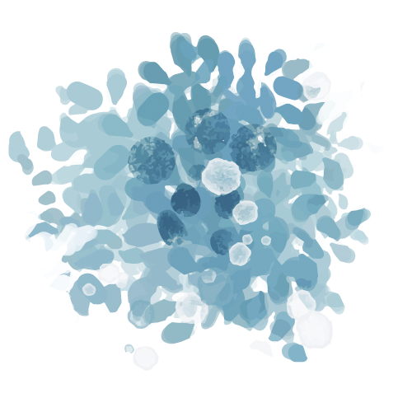
The Chill Project by AHN Mind-Body Connection
Supporting students through mind-body connection by regulating the nervous system
Izzy Cutler, LSW, HSV, RYT
October, 2023

Slide 2
Table of contents
01
03
02
04
Mind-Body Connection
Gentle Movement
Breath Work
Yoga Nidra

Slide 3
Objectives
1
2
3
Will be able to define what the mind-body connection is and identify different somatic techniques.
Will be able to apply somatic techniques to use in a classroom setting and as a form of self care.
Will be able to practice gentle movement that they can use to help calm the nervous system.

Slide 4
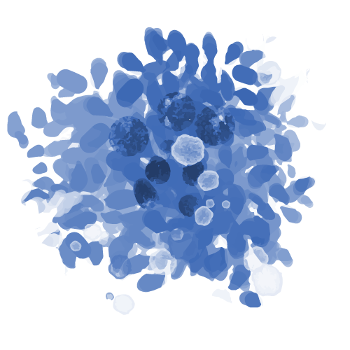
About Me
Izzy Cutler, LSW, HSV, RYT
Licensed Social Worker
Educational Specialist, Home/School Visitor Certificate
Registered Yoga Teacher - 200 hours
Trauma-Informed Yoga Certified
Yoga Nidra Certified
Notes:
Behavioral Health School Educator from The Chill Project by AHN. Manages the Chill Room at the Intermediate School and teaches students mindfulness skills and takes on a few therapy clients.
Education/Work:
B.A. in Psychology and a minor in Educational Studies from Michigan State University.
Master of Social Work, certificate in Home/School Visitor from the University of Pittsburgh.
Licensed Social Worker and advocate for students’ mental health well-being; passionate about cultivating a warm, strengths-based, trauma-informed, and multicultural approach in environments that allow children and families to grow. Her experience is in Restorative Practices, School Social Work, behavior therapy, transitional living programs, teaching yoga in nonprofits, and more.
Self Care: yoga studio, roller blading, or hiking with her partner and Vizsla pup.

Slide 5
Journey to the Heart by Melody Beattie
Notes:
October 9 - The Scattered Pieces Will Come Together
Scattered pieces. Sometimes we look around, and that’s what we see. Scattered pieces of ourselves, our lives, a project, a season of our lives. Where is the connecting thread, we wonder? How can we ever pull this together into something that makes sense, something with purpose, something with meaning?
There are pieces to every whole; yet each piece is complete. Don’t worry about how they will come together. Work joyfully on the piece that’s before you, the piece that’s in your life today.
There are many pieces of you, many beautiful parts. The universe will help you bring all those parts alive. It will bring mirrors to you, people who will reflect those beautiful pieces back to you. Look in the mirror or your life. What pieces do you see reflected? Know it’s you you’re seeing. Then let that part of you come alive.
Pull in the parts of yourself, the many beautiful parts that have come alive. Beck on your warrior, your healer, your playful child. Bring together your professional self, your adult, the passionate part of you, the nurturing part. Let all the parts come together. Don’t send any of them away. You need them all. Each is a beautiful piece of the soul, the life, the person you are.
Trust. Trust the process. Joy is yours, available for the asking and the desiring–even in the developmental stages. Even before the puzzle has been put together. The scattered pieces will come together–the scattered pieces of yourself, your project, your life. The connecting thread is love.
***The picture will be beautiful. Wait and see.

Slide 6
Definitions
Mind-Body
Somatic
Co-Regulation
Vagus Nerve
Self-Compassion
Glimmers & Reminders or Activators
The connection and acknowledgment between the mind, our nervous system, thoughts, behaviors, and bodily sensation.
SOMA, meaning “the body of an organism”
Somatic relates to the autonomic nervous system– the mind, body, and soul
Regulating and harmonizing bodies to feel safe and calm.
The way we treat ourselves matters to our nervous system. Treating ourselves like a good friend, shifting language to take away self-blame or shame, and using “I am” positive affirmations.
Also referred to as “soul nerve”, connects to your parasympathetic nervous system – it connects to your feeling part of your brain, not your thinking brain.
We will use the words “reminder” or “activator” instead of “trigger”; Glimmer can be used as the opposite of a trigger. - something that sparks joy or creates a regulated self.
(Dana, 2020; Dana, 2022; Porges, 2022)

Slide 7
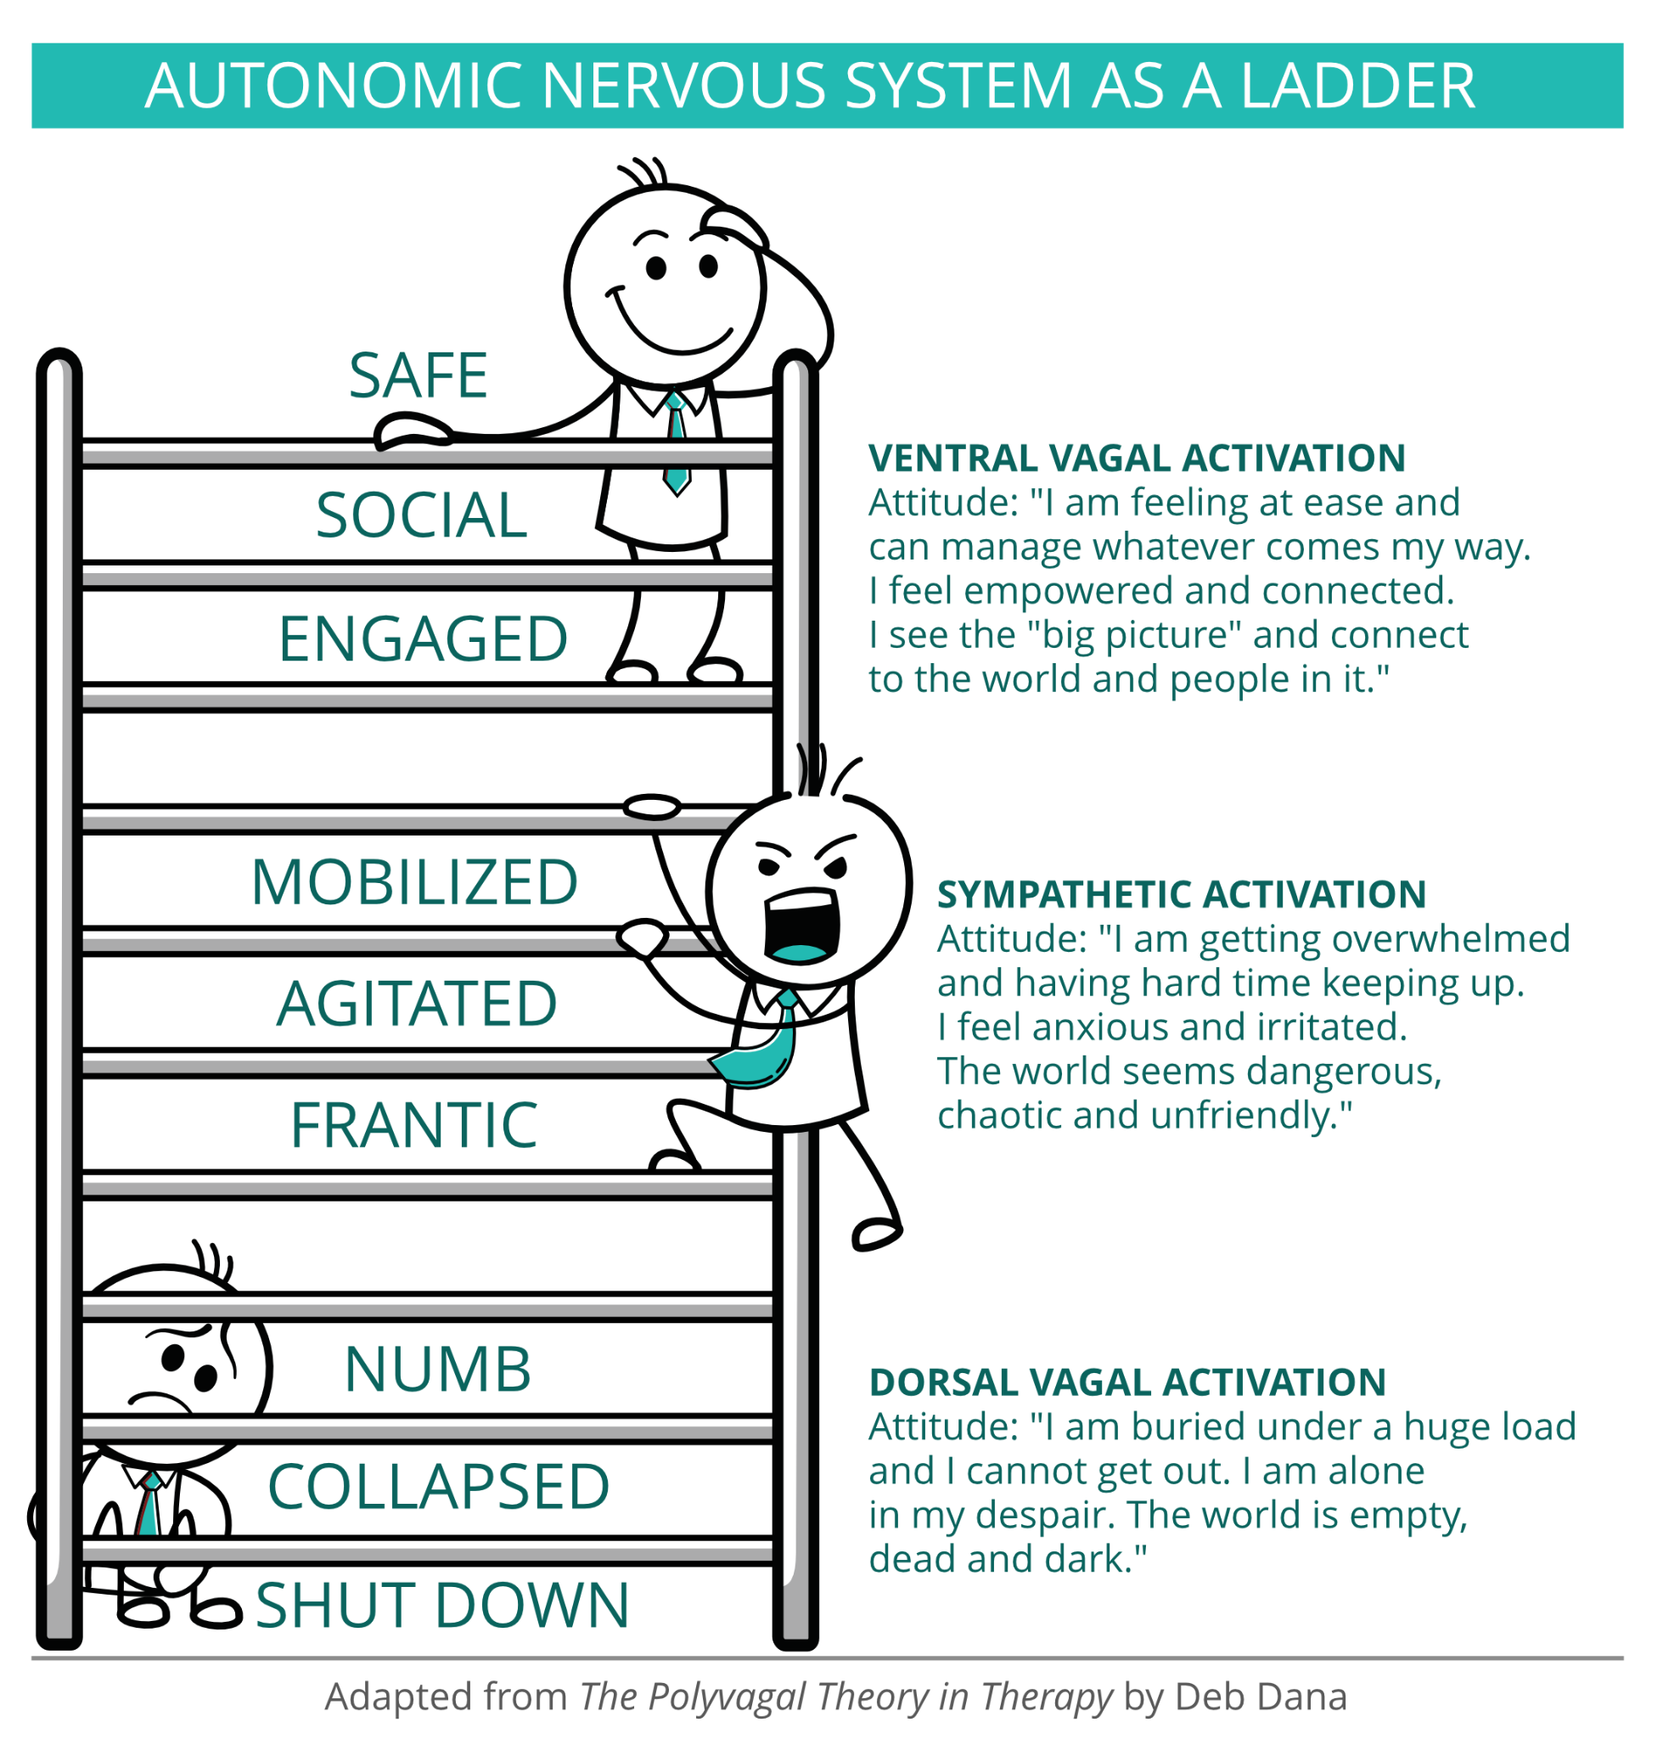
Other Definitions - specific to Polyvagal Theory (Porges)
Ventral
Sympathetic
Dorsal
Hierarchy
Neuroception
Top of autonomic hierarchy, system of connection.
Bottom of hierarchy, regulates digestion and brings nutrients to nourish us. System of shut down.
Down one step on the hierarchy, Helps regulate heart and breath rhythms, bring us energy. System of mobilization. In survival role, activates pathways of fight/flight
Coined by Porges, describes how autonomic nervous system takes in information. Inner, subconscious surveillance system gathers information through three pathways.
Autonomic nervous system is built with three pathways of response (above), and we move between them in a predictable order called the autonomic hierarchy. Each pathway brings its own set of thoughts, feelings, behaviors, and bodily experience.
(Dana, 2020; Dana, 2022; Porges, 2022)
Notes:
Deb Dana, Polyvagal Card Deck

Slide 8
01
Mind-Body Connection

Slide 9
What is the Mind-Body Connection?
(Lemon & Wagner, 2013; Selhub, 2007)
Notes:
The Mind-Body Connection is the idea that our thoughts, body sensations, nervous system, and feelings are all interconnected. Selhub (2007) stated, “In mind-body medicine, the mind and body are not seen as separately functioning entities, but as one functioning unit. The mind and emotions are viewed as influencing the body, as the body, in turn, influences the mind and emotions'' (p. 4). “The goal of mind-body techniques is to regulate the stress response system so that balance and equilibrium can be maintained and sustained, to restore prefrontal cortex activity, to decrease amygdala activity” (Selhub, p. 5).
https://docs.google.com/document/d/1caJ_iUXvHM8ZOTYzrNIrOV3taRdKQDEA-iLBlgedeW0/edit
Reference to psychosomatic symptoms – ACES score (Dr. Nadine Burke Harris), Pyschonueroimmunology (
Reference to the polyvagal theory
Why mind-body connection and how do these impact the brain?
Reference to the stress response
Why practice this ourselves? Co-regulation
Resources for classroom/tips and tricks
resources: dr. bruce perry, manekam, gabbi Garcia, melody beattie, Deb Dana (poly vagal theory),
Bottom-up process is preferred treatment for trauma, EMDR, etc

Slide 10
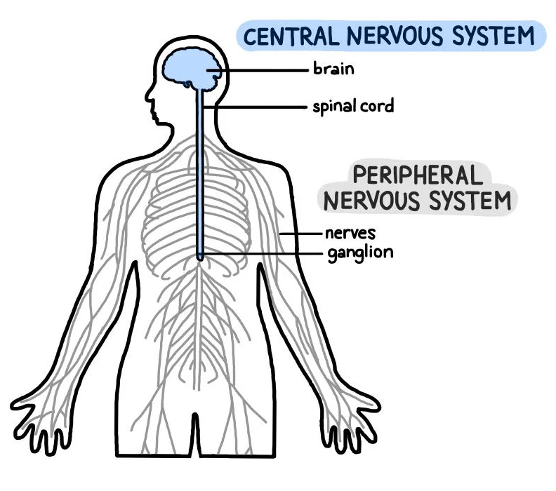
The Nervous System
The Nervous System
Central Nervous System (CNS)
Peripheral Nervous System (PNS)
Autonomic Nervous System
*Involuntary actions (i.e., breathing, heart beating…)
Somatic Nervous System
*voluntary actions
Parasympathetic
“Rest & Digest”
Sympathetic
“Fight or Flight”
(Peripheral Nervous System (PNS) Parts and Function, 2022; Porges, 2022)
Notes:
https://www.simplypsychology.org/peripheral-nervous-system.html
**from yoga training notes:
CNS - main function to interpret information
**dorsal - sensory input
**ventral- sensory output
Parasympathetic
The parasympathetic, or “rest and digest” system is a much slower system that moves along longer pathways. The parasympathetic response is responsible for controlling homeostasis, or the balance and maintenance of the body’s systems. It restores the body to a state of calm and counterbalance, and allows it to relax and repair.
The body undergoes several specific responses when the parasympathetic system is activated. Your saliva is increased Digestive enzymes are released Your heart rate drops The bronchial tubes in your lungs constrict Your muscles relax The pupils in your eyes constrict Your urinary output increases
All of these changes are designed to maintain long-term health, improve digestion, conserve energy, and maintain a healthy balance in your body’s systems.
Sympathetic:
The sympathetic nervous system is faster-acting than the parasympathetic system, and moves along very short, fast neurons. The sympathetic nervous system activates a part of the adrenal gland named the adrenal medulla, which then releases hormones into the bloodstream. These hormones activate the target muscles and glands, causing the body to speed up and become tense, as well as more alert. Functions that are not immediately essential (like the immune system) are shut down to some degree.
Your body goes through a number of changes when the sympathetic nervous system is activated. Your heart rate increases The bronchial tubes in your lungs dilate Your pupils dilate Your muscles contract Your saliva production is reduced Your stomach stops many of the functions of digestion More glycogen is converted to glucose
Evolved to protect us from danger
Staying in this can lead to (Nadine Bur…ted talk)
***just like we can activate the sympathetic nervous system, we can activate the parasympathetic nervous system using relaxation and somatic techniques.

Slide 11
The Brain
Prefrontal Cortex
Amygdala
Hippocampus
Prefrontal Cortex
Amygdala
(WholeHearted School Counseling, 2023; McLaughlin, 2014)
Notes:
f/f/f or stress response
Amygdala - our feeling brain
Hippocampus - learning and memory
Frontal lobe - or prefrontal cortex, our thinkingbrain
The way trauma influences brain development will be different for each child. Just as each child will have different emotional responses to a traumatic event, the way that the brain responds to trauma will also vary across children. The following regions of the brain are the most likely to change following a traumatic event. The amygdala is designed to detect and react to people, places, and things in the environment that could be dangerous. This is important for safety and survival. After trauma, the amygdala can become even more highly attuned to potential threats in the environment, leading a child to closely monitor their surroundings to make sure they are safe and have strong emotional reactions to people, places, or things that might be threatening or that remind them of the trauma. This heightened attention to potential threats in the environment can make it hard for children to pay attention in school, go new places, or interact with people they don’t know. The medial prefrontal cortex (mPFC) helps to control the activity of the amygdala and is involved in learning that previously threatening people or places are now safe. Connections between the mPFC and amygdala are sometimes not as strong in children who have experienced trauma. As a result, the mPFC is not as effective at reducing amygdala reactivity to people, places, and things that are in fact safe and no longer predict danger. This can lead to persistent elevations in fear and anxiety about cues that remind children of the trauma they experienced. The hippocampus is involved in learning and memory. Impairments in learning and memory have been seen in children who have experienced trauma. This suggests that trauma may affect how the hippocampus develops. Trauma likely impacts a variety of types of learning and memory, such as the ability to learn and remember information about the surrounding environment. As a result, children who experience trauma may not be able to retain information about how to tell if one situation is safe and another is dangerous, leading them to experience harmless situations as scary. For example, a child who has experienced trauma may have difficulty distinguishing between activities that are dangerous (e.g., walking down a dark alley) and safe (e.g., walking around a dark corner at home). Critically, these changes in the brain are not permanent. The brain is remarkably plastic, meaning that it changes in response to social and environmental experiences. This enables us to learn, form relationships with people, and develop new skills. Changes in the brain that happen after trauma can improve over time. This is particularly likely to happen when children experience safe, stable, and supportive environments after trauma. In fact, certain kinds of psychotherapy, like cognitive behavioral therapy, can actually lead to positive changes in the same regions of the brain that are influenced by trauma.
https://nwcf.org/wp-content/uploads/2015/04/Trauma-and-the-Brain-Handout-Tips-2014.pdf (McLaughlin, 2014)

Slide 12
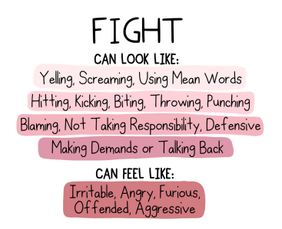
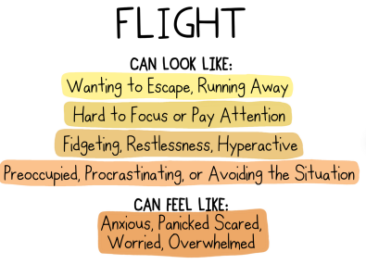
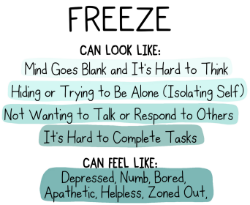
Fight/Flight/Freeze
Adaptive Survival Response
(WholeHearted School Counseling, 2023)
Notes:
Wholehearted counseling

Slide 13
Some Theories and Practices that Support Mind-Body Connection
Somatic
Poly Vagal
Bottom-Up Approaches
“Somatic psychotherapy focuses on restoring self-regulation of the autonomic nervous system, the body’s ‘control system’ “
*Helps find awareness
Polyvagal Theory (PVT) looks at how the nervous system responds to stress and uses the vagus nerve toning to bring the body back to homeostasis.
EMDR, Somatic Experiencing, Expressive Art Therapy, Internal Family Systems (IFS), Trauma Resiliency Model (TRM)
Tones down the amygdala, the danger alarm, in our brain
(Porges 2022; Dana 2020; Grabbe L, Miller-Karas E., 2017)
Notes:
Tones down the amygdala, the danger alarm, in our brain
Very successful approach to trauma (CITE)
Examples: yoga, dance, EMDR, music, breath, movement, touch
***Take out?? Or just touch lightly on? Since most folks are coming from the
These theories and practices support and revolve around somatic approaches or the mind-body connection. It is important to note that Mind-Body connection does not solely focus on the body, and it is important to continue to use evidence-based practices that incorporate both.
Somatic Therapy (other):
Somatic therapy helps you find awareness of the physical sensations inside your body
The more awareness you have about your physical sensations, the more you support your ability to address psychological and physical symptoms, process trauma, and become more integrated in your thoughts, feelings, and bodily sensations
One of the underlying theories of somatic therapy is that your body’s memory of the trauma is more important than your body’s memory of the trauma is more important than your cognitive memory. Somatic therapy is a bottom-up form of therapy that works directly with the autonomic nervous system to release unprocessed trauma, stress, and tension.

Slide 14
Some Somatic Techniques
Somatic Awareness
Resourcing
Movement
Co-Regulation
Grounding
Breathwork
Inner Resources, a safe/nurturing/protective figure
Butterfly tapping, yoga, exercise,
Checking in with body sensations and labelling the different body sensations
Regulating and harmonizing bodies together - can be done through touch, chants, dance, breath
Grounding ourselves to this present moment using strategies that connect to our 5 senses, physical space, and/or using distracting methods.
A variety of breathwork can be done with different outcomes.
(Dann, 2022)
Notes:
Cite book - somatic therapy for healing trauma (dann)
–complete exercise for each (if time allows)
Somatic awarenss
Sometimes i get questions about, how do you know if you are sick or experiencing a big emotion/anxiety? I always recommend ruling out physical symptoms/seeing a school nurse, but if everything looks normal, t

Slide 15
Resources for the Classroom
1.
2.
3.
4.
Allow Space & Time to Self-Regulate
Co-Regulate
Asking the Right Questions The Right Way
Books, Visuals, Tangibles
“The ability to self-regulate is built on ongoing experiences of co-regulation. Through co-regulation we connect with others and create a shared sense of safety”
Use books, vocab walls, or other tangibles to allow students access to body sensations language to describe how they feel in their body. Other visuals may include visuals about the stress response
When the student is ready, try incorporating questions that connect to the body and mind.
-
Understand when a student may be in the escalation cycle, or in fight/flight/freeze. Co-regulate with the student before asking questions.
(Dana, 2020)

Slide 16
1. Allow Time and Space to Regulate
We know that when a student is in the escalation cycle, or in fight/flight/freeze, the prefrontal cortex is blocked off and they are operating from a dysregulated state. The nervous system is in overdrive from their amygdala - the feeling part of the brain.
Give students space, choices, and time to regulate.
Once they are regulated, and if age appropriate, you can engage with the student about your observations related to their escalation cycle.

Slide 17
2. Co-Regulation
“The ability to self-regulate is built on ongoing experiences of co-regulation. Through co-regulation we connect with others and create a shared sense of safety.
With a reliable, regulating other, we engage in the rhythm of reciprocity and build experiences of safety in connection.”
“Survival is dependent on opportunities to successfully co-regulate…a history of successful and predictable co-regulation tunes the nervous system to be sufficiently resilient to function during system periods of separation”
If safe, sit in close proximity to the student.
Breathe with the student. Listen to music with the student.
Ground yourself in proximity to the student. Doing so will allow you to co-regulate.
This also serves as a way to model to students.
(Dana, 2020, p.3, 32-33; Porges, 2022)
Notes:
**Think about when you are rocking a distressed baby to sleep. The more you regulate yourself, the calmer the baby seems (hopefully)
**Manakem, My Grandmother’s hands: “A settled body helps other bodies it encounters to settle. Give those bodies the right context and encouragement and they will begin to harmonize as well. When, over time, enough bodies heal from trauma and learn to harmonize, that harmony can turn into culture…Because a settled nervous system encourages other nervous systems to settle, a calm, settled presence is the foundation for changing the world”

Slide 18
3. Asking the Right Questions the Right Way
Questions that connect the mind and body:
How old do you feel when you connect with that?
What feels familiar about this feeling?
Is there a way you would visualize this emotion?
What does your body want to do when you think about this?
If you could pass the microphone to this part of yourself what would it say?
What feels new or surprising about this?
What would you tell your inner child right now?
What would you say/do if you felt empowered and protected?
My body shows me….
My brain tells me…
Facial Expression
Tone of Voice
Signs of Welcome - through this information, we know if it is safe to approach
Eyes
Gestures

Slide 19
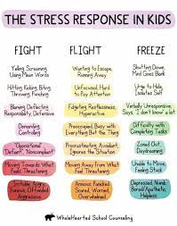
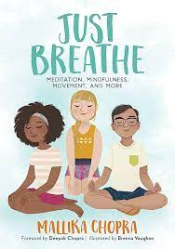
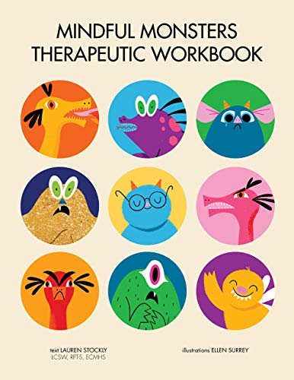
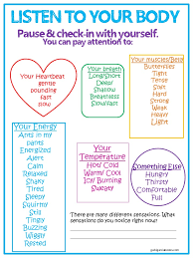
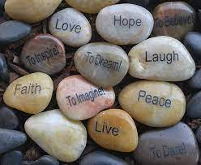
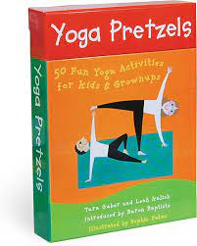
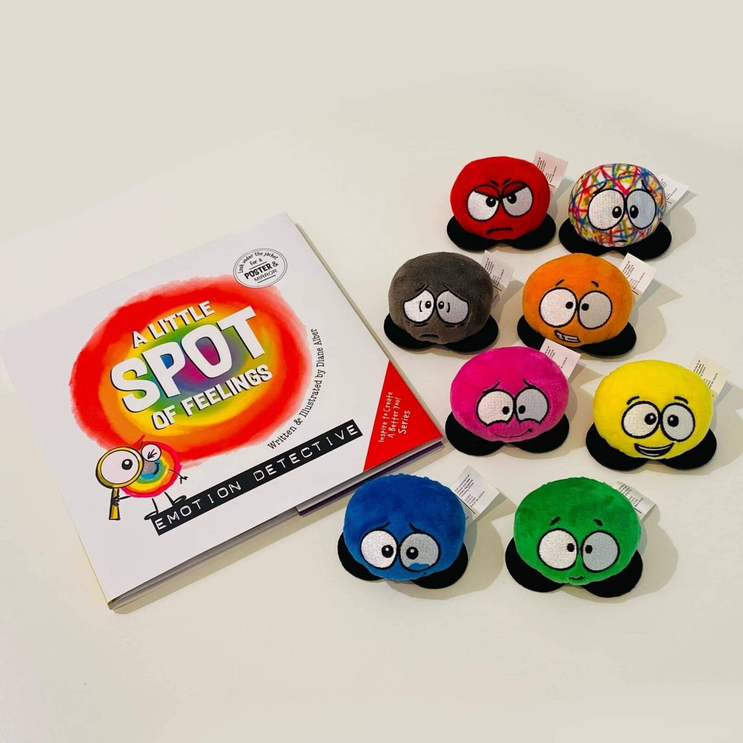
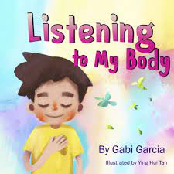
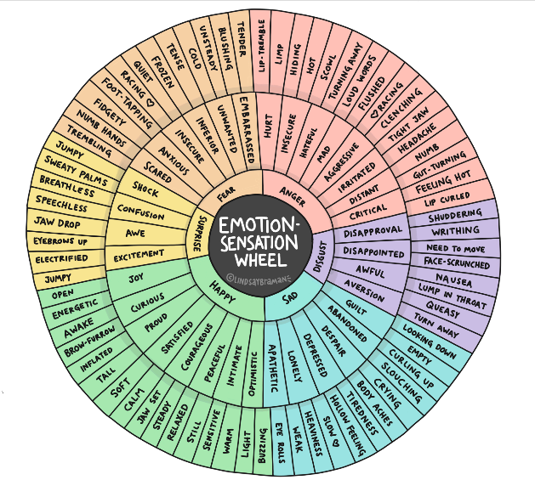
4. Books, Visuals, Tangibles
Recommendations:
Listening To My Body by Gabi Garcia (and visuals that go along)
Creating a Word Wall in your classroom with both feeling words and body sensations
The Mindful Monsters Therapeutic Workbook by Lauren Stockly
Spot Feelings Books
Just Breathe by Mallika Chopra
Yoga Pretzels Card Deck
Fight/Flight/Freeze Poster
Touchstones - having a tangible item that can serve as a safe item– this can be bracelets at the end of a group, worry stones for students, a class stuffed animal, and more.
Feelings Wheel with Body Sensations

Slide 21
Breath Work
02

Slide 22
Let’s Practice
Ocean Breath
Lions Breath
Square Breathing
Notes:
-Start by noticing your breath. Watching as your chest rises and falls, belly rises and falls. Knowing that you do not need to change anything, and our body is breathing on its own. We will move into some different breaths and notice how this makes our body feel. There is no right or wrong with breathing techniques, but they will each offer us different things.
***Need to have tissues available

Slide 23
Mini Slow Flow
03
Notes:
-child’s pose, cat/cow, figure 8, variations of table top, down dog, walk forward rag doll

Slide 24
Yoga Nidra
04
Notes:
***Use 8/11 script - can be done lying down or sitting up

Slide 25
Yoga Nidra
Yoga Nidra is a sanskrit term meaning "Yogic Sleep" and is a deep relaxation technique and a form of meditation. It is a state between sleeping and waking
A regular yoga nidra practice results in deep relaxation and expands the individual's self awareness….Yoga Nidra can bring out immediate physical benefits such as reduced stress, better sleep and also has the potential to heal deep psychological wounds when practiced consistently and can bring about a profound sense of joy & well-being.
In a typical yoga nidra session, a teacher guides practitioners through several stages…Throughout, you are encouraged to tap into an underlying sense of peace that is always present and to cultivate awareness, observing and welcoming whatever is present without getting caught up in it.
(Tummee, 2023)
Notes:
“Yoga Nidra is a sanskrit term meaning "Yogic Sleep" and is a deep relaxation technique and a form of meditation. It is a state between sleeping and waking.
Regular meditation is practiced in a seated posture. It essentially involves the practitioner to become a witness to his or her thoughts and to develop awareness to one's thought process. Also, seated meditation is done with the spine upright and is in a way energizing the whole body and hence cannot be termed restorative or complete relaxation. In a regular meditation practice, there is an intention to be "aware" and while we make our body comfortable to sit for extended duration of time, rest is not the primary focus.
On the other hand, Yoga Nidra promotes deep rest and relaxation that isn't found in a regular seated meditation. A regular yoga nidra practice results in deep relaxation and expands the individual's self awareness….Yoga Nidra can bring out immediate physical benefits such as reduced stress, better sleep and also has the potential to heal deep psychological wounds when practiced consistently and can bring about a profound sense of joy & well-being.
In a typical yoga nidra session, a teacher guides practitioners through several stages…Throughout, you are encouraged to tap into an underlying sense of peace that is always present and to cultivate awareness, observing and welcoming whatever is present without getting caught up in it.
**Tummee Website
-- IREST PROPOSAL AND REFERNCE
–Include inner resource in yoga nidra script

Slide 26
References
Beattie, M. (2010). Journey to the Heart. HarperCollins Publishers.
Dana, D. (2020). Polyvagal Exercises for Safety and Connection. W.W. Norton & Company.
Dana, D. (2022). Polyvagal Card Deck: 58 Practices for Calm and Change [card deck]. Norton, W.W. & Company, Ic.
Dann, J. (2022). Somatic Therapy for Healing Trauma: Effective Tools to Strengthen the Mind-Body Connection. Rockridge Press.
Grabbe L, Miller-Karas E. The Trauma Resiliency Model: A “Bottom-Up” Intervention for Trauma Psychotherapy. (2017) Journal of the American Psychiatric Nurses Association. 2018;24(1):76-84. doi:10.1177/1078390317745133
Lemon, J. C., & Wagner, B. (2013). Exploring the Mind-Body Connection: Therapeutic Practices and Techniques.
McLaughlin, K. (2014). How can trauma affect the brain [PDF]. Stress and Development Lab, University of Washington.
Peripheral Nervous System (PNS) Parts and Function. (2022, November 3). https://www.simplypsychology.org/peripheral-nervous-system.html

Slide 27
References
Porges SW (2022) Polyvagal Theory: A Science of Safety. Front. Integr. Neurosci. 16:871227. doi: 10.3389/fnint.2022.871227
Selhub, E. (2007). Mind-body medicine for treating depression. Alternative & Complementary Therapies, 2, 4-9. doi: 10.1089/act2007.13107
THE BRAIN + STRESS RESPONSE: Stress Management Lesson & SEL Activities. (2023). WholeHearted School Counseling. Retrieved from https://wholeheartedschoolcounseling.com/product/the-brain-stress-response-social-emotional-learning-stress-management-lesson/
Verma, T. (2020). Yoga Nidra Scripts. RTV Yoga Inc.
Yoga Nidra—Scripts and more for Yoga Teachers | Tummee.com. (2023). Retrieved from https://www.tummee.com/yoga-philosophy/yoga-nidra

Slide 28
QR for Resources

