Slide 1

Annual AHN APP Conference 2023 October 14, 2023
Caring for Transgender and Gender Diverse Patients
Charlie E. A. Borowicz, MPH, MSW
Steven R. Wolfe, DO, MPH, FAAFP, AAHIVS

Slide 2
Objectives
Define gender identity, gender incongruence and gender dysphoria
Describe how to respectfully take a history from a patient who identifies as transgender or gender diverse (TGD)
Explain the basic treatment regimens for both masculinizing and feminizing gender affirming hormone therapy (GAHT)
Recognize the disparities and primary care needs of TGD patients

Slide 3
Outline
Gender Identity
Health Disparities
Medical Care
Case Reviews
3

Slide 4
Gender Identity

Slide 5
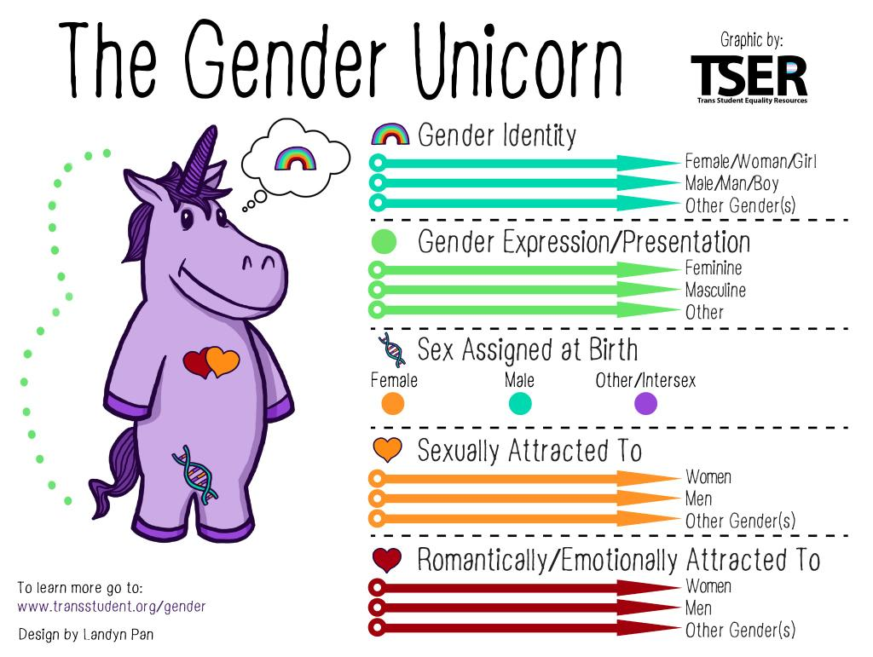
Gender identity is a person’s innate, deeply-felt identification as a male person, female person, both male and female or neither
Gender expression is the way in which a person communicates gender by external means such as clothing, hairstyles, mannerisms or voice

Slide 6

FAQs
Transgender Man:
A male person
who was assigned female at birth (AFAB)
Transgender Woman:
A female person
who was assigned male at birth (AMAB)
What is the difference between a transgender man and a transgender woman?
Notes:
Pause and reflect for understanding
Identity: Discuss “stages” of transition and how not everyone has the same endpoint in transition
Gender expression: why might someone not present as their identified gender? Discuss safety, medical/religious reasons, etc

Slide 7
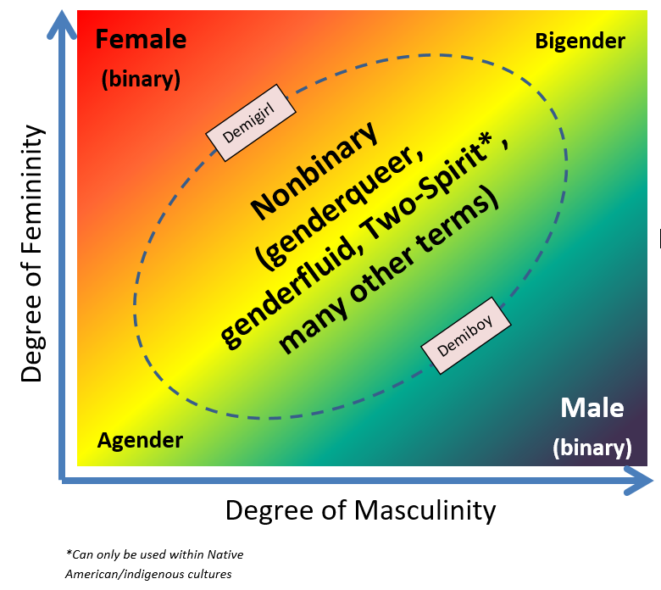
Gender Spectrum
She/her/hers
They/them/theirs
He/him/his
Notes:
Examples: “everyone” “folks” “friends” “colleagues”

Slide 8
Gender Fluid
Gender Expansive
Differently Gendered
Bigender
Gender Diverse
Gender Queer
Gender Neutral
Androgynous

Slide 9
Outdated Terminology
“FTM” and “MTF”
  Use transgender male/female or transmale/transfemale
  Non-binary or gender diverse individual
“Transexual”
  Mixes transgender (gender identity) with medical and surgical management
  Considered offensive by most transgender people as some do not wish for medical or surgical management
“Biologic” or “bio male/female”
  Considered derogatory
  Use assigned male/female at birth (AMAB or AFAB)
“Sexual Reassignment Surgery”
  Use gender-affirming surgery

Slide 10
Transgender and Gender Diverse Umbrella
Intersex
  Reproductive or sexual anatomy that doesn’t fit the typical definitions of female or male
  E.g.: XXY, androgen insensitivity syndrome, hypospadias, adrenal hyperplasia
  1:100 births in aggregate; the individual conditions associated with the intersex variations tend to be much rarer
Eunucks /’yōōnɘks/
  Assigned male at birth (AMAB) and wish to eliminate masculine physical features, masculine genitals, or genital functioning. They also include those whose testicles have been surgically removed or rendered nonfunctional by chemical or physical means
Not addressed today due to time limitations
Hughes et al. 2007
Blackless et al 2000

Slide 11
Bottom line…
Ask the patients
what name and pronouns they use
and use them

Slide 12

Prevalence of TGD
Early health-system based studies: 0.02-0.1%
Newer survey-based studies
  Adults
    0.3 - 4.5% TGD
    0.3 - 0.5% transgender
  Children/adolescents
    2.5 - 8.4% TGD
    1.2 - 2.7% transgender
In US, up to 16 million TGD
Standards of Care for the Health of Transgender and Gender Diverse People, Version 8

Slide 13
Health Disparities

Slide 14
Being Trans in PA
0.44% (43800) of Pennsylvanians identify as transgender
2015 U.S. Transgender Survey > 1171 respondents from PA
30% reported at least one negative experience in the past year with medical providers
  Being refused treatment
  Being harassed or assaulted
  Having to teach the provider how to care for them
22% did not see a doctor due to fear of mistreatment
2015 U.S. Transgender Survey (National Center for Transgender Equality)

Slide 15
Social Determinants of Health
46% verbally harassed in the last year
9% physically assaulted in the last year
24% lifetime experience of severe intimate partner violence
15% unemployed: 3x general population
29% living in poverty: 2x general population
30% lifetime homelessness
2015 U.S. Transgender Survey (National Center for Transgender Equality)

Slide 16
Mental Health Disparities
39% serious psychological distress past year: 5x general population
40% lifetime suicide attempt: 9x general population
7% suicide attempt in the past year: 12x general population
1.6% lifetime risk of death by suicide
2015 U.S. Transgender Survey (National Center for Transgender Equality)

Slide 17
Inclusivity

Slide 18
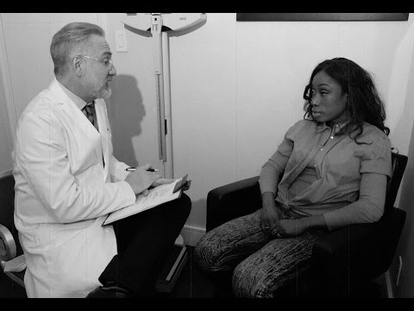

Slide 19
Entering the Clinic
According to the AAMC, many LGBTQ+ individuals look for favorable clues when entering healthcare offices
What we can do
  Post non-discrimination policies
  Make sure that we have inclusive intake forms that include gender identity, sex assigned at birth and a variety of choices
  Educate staff – AHN can provide direct training
  Discuss with the whole team the day of the visit
  Call patients by preferred name/pronouns and make sure they are documented in Epic
  Bathrooms that are not gender-specific OR are single user
  “I’m Dr. Smith, I use she/her. What do you go by?”

Slide 20

Ask About Gender Identity
Recommended question by the National LGBT Health Education Center:
"Because many people are affected by gender issues, I ask patients if they have any relevant concerns. Anything you say will be kept confidential. If this topic isn't relevant to you, tell me and I will move on"
OR
"It is common to have concerns relating to gender, would you like to discuss your gender identity?”

Slide 21
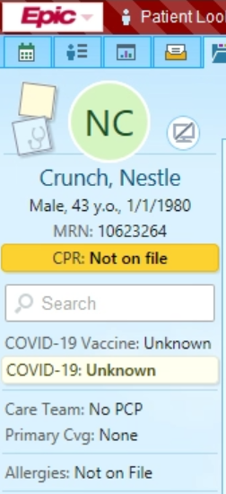
Entering Affirmed Name and Pronouns
Legal Name: Nestle Crunch
Affirmed Name: Reese
Legal Sex: Male
Gender Identity: Nonbinary
Pronouns: They/them

Slide 22
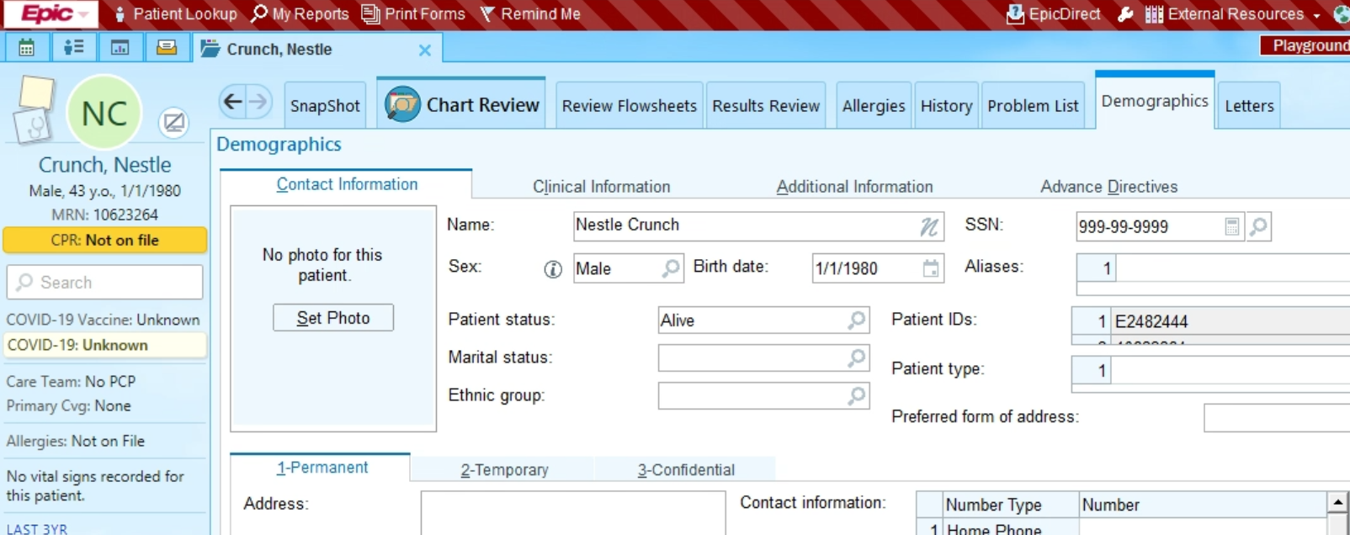
Entering Affirmed Name

Slide 23
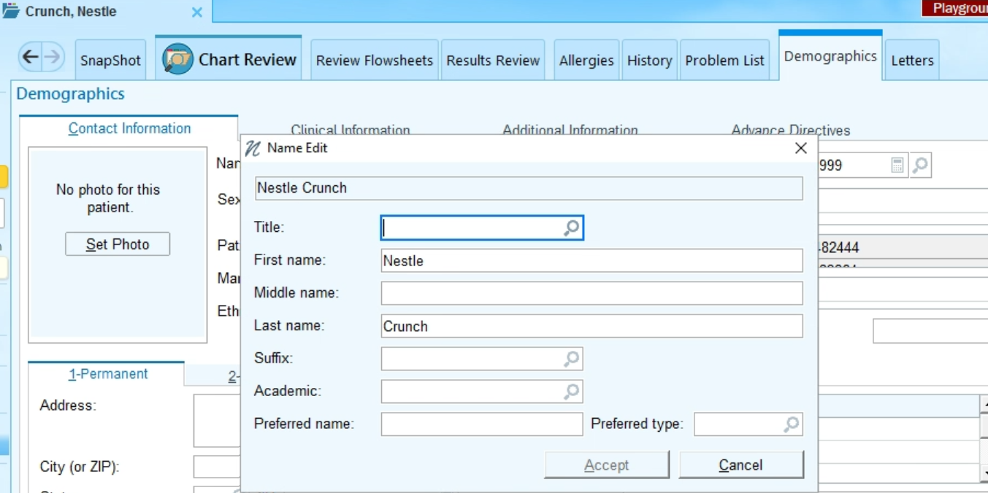
Entering Affirmed Name

Slide 24
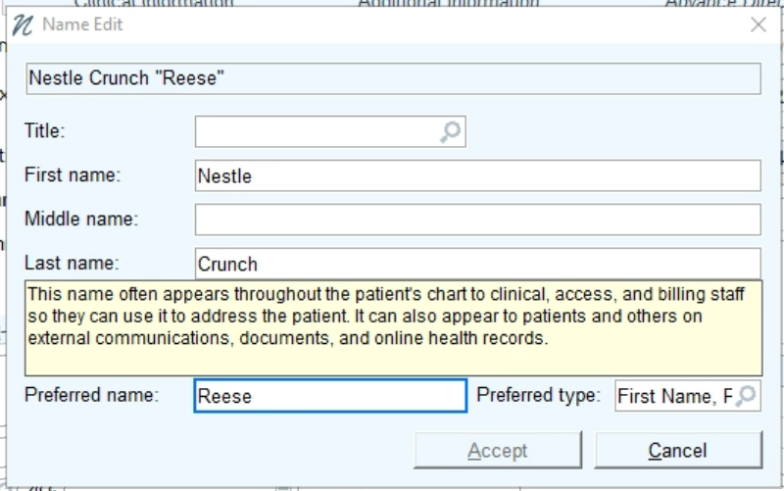
Entering Affirmed Name

Slide 25
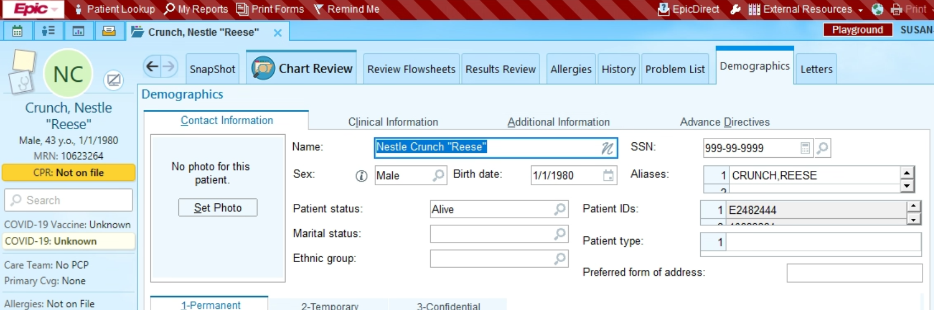
Entering Affirmed Name
Affirmed name will show up in 3 locations: Storyboard (left) in quotations, and Demographic screen under Name in quotations, and under Aliases

Slide 26
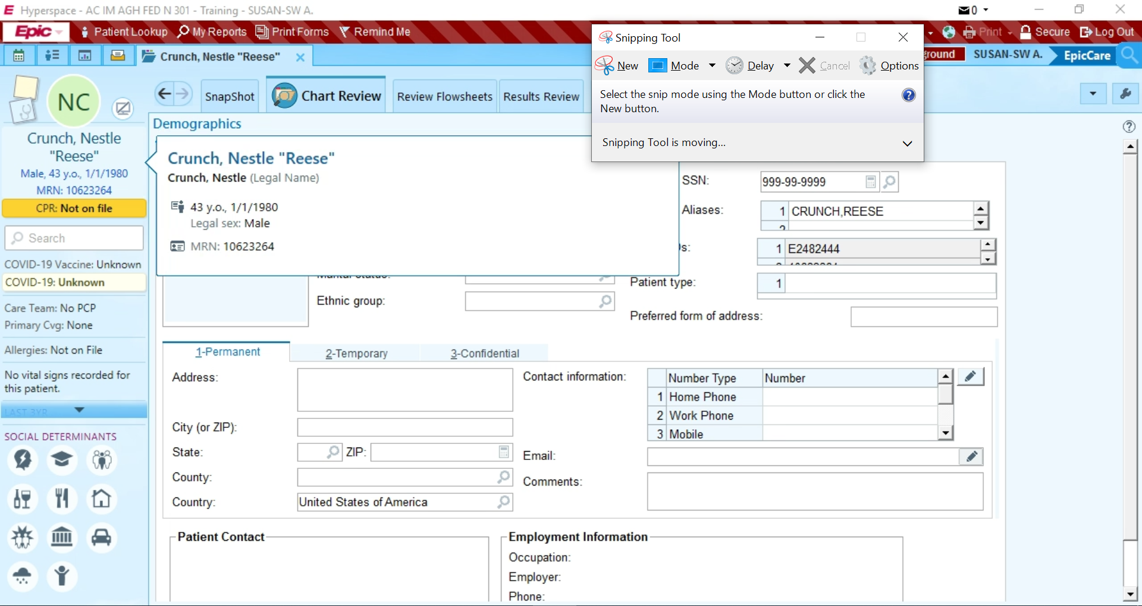
Entering Pronouns and Gender Identity
Hover over the line below the name, and a pop-up will show additional information.
Click on the line below the name, and the SOGI Smartform will come up.

Slide 27
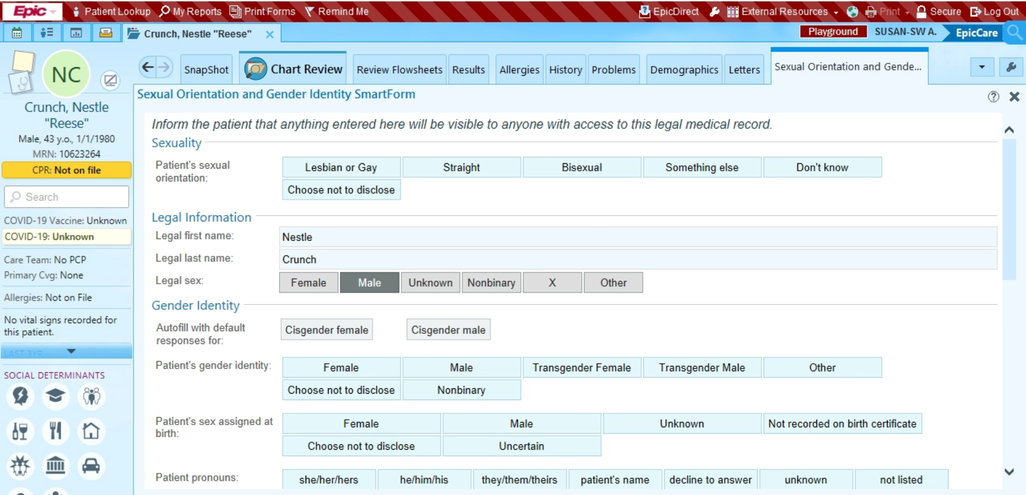
Entering Pronouns and Gender Identity

Slide 28
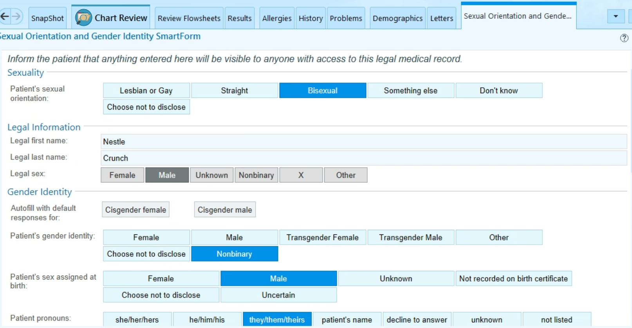
Entering Pronouns and Gender Identity

Slide 29
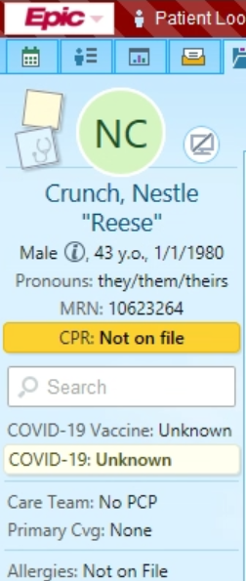
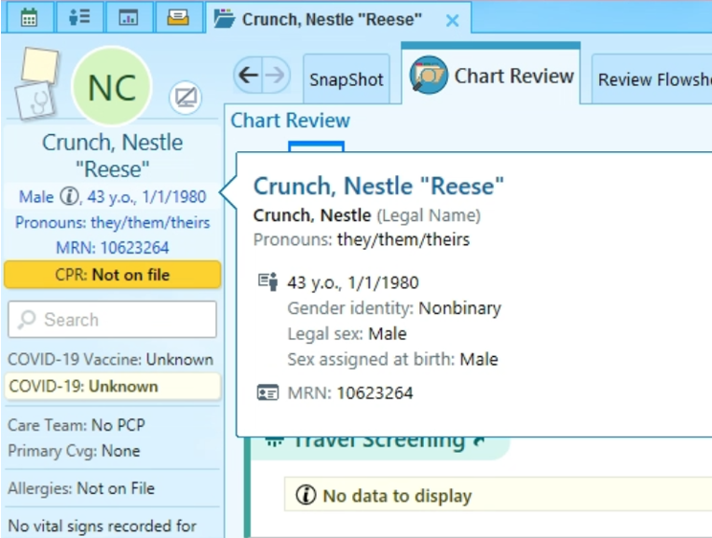
Entering Pronouns and Gender Identity

Slide 30
Documentation in Epic
Ask for preferred name and pronouns
When typing or dictating use preferred name and pronouns throughout note
Reflect the patient’s language and use the same terms
Discuss confidentiality: OK to discuss what parts of conversation will be documented in the chart and the one’s they would prefer would not be documented
Clarify unfamiliar terms
Apologize and take responsibility for making mistakes

Slide 31
History and Diagnosis

Slide 32
Gender Dysphoria: DSM-V
Marked and sustained incongruence between one’s experienced/expressed gender and assigned gender
Communicates the emotional distress
Associated with clinically significant distress or impairment in social, occupational, or other important areas of functioning
Removes the stigma of “disorder” previously in DSM-4
Remember not all gender diverse people have gender dysphoria

Slide 33

Diagnosis
ANY medical provider with a clear understanding of the DSM-5 criteria can diagnose gender dysphoria
Diagnosis provides an avenue for medical and surgical treatment including insurance coverage
Gender Incongruence (ICD-10: F64.9)
  Not all patients whose gender identity is different from their sex assigned at birth have dysphoria or need medical management for it

Slide 34

Gender History Taking
Use open-ended questions
  “Tell me about your journey with gender”
Assess previous gender-affirming medical and/or surgery treatments (GAMST)
  Many patients have had experiences with providers asking unnecessary questions out of curiosity
Assess goals – everyone is different
  What changes or characteristics are important to them
    Gender-affirming medical treatment
    Gender affirming surgeries
  Understand the patient’s expectations

Slide 35
Sexual History Taking
Use open-ended questions
  “What types of partners do you have?”
  “Do you have multiple partners?”
Use gender-neutral words to ask about relationship partners
  “Partner”, “significant other”, “spouse”
  “Are you in a relationship?” or “Do you live with anyone?”
  Avoid: “Are you married?” or “Do you have a boy/girlfriend?”
Be especially sensitive when discussing genitals
  Can ask what patients prefer to call their anatomy; review SOGI together
Watch word choice when assessing pregnancy risk
  “Do you have penetrative sex with anyone who produces sperm?”

Slide 36
How Do We Treat?
Gender Affirmation (gender transition) – process of recognizing, accepting, and expressing one’s gender identity
  Proven benefit for dysphoria symptoms, suicidal ideation, QOL, sexual function, and more
Medically necessary and effective for dysphoria (AMA, WPATH)
  Systematic review of 7928 transgender patients who underwent gender affirming surgeries showed regret at 1% (n=77 patients)
  Survey of surgeons who treated between 18,000 and 27,000 patients showed regret rates at 0.2-0.3%
Plast Reconstr Surg Glob Open 2021
Annals of Translational Medicine 2021

Slide 37

Treatment Options
Social: clothing, hair, name or gender marker change
Binding
Facial/body hair removal
Voice modification
Genital tucking/packing
Gender-affirming medical treatment
Gender-affirming surgical treatment

Slide 38
Gender-Affirming Surgical Treatment
Masculinizing surgery
Chest or “top” surgery
Hysterectomy, oophorectomy
Metoidioplasty (clitoral release/enlargement)
Phalloplasty/scrotoplasty
Feminizing surgery
Breast augmentation
Orchiectomy
Facial feminization
Vaginoplasty
Voice surgery

Slide 39
Gender-Affirming Medical Treatment

Slide 40
Initiating Gender-Affirming Medical Treatment (GAMT)
  Assess readiness based on your history taking
  Clearance by a psychologist is not necessary for hormone therapy
Assess risk factors and relative contraindications
Assess patient’s goals and expectations
  May be based from experiences of friends or social circles
Discuss reversible vs irreversible changes
Discuss patient’s desire for future children
  Testosterone or estradiol treatment may reduce and eliminate fertility options

Slide 41

Adolescent Consideration

Slide 42
Adolescent Transgender Patients
Providers should receive training and develop expertise in autism spectrum disorders and other neurodevelopmental presentations or collaborate with a developmental disability expert when working with autistic/neurodivergent gender diverse adolescents
Health care professionals provide transgender and gender diverse adolescents with health education on chest binding and genital tucking, including a review of the benefits and risks
Norethindrone acetate 5-10 mg daily will suppress menses in transgender men and significantly reduce gender dysphoria in select patients that are not ready for testosterone therapy

Slide 43
Feminizing Medical Management
Estrogens: 17-β estradiol
  Oral (most cost effective)
  Transdermal (first choice for age > 45 or at increased risk for VTE or CVD)
  Injectable IM or SQ: estradiol valerate or cypionate
Spironolactone (anti-androgen used to suppress testosterone)
Progesterone (not encouraged but safe to use if requested)
  May help breast growth, mood, or libido
5-α reductase inhibitors (finasteride, dutasteride)
  Used without estradiol to explore partial feminization – less potent than spironolactone
  For suppression of male-pattern baldness, skin changes, decreased body hair in those with virilizing features even while testosterone suppressed
GnRH analogs can be considered but are not routinely used in adults and mostly used to suppress puberty in adolescent moving past Tanner Stage 3

Slide 44
Feminizing Onset Timeline
Decreased libido
Decreased spontaneous erections
NOTE: Voice will not change from medical management alone
Initiation 3 months 6 months 9 months 12 months
Redistribution of body fat
Decrease in muscle mass/strength
Softening of skin
Breast growth (2 years)
Decreased testicular volume
Decreased terminal hair growth
Adapted from Hembree et al., 2017

Slide 45
Dosing
Hormone | Initial Dose | Therapeutic Dose | Goal Serum Level
Estradiol oral/sublingual | 2 mg daily | 6-10 mg daily | 150-200 pg/mL
Estradiol transdermal | 0.025 – 0.2 mg daily | N/A
Estradiol Valerate | 10 mg IM/SC weekly or 20 mg IM/SC biweekly | N/A
Estradiol Cypionate | 1 mg IM weekly or 2 mg IM biweekly | N/A
Spironolactone | 100 mg daily* | 100-300 mg daily* | < 55 ng/dL
Medroxyprogesterone acetate (Provera) | 5 mg PO daily | 5-10 mg daily | No goal. Based on clinical benefit.
Micronized progesterone (Prometrium) | 100 mg PR daily | 100-200 mg PR daily
* May use BID dosing based on patient preference

Slide 46
Monitoring
Tests | Baseline | Q3 Months | Goal | Monitoring Once at Goal
BUN/Cr/K+ (if using spiro) | X | X | Normal range | 1-2x/year
Estradiol |  | X | 150-200 pg/dL | 1-2x/year
Total Testosterone |  | X | < 50 ng/dL | Not necessary unless clinically indicatated
Check lipids and A1C based on USPSTF guidelines
Can consider SHBG, albumin, and prolactin based on clinical indications
Lower levels are appropriate based on patient preference
Estradiol levels should be checked mid-cycle for patients injecting estradiol OR need to adjust goal level up or down based on when it estradiol was checked.

Slide 47
Risks Associated with Feminizing Treatments
Likely Increased Risk
VTE (less with transdermal)
Likely Increased Risk with Presence of Additional Risk Factors
Cardiovascular disease
Possible Increased Risk
Hypertension
Weight gain
Hypertriglyceridemia
Hyperkalemia
Cerebrovascular disease
Gall stones
Polyuria/dehydration
Erectile dysfunction
Infertility
WPATH Standards of Care 8
Notes:
From IOM SOC

Slide 48
Risks Associated with Feminizing Treatments
Possible Increased Risk with Presence of Additional Factors
Type 2 Diabetes.
Not Increased or Inconclusive
Breast Cancer
Low bone mass/osteoporosis
Hyperprolactinemia
Prostate Cancer
WPATH Standards of Care 8
Notes:
From IOM SOC

Slide 49
Feminizing Hormones - Contraindications
VTE – increased risk with oral estrogen. Can use transdermal
Unstable cardiac disease
End-stage liver disease
Active hormone-sensitive cancers

Slide 50
Masculinizing Medical Management
Testosterone
  Testosterone cypionate intramuscularly (IM) or subcutaneous (SQ)
    Testosterone enanthate is bioidentical (same dosing) but much less available and virtually no insurance coverage
  Transdermal: gels and patches
  Maximum dosing does not equal maximum effect

Slide 51
Masculinizing Onset Timeline
Skin oiliness/Acne
Cessation of menses
Voice deepening
Fat redistribution
Clitoral enlargement
Vaginal atrophy
Initiation 3 months 6 months 9 months 12 months
Facial/body hair growth
Scalp hair loss
Increased muscle mass/strength
Adapted from Hembree et al., 2017

Slide 52
Testosterone Dosing
Androgen | Initial Dose | Comments
Testosterone Cypionate 100 mg/mL | 0.5 mL or 50 mg weekly IM/SQ* | For q 2wk dosing, double each dose
Testosterone Cypionate 200 mg/mL | 0. 3 mL or 60 mg weekly IM/SQ* | For q 2wk dosing, double each dose
Topical gel 1% | 50-100 mg daily | Pump or packet form Apply on shoulders or upper arms
Topical gel 1.62% | 40.5-103.25mg daily | Pump or packet form Apply on shoulders or upper arms
Patch | 4-8 mg daily | 2 mg and 4 mg formulations only
Cream | 50-100 mg
Axillary gel 2% | 60-120 mg daily | 1 pump = 30mg
Testosterone Undecanoate | 750 mg IM, rpt in 4 wk, then q 10wk | Requires participation in monitored program
* Adjust dose by 0.1 mL when changing doses near therapeutic goal. GOAL LEVEL 500-700 ng/dL.

Slide 53
Masculinizing Medical Management
Supplies for injections
IM injections: 1-1.5 inch needle, 22-23 gauge
SQ injections: 5/8 inch needle, 25 gauge
Some patient like using 1 inch,18 gauge needles to draw up testosterone (it’s viscous)
Frequency
  Weekly: 1 or 3 ml syringe
  Biweekly: 3 ml syringe
Vials
  Testosterone 100 mg/mL: Use 10 mL vial and remind patient not to throw away after one use as is often told to patient by pharmacy
  Testosterone 200 mg/mL: 1 mL vial much more available at retail pharmacies than 10 mL vial

Slide 54
Monitoring
Tests | Baseline | Q3 Months | Target | Monitoring Once at Goal
Hgb/Hct | X | X | Normal male range | 1-2x/year
Testosterone |  | X | 500-700 | 1-2x/year
Check lipids and A1C based on USPSTF guidelines
Can consider SHBG, albumin, and prolactin based on clinical indications
Lower levels are appropriate based on patient preference
Checking testosterone levels
  Testosterone injection
    Mid-cycle
    If not done mid-cycle, adjust goal level down if after mid-cycle or up if before mid-cycle
  Testosterone patch/gel: No sooner than one week than after one week of application and at least two hours after application

Slide 55
Risks Associated with Masculinizing Treatments
Likely Increased
Polycythemia (Elevated Hgb)
Likely Increased Risk with Presence of Additional Risk Factors
Cardiovascular disease
Infertility
Acne
Androgenic alopecia
Hypertension
Sleep apnea
Weight gain
Decreased HDL and increased LDL
Hypertriglyceridemia
WPATH Standards of Care 8
Notes:
From IOM SOC

Slide 56
Risks Associated with Masculinizing Treatments
Possible Increased Risk with the Presence of Additional Risk Factors
Type 2 diabetes
Low bone mass/osteoporosis
Not Increased or Inconclusive
Cardiovascular disease
Cancers
Breast
Cervical
Ovarian
Uterine
WPATH Standards of Care 8
Notes:
From IOM SOC

Slide 57
Testosterone Relative Contraindications
Unstable psychiatric illness
Polycythemia with Hgb > 18 or Hct >55%
  Either reduce dose or get therapeutic phlebotomy
Unstable coronary disease
Pregnancy: Need to be on highly effective birth control if applicable
Hormone-sensitive cancers

Slide 58
Persistent Menses
On testosterone, cessation of menses is expected within 6 months
Etiologies:
  Non-compliance is almost always the issue
  Structural: polyps, adenomyosis, leiomyomata, endometrial hyperplasia, malignancy
  Non-structural: pregnancy, coagulopathy, endometrial atrophy, iatrogenic, obesity
Treatment:
  Encourage consistent dosing first
  Increasing testosterone
  Trial of progesterone (oral, injected, implanted, or IUD)
  Trial of aromatase inhibitors
  Surgical intervention with endometrial ablation, hysterectomy

Slide 59
Preventative Care

Slide 60
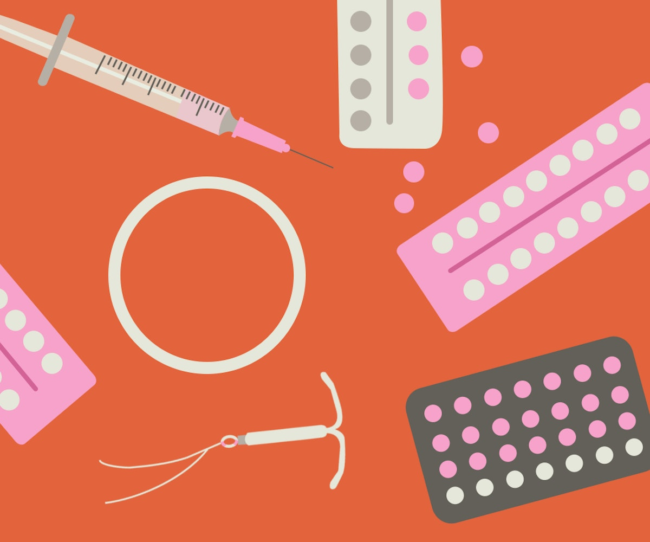
Contraceptive Counseling
GAHT is not contraception
Contraception should be offered to anyone who can become pregnant
Testosterone is a known teratogen
  If pregnancy is desired, testosterone should be stopped several months before trying to conceive
Fertility preservation should be offered prior to starting hormones

Slide 61
Cardiovascular Disease
Transgender men: cardiovascular (CV) risk is unchanged
  CV risk likely increased with the presence of additional risk factors
Transgender women: data are unclear for risk
  CV risk likely increased with the presence of additional risk factors
  Some studies found increased morbidity and mortality from MI and CVA, however these studies did not adjust for risk factors including tobacco use, obesity, and diabetes
To calculate ASCVD risk, determine which sex to use based on age at which hormones are started and total length of exposure to hormones
  EXAMPLES
  If a patient AFAB started testosterone late in life, continue to use female in the calculation
  If a patient AMAB started estradiol at age 20, and they are now 50 YO, then use female for risk calculation given they have lived longer with estradiol influencing their body (~30 years) than testosterone (~10 years)
Eur J Endocrinol 2013 & 2014
Arch Sex Behav 2014

Slide 62
Smoking
Not an absolute contraindication
Counsel at each visit
Use informed decision and harm reduction approach
Transdermal estrogen preferred
Abstain from tobacco/nicotine prior to gender-affirmation surgery
Consider ASA 81 mg daily
  No evidence to discuss risk vs benefit between venous thromboembolism (blood clot) and gastrointestinal bleeding

Slide 63

HIV Prophylaxis
Transwomen are at much higher risk of acquiring HIV
Discuss use of Pre-Exposure Prophylaxis (PrEP)
  Generic Truvada or brand-name Descovy daily
  Cabotegravir q 2 month IM injection also available
Safe to use with gender-affirming medical treatment

Slide 64
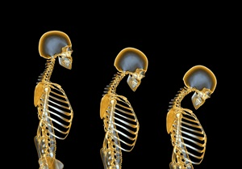
Osteoporosis Screening
Transgender women: mixed data
  Risk factors: underutilization of hormones after gonadectomy, use of androgen blockers without estrogen, GnRH analogues
Transgender men: no change or increase in BMD
  Risk factor: oophorectomy without optimal hormone replacement
Screening for transgender people (regardless of sex assigned at birth)
  s/p gonadectomy and 5 years without hormones
  50-64 with known risk factors
  All transgender people starting at age 65
J Sex Med. 2012
Bone 2008
J Clin Endocrinol Metab 2012

Slide 65

Breast Cancer Screening
Transgender women:
  Begin at age 50, at least 5 years after starting hormones
Transgender men:
  If they have breast tissue, should follow screening guidelines for cis-women
  If they had a mastectomy, discuss breast cancer risk and potentially screen using US or MRI
WPATH Standards of Care 8

Slide 66
Cervical Cancer Screening
Transgender men are less likely to be current on cervical cancer screening
As long as someone has a cervix, the recommendations are the same as for cis-women
Pap smears on transgender men have a ten-fold higher incidence of an unsatisfactory result compared to cis-women
Preliminary research on self-collected vaginal samples for HPV compared to clinician obtained samples show promise
  Very appropriate for transmen who have a lot of gender dysphoria with pelvic exams
Am J Prev Med 2014
J Gen Intern Med 2014
Pediatr Infect Dis 200
Can Med Assoc J 2000

Slide 67
Prostate/Testicular Cancer Screening
Prostate cancer in transgender women
  Likely lower risk than in cis-men
  Same screening recommendations as cis-men
Testicular cancer in transgender women
  Likely lower risk than in cis-men

Slide 68
Questions

Slide 69
Case Review

Slide 70
Case #1: Initiating transfeminine treatment
22 YO obese transfeminine patient (she/her) AMAB presents to your office for initiation of GAHT. She has a PMH of gender dysphoria and depression for which she has seen a therapist for the past 2 years. She has no significant PSH. She reports good social support and is excited to start hormone therapy.
1. Which labs should be drawn today?
  For GAMT: BMP
  For obesity: LFTs, A1C and lipids

Slide 71
Case #1: Initiating transfeminine treatment
2. What GAMT should be started?
  Spironolactone (anti-androgen) 100 mg daily or 50 mg BID, titrate 50 mg Q3 months until goal therapeutic testosterone level < 55
  (max: 300 mg daily)
  Estradiol
    2 mg daily, titrate 2 mg Q3 months until estradiol therapeutic goal ~ 150-200 (max: 10 mg daily)
    Estradiol valerate 10 mg IM/SC weekly or 20 mg IM/SC biweekly
3. How often should she monitored and what blood work is needed?
  Check BMP and estradiol Q3 months for the first year and until estradiol therapeutic goal then q 6-12 months afterwards
  Check total testosterone until testosterone < 55, then stop
    AHN Core Lab: Check testosterone only and value will return in one day
    If you order total and free testosterone, the test will be sent out and take several days to return

Slide 72
Case #1: Transfeminine follow-up
Patient returns in 3 months for a follow-up appointment. She had her 3 month labs drawn prior to presenting to clinic. Her estradiol level is 75 pg/ml and her testosterone levels is 100 ng/dl. She reports feeling more tearful at times during the day, decreased libido, a few episodes of galactorrhea and weight gain specifically around hips. She denies dizziness.
1. Should we adjust hormone dosage today?
  Goal estradiol level is 150-200 pg/ml, testosterone level < 55 ng/dl. But lower targets can be used based on patient goals
  Increase spironolactone to 150 mg daily or 75 mg BID
  Increase estradiol by 2 mg
    Low-quality evidence noted better breast development with slow graduation upward of oral estradiol

Slide 73
Case #1: Transfeminine follow-up
2. Discuss side effects of initiating GAMT.
  Mood instability (e.g. tearful at times)
    Increased emotionality when adjusting hormones is normal and reassurance alone is usually fine.
    Patient should complete PHQ-9 to screen for depression as “coming out” with GAMT may be transiently associated with increased depression secondary to others reaction to their coming out.
  Decreased libido
    Expected potential side effect of decreasing testosterone
    May also experience erectile dysfunction and difficulty with orgasm
  Galactorrhea
    May occur early in the course of transition. Almost always physiologic and does not warrant any further work-up.
  Dizziness
    Spironolactone can cause self-limited polyuria, polydipsia and orthostasis

Slide 74
Case #1: Transfeminine follow-up
Patient continues to maintain regular follow-up for the next year. She has been stable on estradiol 4 mg BID and spironolactone 100 mg BID; BID dosing is the patient preference. She reports smaller testicle size. Her skin has softened significantly and has noticed a reduction in hair around her face and chest. Reports carrying her weight around her hips. She asks what she can do to increase her breast growth.
1. What can we do to aid in breast development?
  Can start progesterone daily
    Provera 5 mg PO daily (low serum concentration)
    Prometrium 100-200 mg PR daily (much higher serum concentration)
  Side effects
    Weight gain, abdominal distress (pain, bloating or nausea) and headache

Slide 75
Case #2: Transmasculine follow-up
31 YO transmasculine patient (they/them) presents to your office for follow-up care. They have been on testosterone cypionate 100 mg/mL, 0.5 mL (50 mg) weekly for the last 6 months. They notice increased acne (☹) but increased facial and body hair (☺). They have been going to the gym and have noticed an easier time increasing muscle mass. They are still having vaginal intercourse but feels like it has been more uncomfortable. Also reporting occasional breakthrough bleeding.
1. Should we adjust their hormone dosages today?
  Check on compliance first which is the number one reason for break-through bleeding. Missing 1-2 doses can lead to breakthrough due to low testosterone level.
  Can consider increasing testosterone dose from 0.5 mL to 0.6 mL to improve irregular bleeding
  Check testosterone level, goal should be 600-700 ng/dL (mid-range)
  Could offer long-acting reversible contraception or Depo-Provera for menstrual suppression

Slide 76
Case #2: Transmasculine follow-up
2. Can we improve their dyspareunia?
  Vaginal atrophy (most common)
    Encourage lubricants or moisturizers
    Consider adding vaginal estrogen cream
  Desquamative inflammatory vaginitis
    Symptoms may include dyspareunia, yellow vaginal discharge, vulvar pain and post-coital bleeding
    Secondary to testosterone treatment
    Treated with 2% clindamycin cream or hydrocortisone cream

Slide 77
Case #2: Transmasculine follow-up
They return to your clinic in 3 months for another follow-up visit after graduation of the testosterone cypionate 100 mg/mL, 1 ml weekly. They are concerned though about more headaches and dizziness. Also endorse generalized pruritus after a hot shower. CBC at the visit shows hemoglobin 17.1.
1. Should we reduce their dose of testosterone dose?
  Discuss risk/benefits of elevated hemoglobin/polycythemia
  Reduction of dose to low-therapeutic range of testosterone (~ 400) often reduces hemoglobin level
  Refer for therapeutic phlebotomy if patient concerned about dropping dose of testosterone

Slide 78
Additional Resources

Slide 79


Resources at AHN
Transgender Health Team
  Charlie Borowicz: Transgender Health Manager
  Ava O’Brien: Community Health Worker
  Referral in Epic
Primary care
  IM Molly Fisher, MD, MS
        Pat Sleckman, DO
  FM Steve Wolfe, DO, MPH
        Brad Fox, MD (Erie)
Transgender treatment team includes primary care, OB/Gyn, pelvic floor PT, plastic surgery, psychiatry/psychology, urology, social work, case managers

Slide 80
Guidelines
WPATH Standards of Care for the Health of Transgender and Gender Diverse People, Version 8, Standards of Care for the Health of Transgender and Gender Diverse People, Version 8 (tandfonline.com)
UCSF Transgender Care: https://transcare.ucsf.edu/guidelines
Hembree et al. Endocrine treatment of gender-dysphoric/gender-incongruent persons: an endocrine society clinical practice guideline. The Journal of Clinical Endocrinology & Metabolism 2017; 102:11 (3869-3903).
Health care for transgender and gender diverse individuals. ACOG Committee Opinion No. 823. American College of Obstetricians and Gynecologists. Obstetrics and Gynecology 2021; 137:e75-88.
General approaches to medical management of menstrual suppression. ACOG Clinical Consensus No.3. Obstetrics and Gynecology 2022; 140:528-41.
Fenway Health: https://fenwayhealth.org/care/medical/transgender-health/
National LGBTQIA+ Health Education Center: https://www.lgbtqiahealtheducation.org/
https://medicine.umich.edu/dept/obgyn/education/continuing-medical-education-cme/transgender-healthcare-curriculum

Slide 81


Slide 82
References
Conron KJ et al. Transgender Health in Massachusetts: Results From a Household Probability Sample of Adults. Am J Public Health. 2012 Jan;102(1):118-22.
Collin L et all. Prevalence of Transgender Depends on the “Case” Definition: A Systematic Review. J Sex Med. 2016 Apr;13(4):613-26
Winter S et al. Transgender people: health at the margins of society. Lancet 2016 Jul;388(10042):390-400
2015 U.S. Transgender Survey (National Center for Transgender Equality)
Bustos VP et al. Regret after Gender-affirmation Surgery: A systematic Review and Meta Analysis of Prevalence. Plast Reconstr Surg Glob Open 2021 Mar;9(3): e3477
Narayan SK et al. Guiding the conversation – types of regret after gender-affirming surgery and their associated etiologies. Ann Transl Med. 2021 Apr;9(7): 605
Gooren et al. Cardiovascular disease in transsexual persons treated with cross-sex hormones: reversal of the traditional sex difference in cardiovascular disease pattern. Eur J endocrinol. 2014 Jun 1;170(6):809-19
Wierckz et al. Prevalence of cardiovascular disease and cancer during cross-sex hormone therapy in a large cohort of trans persons: a case-control study. Eur J endocrinol Eur Fed Endocr Soc. 2013 Oct;169(4):471-8

Slide 83
References
Dhejne C et al. An analysis of all applications for sex reassignment surgery in Sweden, 1960-2010: prevalence, incidence, and regrets. Arch Sex Behav. 2014 May 29
Van Caenegem E et al. Bone mass, bone geometry, and body composition in female-to-male transsexual persons after long-term cross-sex hormonal therapy. J Clin Endocrinol Metab. 2012 Jul;97(7):2503-11
Lapauw B et al. Body composition, volumetric and areal one parameters in male-to-female transsexual persons. Bone. 2008 Dec;43(6):1016-21
Wierckx K et al. Long-term evaluation of cross-sex hormone treatment in transsexual persons. J Sex Med. 2012 Oct 1;9(10):2641-51
Peitzmeier SM et al. Pap test use is lower among female-to-male patients than non-transgender women. Am J Prev Med. 2014 Dec;47(6):808-12
Peitzmeier SM et al. Female-to-male patients have high prevalence of unsatisfactory paps compared to non-transgender females:implications for cervical cancer screening. J Gen Intern Med. 2014 May;29(5):778-84

Slide 84
References
Jacobson DL et al. Concordance of human papillomavirus in the cervix and urine among inner citty adolescents. Pediatr Infect Dis J 2000 Aug;19(8):722-8
Sellors JW et al. Comparison of self-collected vaginal, vulvar and urine samples with physician-collected cervical samples for human papillomavirus testing to detect high-grade squamous intraepithelial lesions. Can Med Assoc J. 2000;163(5):513-8

