Slide 1
Educate. Advocate. Give Hope.

Slide 2
ABOUT US
The Chuckie F. Mahoney Memorial Foundation, formed by Mr. and Mrs. Charles Mahoney III and family, was established in 2002. The mission of the memorial foundation is to communicate that with proper training and education on suicide prevention, and by telling Chuckie’s story, lives can be saved. The foundation strives to provide support and give to organizations that promote and advocate for mental health issues and suicide prevention.
TODAY'S PRESENTERS
Chal Mahoney
Debi Mahoney

Slide 3
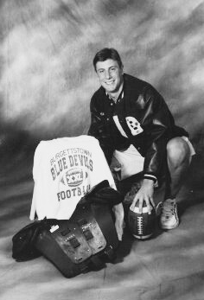
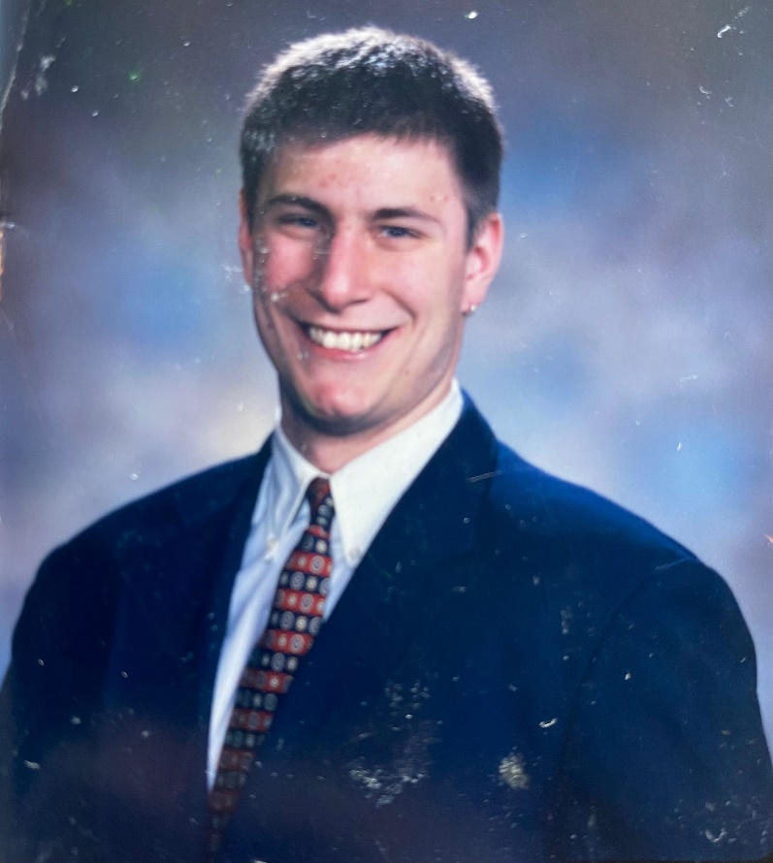
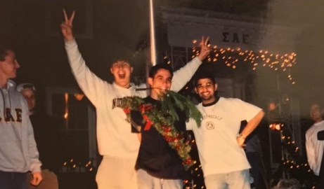
CHUCKIE'S STORY
Charles “Chuckie” Francis Mahoney IV
May 7, 1981 – February 11, 2002
Chuckie was many things to many different people. He was a leader, a friend, compassionate towards others, intelligent, fun, pleasant, had great sense of humor and an ornery disposition, and he loved sports and competition. Chuckie hated to lose, had a strong work ethic, was loyal, he never quit no matter how bad things got and his energy was boundless. He hated injustice and wasn’t afraid to express his opinions. Most importantly, Chuckie loved his family, and the world has lost a very special person (son, brother, friend) who would have made great contributions had he have had the chance.

Slide 4
LATEST STATISTICS
According to the Center for Disease Control (CDC) there is a suicide in the US every ten minutes.
In 2022 it was the highest, 49,500 died from suicide.
Second leading cause of death in young people (10-34 year old), 48% increase.
In ages 12-17 it is up 6.5%, there is 26.9% that have one of more mental or emotional problems.
36.7% of high school students reported feelings of sadness and/or hopelessness.
College age 29.1% report anxiety and 23.6% were diagnosed with depression.
18.8% of high schoolers have reported having suicidal thoughts in the past year.
8.9% of high school students attempted suicide in 2020 according the the CDC.
For every suicide there are at least 20 people affected by the loss.

Slide 5
CHECKING BOXES
3 sport letterman football, basketball, baseball
Graduated High School in 1999 and entered Allegheny College in August of 1999 – to be a part of the football team.
In August of 1999, Chuckie had his first episode with anxiety and was then diagnosed with depression.
Under the care of counselor through the college and home (therapist and psychiatrist) from Aug. 1999 until his death in 2002. (Had 2 sets - psychiatrist and counselor, one at home and one at school)
Through it all he flourished as a student athlete, was an Alden Scholar, pledged to a fraternity, VP of the SAE, football team, had a job on campus for work study, and had an internship at the Washington County Court House during the summer. His goal was to become a child advocate lawyer.
In fall of 2001, he broke up with his college girl friend of two years, he adopted a dog who lived with him at the frat house. All this time he was still in counseling and was under the care of a psychiatrist for medication.
He got good at masking his feelings to family and friends but shared his struggles with his counselor.
In January of 2002, his behavior had changed which alerted his fraternity brothers that he would need help and began to report their concerns with the college authorities, i.e. Deans, his counselor and other authorities representing the college. A total of 8 contacts were made with college administrators by his fellow fraternity brothers over a period of many months. They became even more alarmed when he began making arrangements to give away some of his prize possessions; his dog Gracie as one example.

Slide 6
CHECKING BOXES
At the beginning of every school semester at Allegheny College, Chuck would sign a standard form, which stated ”if I am a danger to myself or others you have my permission to contact my parents.”
Each time the fraternity brothers reached out to the college authorities to report his change of behavior and indicated to them they were concerned about his safety, the response from the college authority figures was “we will contact the home.” No call was ever made to the parents. Another failure to intervene.
Again, numerous red flags and signs were missed
The night before his death, February 10, 2002, he sent his college counselor a very honest and detailed email about how he couldn’t go on and struggled to live everyday.
The counselor called him in to her office the next day and held a 90-minute session, according to the files and our sons last note, the counselor stated to him she could no longer help him and would have to find another counselor. At this session, he presented her his actual plan. He was very honest with her.
The counselor told him they would schedule a meeting for the following day and released him to attend his class in which he turned in a 20-page term paper, went to the library – which is where he wrote his final note.
He went through the back door of the frat house, up to his room, and by 6PM that evening he was dead.
As you can see, there were numerous missed opportunities to save his life, he never should have died on February 11, 2002. We know these facts our true due to the testimony provided against Allegheny College.

Slide 7
LESSONS TO BE LEARNED
Never tell someone that is thinking of taking their life “To come back tomorrow.” There might not be one and there is a small window of opportunity to intervene.
Get yourself trained in prevention – it is CPR for the brain, know the signs, and what to say.
Our son was desperately looking for a “lifesaver” – he wanted to live but he lost hope.
If you don’t know what to do – at the very least call the National Hotline #988 – they will direct you to your local resources in your area.

Slide 8
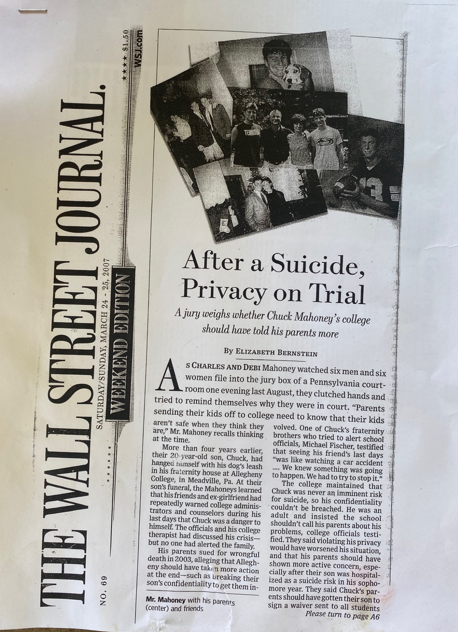
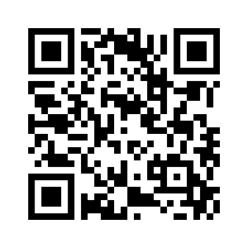
After…
Case went to trial, but was unsuccessful. For more information reference the Wall Street Journal article from March 24, 2007. (https://www.wsj.com/articles/SB117470447130847751)

Slide 9
BE SOMEBODY’S LIFE SAVER!
CONTACT US
Chal Mahoney - chalmahoney13@gmail.com
Debi Mahoney - m_deb13@hotmail.com
To learn more, donate or to get involved in the Chuckie F. Mahoney Foundation go to https://chuckiefmahoney.org/ or scan the QR code.

