Slide 1
Suicide risk in autistic students: supporting relational safety at school so students can thrive
Bethany Ziss MD
October, 2023

Slide 2
The scope of the problem
Suicide was the top cause of death for autistic adults without intellectual disability in 2016 population based study in Sweden

Slide 3
Objectives
Recognize additional risk factors for suicide and self injury in autistic children and teens
Explore ways to improve relational safety and decrease the risk of suicidal thoughts

Slide 4
Who am I?
AHN’s developmental behavioral pediatrician
I take care of neurodivergent kids from toddlers to young adults
About half have autism diagnoses
Practice from the neurodiversity paradigm
Taught science in a private residential school for kids with ADHD and LDs
It was the 90s – how many of the kids were actually also autistic?
Active in the Society for Developmental Pediatrics
DEI committee and neurodiversity workgroups
On the steering committee for the Pittsburgh Center for Autistic Advocacy
Run by and for autistic adults from intersectional feminism lens
Disabled community member and advocate

Slide 5
Assumptions
Everyone here works with some autistic children on a regular basis
The autistic children served by the Chill project generally have conversational language and are largely in regular education settings
may have some learning support, emotional or autism support services
I am not using “functioning” labels here
Not all the autistic children you encounter are formally diagnosed
This is even more likely for children of color and those assigned female
Even if formally diagnosed, you may not be informed and/orthe child may not be informed (and you may be specifically requested not to inform the child)
Most school and mental health professionals are not autistic

Slide 6
Why do I say “autistic”?
Many parents of children with autism and professionals (like you!) have been taught to say “person with autism” or “child with autism” which is consistent with “Person First” language advocated by many disability-related groups, especially people with intellectual disabilities.
Surveys show 60-80% of autistic people prefer to be called “autistic.” They often consider autism to be part of their identity, not something separate or removable. Most of my autistic and disabled friends prefer this “Identity First” language. At least one study suggests this is less stigmatizing than “Person First.”

Slide 7
Why do I say “autistic”? Because it may be lifesaving
2023 study of 225 autistic doctors worldwide found that self-identification as “autistic” was linked to a lower likelihood of suicidal thinking than self-identification as “person with autism”
Use the language that a specific person or groups use. Certainly say “with autism” if your student prefers.
Thoughts to return to:
If all your students prefer “with autism” – have they ever been exposed to a positive or neutral view of being autistic?
If a person experiences therapies with an aim to reduce autistic traits, can they even develop a positive or neutral view of themselves as autistic?

Slide 9
Some neurodiversity terminology many very well-meaning people often get wrong
Neurodivergent – “neurologically divergent from typical” *Kassiane Asasumasu
Neurotypical – having a typical neurotype
Neurodiverse refers to groups, not individuals (image from *Giraffe Party)
Allistic – “not autistic”
from allos, other (contrasted with autism, from auto, self)
Many people are neurodivergent and allistic

Slide 10
Neurodivergencies might include
Autism
Dyspraxia
Intellectual disability
ADHD
Dyslexia
Cerebral palsy
Depression
Tourettes
Dyscalculia
Sensory processing differences
OCD
Epilepsy
Bipolar disorder
Non-verbal learning disability
Anxiety
Traumatic brain injury
Dyspraxia
. . .

Slide 11
Models of Disability
Medical Model
Places the problem within the individual with the impairment
Seeks individual medical solutions
Most medical training about disability tacitly or overtly reinforces this model
Think “services” part of the IEP
Social Model
Places the problem within the society
Seeks community solutions
Largely unknown by most health care providers
Think “modifications” and “accommodations” part of the IEP

Slide 12
Neurodiversity
Neurodiversity is a fact: brains are different
The neurodiversity paradigm is a model:
asserts that there are multiple ways to have a brain, and that neurodivergence and difference is not inherently a deficit
Derived from the social model of disability

Slide 13
Why are autistic people at increased risk for depression and suicidal thinking?
1) Biological
2) Minority stress model

Slide 14
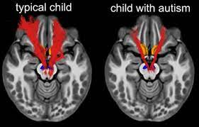
Biology
Autism can be associated with structural brain changes
Over 100 known genes associated with autism
About 10-15% of autistic people have a known genetic change
More likely with co-occurring intellectual disability or medical problems
We thought we might find distinct genetic “autisms”
More language impairment
Better response to specific medication or therapy

Slide 15
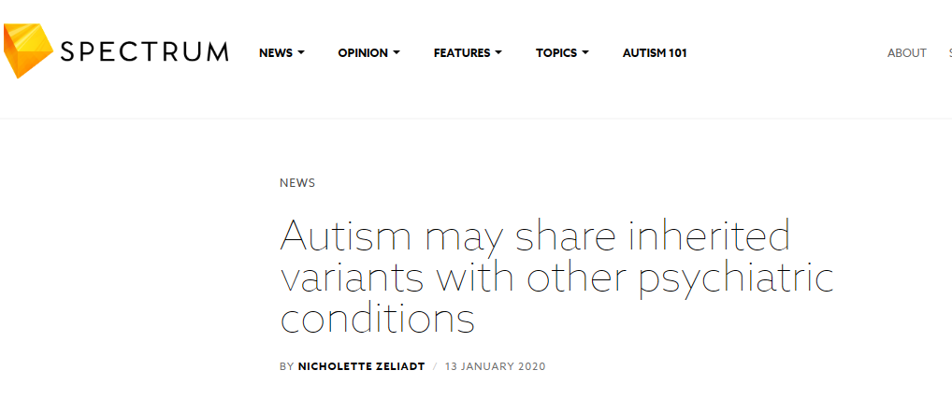

Slide 16
Every known “autism gene”
Is also associated with other mental health conditions
Sometimes even in the same family
Schizophrenia
Bipolar disorder
Depression
ADHD
OCD
Eating disorders
Tourette syndrome
Genetic testing is somewhat common for autistic people and people with intellectual disabilities but is not very common for people with mental health diagnoses. . .so there is a lot we don’t know

Slide 17
Minority Stress Model
First coined to describe increased rates of mental health diagnoses in LGBTQIA+ people
Extended to people of other stigmatized populations including racialized groups
Mental and physical health problems attributed to daily experiences with prejudice and stigma compared to majority populations
Autistic people are a minority neurotype

Slide 18
My absolute bare bones, paraphrased cliff-notes version of the DSM 5 autism criteria
A) Difficulty in all of
Social reciprocity (including reciprocal conversation)
Non-verbal communication
Developing and understanding relationships
B) Impairment in 2 out of
Repetitive behavior and/or language
High need for sameness and difficulty with transitions
Unusual or unusually strong interests
Over or under reactive to sensory input
Support need can be assigned for each area
“Support” “substantial support” or “very substantial support”
There is no official definition for function levels and I don’t use them

Slide 19
Schools designed by neurotypicals, for neurotypicals
May struggle with
yes/no academic questions
(joke online is that autistic people can be identified by saying “it depends” to online autism screeners)
open ended academic questions
the “why” of literature and history
Creative writing assignments, fantasy
Word problems
Handwriting
Focus
Executive function

Slide 20
Schools designed by neurotypicals, for neurotypicals
The sensory experience can include:
Overwhelming odors in the cafeteria
School lunch or bag lunch is the wrong texture or temperature
Noise from the bells, the fire alarm
The clamor of the cafeteria and the hallway
The sound from a classmate’s stimming, the lawnmower out the window
The juice machine and fluorescent lights no one else hears
The texture of required clothing
Art materials
Soap
Autistic people are often not believed when they report sensory discomfort
70% of autistic people have measurable differences in auditory processing. . . which is associated with increased rates of externalizing behaviors

Slide 21
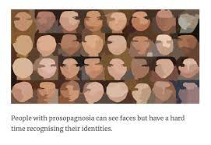
Schools designed by neurotypicals, for neurotypicals
30% of autistic people may have some degree of prosopagnosia (face blindness) which can impact:
Making friends and recognizing them across settings
The cafeteria
Group projects
Teams in PE
Recognizing teachers
Ability to report bullying

Slide 22
Schools designed by neurotypicals, for neurotypicals
Difficulty recognizing tone, sarcasm, non-verbal social cues
Schedule changes
Being told changes is “no big deal”
Being told the change is going to be So Much Fun!
No one else likes the same things
Experiencing bullying and exclusion
Directions all day long
“look at me”
“quiet hands”
“use your words”
“no scripting”
“stop talking about dinosaurs/trains/garbage trucks”
“no one will like you if you keep talking about dinosaurs/trains/garbage trucks. . . “

Slide 23
Cultural clash: the double empathy problem
*Damian Milton proposes a “double empathy” problem
Autistic people have difficulty understanding neurotypical people
But neurotypical people have similar difficulty understanding autistic people
The autistic people are generally blamed in both cases
“Telephone game” study
Messages preserved if all participants were autistic or all neurotypical
Message degraded in mixed groups
Neurotypical people make very quick negative judgements of autistic people on audio or video recordings (not reading written transcripts)

Slide 24
The scope of the problem: autistic children
35% self-report depressive symptoms
75% or parents report their child has depressive symptoms
32% report suicidal thoughts
14% have talked about or attempted suicide
2% had active suicidal ideation
Prevalence of anxiety is estimated over 50%
Prevalence of ADHD is also estimated at over 50%
ADHD diagnosis can delay autism diagnosis

Slide 25
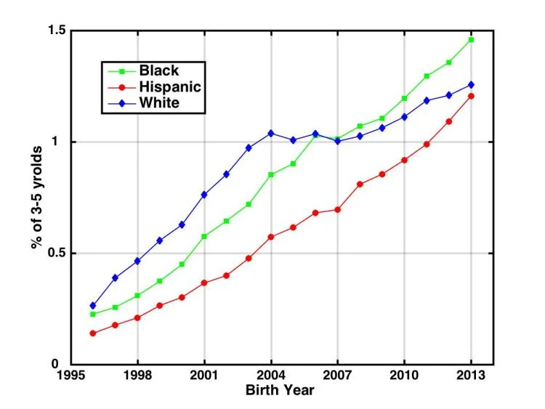
Intersectionality: race
Diagnostic rates in Black and Hispanic children approaching that of white children over time
Black children diagnosed an average of 18 months later than white children (even though parents report initial concerns at the same age)
Diagnosis rates may be higher in Asian children

Slide 26
Intersectionality: race
Additional fear of police violence
Not responding to verbal directions
Lack of eye contact and repetitive movements viewed as suspicious
“School to prison pipeline”
Disparate school discipline referrals
Many Allegheny County suspend Black students as 2x the rate

Slide 27
Intersectionality: gender
Who else here learned that autism is a “boy” condition?
CDC still says autism occurs 4x as often in boys
Do girls and boys present differently?
Did we write the diagnostic criteria on 8 year old (white) boys and don’t recognize autism in anyone else?

Slide 28
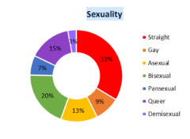
Intersectionality: LGBTQIA+ identities
Should not assume autistic people are non-sexual
More likely to be asexual (this is an identity)
Pittsburgh Center for Autistic Advocacy 2018 survey of 106 teens and adults:

Slide 29
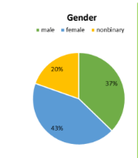
Intersectionality: LGBTQIA+ identities
Up to 70% of autistic adults identify as LGBTQA+
Up to 6% of autistic teens expressed a wish
“to be of opposite sex” in one study
From the Trevor Project: LGBTQ youth who are diagnosed with autism had over 50% greater odds of attempting suicide in the past year compared to those who had never been diagnosed with autism

Slide 30
Trans rights and autistic rights: interlinked
2016 death of Kayden Clarke
24 year old transgender autistic man
Friends called 911 due to concerns about suicide
Killed by police after allegedly approaching them holding a knife
Gender clinic had recently refused to provide hormone therapy until his “autism spectrum disorder” was “cured”
Current attempts across the US to limit gender affirming care have listed autism as a reason to deny treatment in Georgia, Arkansas and Missouri

Slide 31
Risk Factors
Bullying
Depression
ADHD
Autistic kids with ADHD are less likely to verbalize suicidal thoughts
But we know ADHD is a risk factor in non-autistic children
Black and Hispanic children
Unclear role of gender

Slide 32
Things to watch for
Loss of interest in activities previously enjoyed
School anxiety
Frequent tearfulness
Increased externalizing behaviors
Always tired
“restraint collapse” (internalizing at school and externalizing at home)
Lack of “belongingness”
A verbal or written suicide plan

Slide 33
Things maybe not to watch for
“Flat” affect
Lack of eye contact
Spending time alone

Slide 34
“I WISH I WERE DEAD!!!!!”
Be cautious about over attributing yelled suicidal or homicidal words during extreme escalation
Clarify at a calmer time!
Plot of 12 Angry Men hinged on
this phenomenon

Slide 35
Where have I heard that before?
Also be cautious about over-interpreting very specific, repetitive suicidal comments
May be a script from a classmate, a TV show, Youtube, TikTok or wherever the kids are getting their media from these days
Again, clarify – where did it come from? What does it mean?

Slide 36
Is self-injurious behavior suicidal?
Self-injurious behavior often attributed to those with co-occurring ID
But 49% of autistic doctors surveyed report engaging in self-harm
SIB may occur in 30% of autistic children
SIB in non-autistic people, such as cutting generally seen as a sign of distress and treated with CBT/DBT
SIB in autistic people generally seen as a “behavior” and addressed with reinforcement programming

Slide 37
Is self-injurious behavior suicidal?
Often called “non-suicidal self injury”
But may also correlate to risk of suicidal thinking and attempts in both non-autistic and autistic adults

Slide 38
Formal assessment measures
Everyone uses the PHQ-9
Not well validated in autistic people
May underreport
The Beck Depression Index may be a stronger measure for teens
Every year or so another new autism-specific measure for depression and/or suicidal risk is sent around the internet looking for study participants
Often modifications of more standard measures
None have “caught on” that I know of
SBQ-ASC (Suicidal Behaviours Questionnaire—Autism Spectrum Conditions) may have some promise, stay tuned

Slide 39
Masking or camouflaging autistic traits
Associated with higher rates of suicidal thinking in adults
Most of the studies come out of the UK
Most studies on autistic adults come out of the UK
Social Model of Disability more used than in the US
Behavioralism less often used than in the US
To what extent do we explicitly or implicitly encourage masking in our goals and therapeutic strategies?

Slide 40
Masking or camouflaging autistic traits
“Camouflaging and unmet support needs appear to be risk markers for suicidality unique to ASC. Non-suicidal self-injury, employment, and mental health problems appear to be risk markers shared with the general population that are significantly more prevalent in the autistic community.” Cassidy et al

Slide 41
So what do we do?
Targeting
Depressive symptoms
Anxiety
traditional anxiety such as phobias, generalized, separation
“autistic anxiety” such as difficulty with change
Impulsivity
Cognitive distortions
Perspective taking (with caution)
Autistic people generally recommend against targeting
Non-verbal communication differences
“stimming”
Unusual interests
Alone time

Slide 42
CBT
Gold standard for anxiety/depression
Can be used successfully for autistic people
May need to be modified for more concrete thinkers
Coping Cat has been studied specifically
Parent involvement may be needed at an older age than in allistic children
One study found more improvement in parent report than self-report

Slide 43
Autistic concerns about CBT
Some autistic people feel CBT gaslights them
Is it social anxiety if they really ARE laughing at you?
Feels it is teaching masking
Caution about viewing sensory processing problems as “phobias”
Autistic people do not “habituate” to repeated sounds the way non-autistic people do

Slide 44
Alexithymia
Raise your hand if you have ever learned about this in a professional setting? (I haven’t!)
Difficulty or inability to express feelings in words
Estimated to affect about 50% of autistic people
Do we go through it
keep working on naming feelings
Or around it
focus on body sensations
Identify the size of the feeling
Or both

Slide 45
The Incredible 5 Point Scale
Can be customized with numbers, colors, dinosaurs, cartoon characters, words. . .
Focus more on size than specific emotional words
Child to English dictionary
Get quiet?
Talk faster?
Start pacing?
Ears get red?

Slide 46
What else?
Interoception (phone an occupational therapist friend for this one)
Recognizing internal body signals
Teaching interoception in a school setting found to improve emotional regulation
Declarative Language
(created by an SLP but your SLP friends may not have discovered it yet)
DECLARATIVE LANGUAGE HANDBOOK
Substitute statements (and wait time!) for directions and questions
Focus on co-regulation over self-regulation

Slide 47
What else?
DBT may be appropriate for teens
May be a role for supportive therapy
Being a safe space to be autistic
Practice self-advocacy scripts
Typing or AAC may be more accessible (even for very verbal people)
Groups
(benefit may be in finding true peer group rather than “social skills” teaching)
Teaching the non-autistic children about autism may be beneficial
Reduce demands. No seriously you can reduce that one. And that one too. Think as far outside the box as possible to restore stability

Slide 48
What else?
Have you noticed I have not mentioned really common interventions often used for autistic kids in school such as FBAs and behavior support plans?
Obtain something
Avoid or escape something
Obtain attention
Sensory
Does not factor in thoughts or feelings
Many autistic adults report behavioral reinforcement programs attempted to change who they are, teach masking, and cause trauma

Slide 49
Collaborative and Proactive Solutions
Developed by Ross Greene et all
Book for parents, “The Explosive Child”
Book for teachers and school staff, “Lost at School”
Book for therapists, “Treating Explosive Kids”
Extensive online materials
“Kids do well if they can” – views problems as skill deficits
Targets problems rather than diagnoses or behaviors
“difficulty with the transition off electronics after free time”
“difficulty participating in science activities with a partner”
Two steps:
adults list and triage problems
Collaborate with child on a solution for selected problems
Does not use reinforcement

Slide 50
Collaborative and Proactive Solutions
When applied school-wide, marked decrease in classroom disruption and office referrals
Best studied in children with ODD diagnosis including those with co-occurring ADHD, depression and anxiety
Autistic children may get an ODD diagnosis instead of (or in addition to an autism diagnosis)
African-American children are disproportionally likely to first be diagnosed with ODD or a conduct disorder
Has been used with autistic children in school and outpatient settings
Parents of autistic children without intellectual disability asked about interventions including ABA, PCIT, Zones of Regulation®, CPS™ and medications rated CPS™ and medications the most helpful

Slide 51
Child plays alone at recess
Has anyone asked the child why or what they like to do at recess?
Preference
Leave alone?
Needs time to decompress
Leave alone? Build breaks in elsewhere?
Wants to play, doesn’t know the games
Teach specific games or scripts? Role-play?
Doesn’t know how to initiate
Social scripts, visual prompts, paraprofessional prompts
Prefers own activities to those classmates prefer
Leave alone? Find other children with similar interests? Make choice explicit?
Being bullied/excluded
Educate other children? Monitor interactions? Identify children who might be better fit?

Slide 52
What if the kid isn’t diagnosed?
What would you do differently if the child is diagnosed?
Can you do that regardless?
(likely possible for therapeutic strategies)
(May also be possible for IEP or 504 accommodations and supports)
If a strategy designed for autistic learners seems to fit, why not use it?
Two reasons to seek diagnosis (of any condition ever, not just autism)
Does it change management?
Does it increase self-knowledge and peace of mind?

Slide 53
What if the kid doesn’t know their diagnosis?
Obviously talk to the family first
I have both “why” and “how-to” resources at the end
Thoughts to share
Disability identification correlated with increased self-esteem in those with visible and invisible disabilities. Disability pride “partially mediated” the relationship between stigma and self-esteem
Adolescents whose parents voluntarily disclosed their autism diagnosis to them described autism and themselves more positively than adolescents who did not experience voluntary disclosure (but found out anyway)
If it falls to you. . .
Tie it to experiences the student already knows about themselves
Including some challenges but also positive/neutral traits
Do not recommend “superpower” language
Try not to disclose when a kid is feeling terrible about themself
Offer community (books by autistic authors, school group, mention you have autistic friends or co-workers if true)

Slide 54
Even more scope of the problem
2022 study of deaths by suicide in England
0.5% were diagnosed with autism
41% had autistic traits but were not diagnosed
Is self-knowledge lifesaving?

Slide 55
In a crisis
You are probably more aware of crisis resources than I am
Autistica (UK advocacy organization) has a nice online crisis guide
amrcopenres-180115.pdf (healthopenresearch.s3.amazonaws.com)
Autistic teens may be more likely to access a text based than voice based crisis service
988 and the Trevor Project both have text options

Slide 56
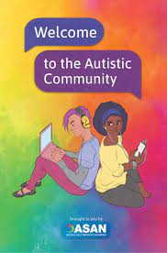
Relational Safety
I can’t prescribe it or describe it – each person experiences this differently
Does your autistic student feel safe in your school?
Your classroom?
Your office?
Anywhere?

Slide 57
*Resources: neurodiversity toolkit
“The Real Experts: Readings for parents of autistic children” (ed. Michelle Sutton)
Don’t Mourn for Us: https://www.autreat.com/dont_mourn.html
(Jim Sinclair)
Quiet Hands: https://juststimming.wordpress.com/2011/10/05/quiet-hands/
(Julia Bascom)
ASAN’s “Welcome to the autistic community”
Welcome to the Autistic Community - Autistic Self Advocacy Network (autisticadvocacy.org)
https://www.youtube.com/watch?v=XnuGPJ7UdpU

Slide 58
Resources: books for kids
For younger children:
*Just Right For You, Melanie Heyworth
*The Brain Forest, Sandhya Menon
Why Johnny Doesn’t Flap, Clay Morton and Gail Morton, 2015
For older children:
*I Love Being My Own Autistic Self, Landon Bryce, 2012
Arnie and His School Tools, Jennifer Veenendall, 2008
Autism: What Does It Mean to Me?, Catherine Faherty, 2014
For teens:
Welcome to the Autistic Community (autismacceptance.com)
Welcome To The Autistic Community - YouTube

Slide 59
*Resources: disclosure
https://chavisory.wordpress.com/2013/11/01/you-should-tell-your-kids-that-theyre-autistic/
http://www.stimeyland.com/2016/01/telling-kids-they-autistic-i-want-your.html
http://www.stimeyland.com/2016/02/whyand-howto-talk-to-your-kid-about.html
http://autisticnotweird.com/when-should-i-tell-my-child/.

Slide 60
References
2019;176(12):1010-1020. doi:10.1176/appi.ajp.2019.18121333
amrcopenres-180115.pdf (healthopenresearch.s3.amazonaws.com)
Are We Gaslighting Autistics Into Believing a Rational Fear Response is a Co-morbid Mental Illness? – The Autistic Doc (wordpress.com)
ASAN Joint Statement on the Death of Kayden Clarke - Autistic Self Advocacy Network (autisticadvocacy.org)
Autism rates increasing fastest among blacks and Hispanics | CU Boulder Today | University of Colorado Boulder
Cassidy, S. A., et al. "Is camouflaging autistic traits associated with suicidal thoughts and behaviours? Expanding the interpersonal psychological theory of suicide in an undergraduate student sample." Journal of autism and developmental disorders 50 (2020): 3638-3648
Cassidy, Sarah A., et al. "Development and validation of the suicidal behaviours questionnaire-autism spectrum conditions in a community sample of autistic, possibly autistic and non-autistic adults." Molecular autism 12.1 (2021): 46.
Cassidy, Sarah, et al. "Autism and autistic traits in those who died by suicide in England." The British Journal of Psychiatry 221.5 (2022): 683-691.
Cassidy, Sarah, et al. "Risk markers for suicidality in autistic adults." Molecular autism 9 (2018): 1-14.
Data & Statistics on Autism Spectrum Disorder | CDC
Gernsbacher, Morton Ann. "Editorial perspective: The use of person‐first language in scholarly writing may accentuate stigma." Journal of Child Psychology and Psychiatry 58.7 (2017): 859-861.
Gotham, Katherine, Kathryn Unruh, and Catherine Lord. "Depression and its measurement in verbal adolescents and adults with autism spectrum disorder." Autism 19.4 (2015): 491-504.

Slide 61
References
Green SA, Hernandez L, Lawrence KE, et al. Distinct Patterns of Neural Habituation and Generalization in Children and Adolescents With Autism With Low and High Sensory Overresponsivity. Am J Psychiatry.
Greene, R.W., & Winkler, J. (2019). Collaborative & Proactive Solutions™: A review of research findings in families, schools, and treatment facilities. Clinical Child and Family Psychology Review, 22(4), 549-561
Hirvikoski, Tatja, et al. "Premature mortality in autism spectrum disorder." The British Journal of Psychiatry 208.3 (2016): 232-238.
Horowitz, Lisa M., et al. "Talking about death or suicide: Prevalence and clinical correlates in youth with autism spectrum disorder in the psychiatric inpatient setting." Journal of Autism and Developmental Disorders 48 (2018): 3702-3710.
https://19thnews.org/2023/05/trans-laws-autistic-youth-mental-health/
https://autisticpgh.org/ans2019/
https://en.wikipedia.org/wiki/Minority_stress
https://network.autism.org.uk/knowledge/insight-opinion/double-empathy-problem
https://www.thetrevorproject.org/research-briefs/mental-health-among-autistic-lgbtq-youth-apr-2022/
https://www.thirdspace.scot/wp-content/uploads/2023/02/NAIT-Webinar-Slides-Reflections-on-CBT-and-Autistic-Thinking-03.02.23.pdf
https://www.ualberta.ca/folio/2023/07/a-simple-intervention-could-help-promote-understanding-of-autistic-children.html
Just_Discipline_and_the_School_to_Prison_Pipeline_in_Pittsburgh.pdf (heinz.org).
Kent, Rachel, and Emily Simonoff. "Prevalence of anxiety in autism spectrum disorders." Anxiety in children and adolescents with autism spectrum disorder (2017): 5-32.

Slide 62
References
Kinnaird, Emma, Catherine Stewart, and Kate Tchanturia. "Investigating alexithymia in autism: A systematic review and meta-analysis." European Psychiatry 55 (2019): 80-89.
Lau, Bonnie K., et al. "The prevalence and developmental course of auditory processing differences in autistic children." Autism Research 16.7 (2023): 1413-1424.
Mahler, Kelly, et al. "Impact of an interoception-based program on emotion regulation in autistic children." Occupational therapy international 2022 (2022).
Mayes, Susan Dickerson, et al. "Suicide ideation and attempts in children with autism." Research in Autism Spectrum Disorders 7.1 (2013): 109-119.
Minio-Paluello, Ilaria, et al. "Face individual identity recognition: a potential endophenotype in autism." Molecular Autism 11.1 (2020): 1-16.
Ollendick, T. H., Greene, R. W., Austin, K. E., Fraire, M. G., Halldorsdottir, T., Allen, K. B., ... & Wolff, J. C. (2016). Parent management training and collaborative & proactive solutions: A randomized control trial for oppositional youth. Journal of Clinical Child & Adolescent Psychology, 45(5), 591-604
Pilunthanakul, Thanita, et al. "Validity of the patient health questionnaire 9-item in autistic youths: a pilot study." BMC psychiatry 21.1 (2021): 1-11.
Rates of Autism Increase, but Numbers Don’t Paint the Full Picture | PolicyLab (chop.edu)
Riccio, A., Kapp, S. K., Jordan, A., Dorelien, A. M., & Gillespie-Lynch, K. (2020). How is autistic identity in adolescence influenced by parental disclosure decisions and perceptions of autism?. Autism, 1362361320958214.
Rock, A. J. (2017). A mixed methods approach to using Collaborative and Proactive Solutions™ with students with emotional and behavioral disorders while applying the self-determination theory (Paper 314) [Doctoral dissertation]
Segers, Magali, and Jennine Rawana. "What do we know about suicidality in autism spectrum disorders? A systematic review." Autism Research 7.4 (2014): 507-521.
Shkedy, Gary, Dalia Shkedy, and Aileen H. Sandoval-Norton. "Treating self-injurious behaviors in autism spectrum disorder." Cogent Psychology 6.1 (2019): 1682766.
Tshida, J.E., Maddox, B.B., Bertollo, J.R., Kuschner, J.S., Miller, J.S., Ollendick, T.H., Greene, R.W. &Yerys, B.E. (2021). Caregiver perspectives on interventions for behavior challenges in autistic children. Research in Autism Spectrum Disorders, 81.
Wang, X., Zhao, J., Huang, S., Chen, S., Zhou, T., Li, Q., Luo, X. & Hao, Y. (2021). Cognitive behavioral therapy for autism spectrum disorders: A Systematic review. Pediatrics, 147(5).
Wijnhoven, Lieke AMW, et al. "Prevalence of comorbid depressive symptoms and suicidal ideation in children with autism spectrum disorder and elevated anxiety symptoms." Journal of Child & Adolescent Mental Health 31.1 (2019): 77-84.
Wood, J., Kendall, P., Wood, K., Kerns, C., Seltzer, M., Small, B., Lewin, A. & Storch, E. (2019). Cognitive behavioral treatments for anxiety in children with autism spectrum disorder: A randomized clinical trial. Journal of the American Medical Association – Psychiatry, 77, 1-10.

