Slide 1

2023
PAIN
From a Rheumatology Perspective
Joanna Marco, MD
Assistant Professor of Medicine

Slide 2
Learning Objectives
Contrast symptoms and etiologies for inflammatory, mechanical, neuropathic, and nociplastic pain
Recognize signs and symptoms of inflammatory arthritis and identify appropriate patients for rheumatology referral
Diagnose and manage osteoarthritis and mechanical joint pain
Diagnose and manage fibromyalgia
Marco JL | 2023
2

Slide 3
What is Pain?
Per the International Association for the Study of Pain:
An unpleasant sensory and emotional experience associated with actual or potential tissue damage, or described in terms of such damage.
Pain can occur with tissue damage (e.g. rheumatoid arthritis) or without tissue damage (e.g. fibromyalgia)
Marco JL | 2023
3

Slide 4
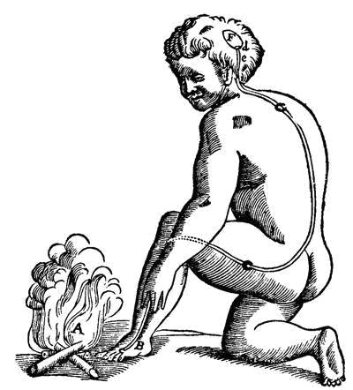
Nociceptive Pain: the traditional model
Marco JL | 2023
4
Notes:
Nociceptive pain: pain that occurs because nociceptors or pain receptors are detecting tissue damage
In this model, you can see this man is burning his foot. There is tissue damage occurring in the foot. Nociceptors are activated. They send their signal up through the spinal cord and then to the thalamus and cortex of the brain where pain is perceived

Slide 5
Neuropathic Pain
Pain initiated or caused by a primary lesion or dysfunction in the nervous system
May be peripheral or central
Marco JL | 2023
5
Notes:
Neuropathic pain: what if there’s no fire damaging the tissue, but instead there’s something broken about the nerves

Slide 6
Nociplastic Pain
Pain occurring due to abnormalities in CNS regulation or interpretation of pain
Centralized pain
Central pain sensitization
Pain amplification
Marco JL | 2023
6

Slide 7
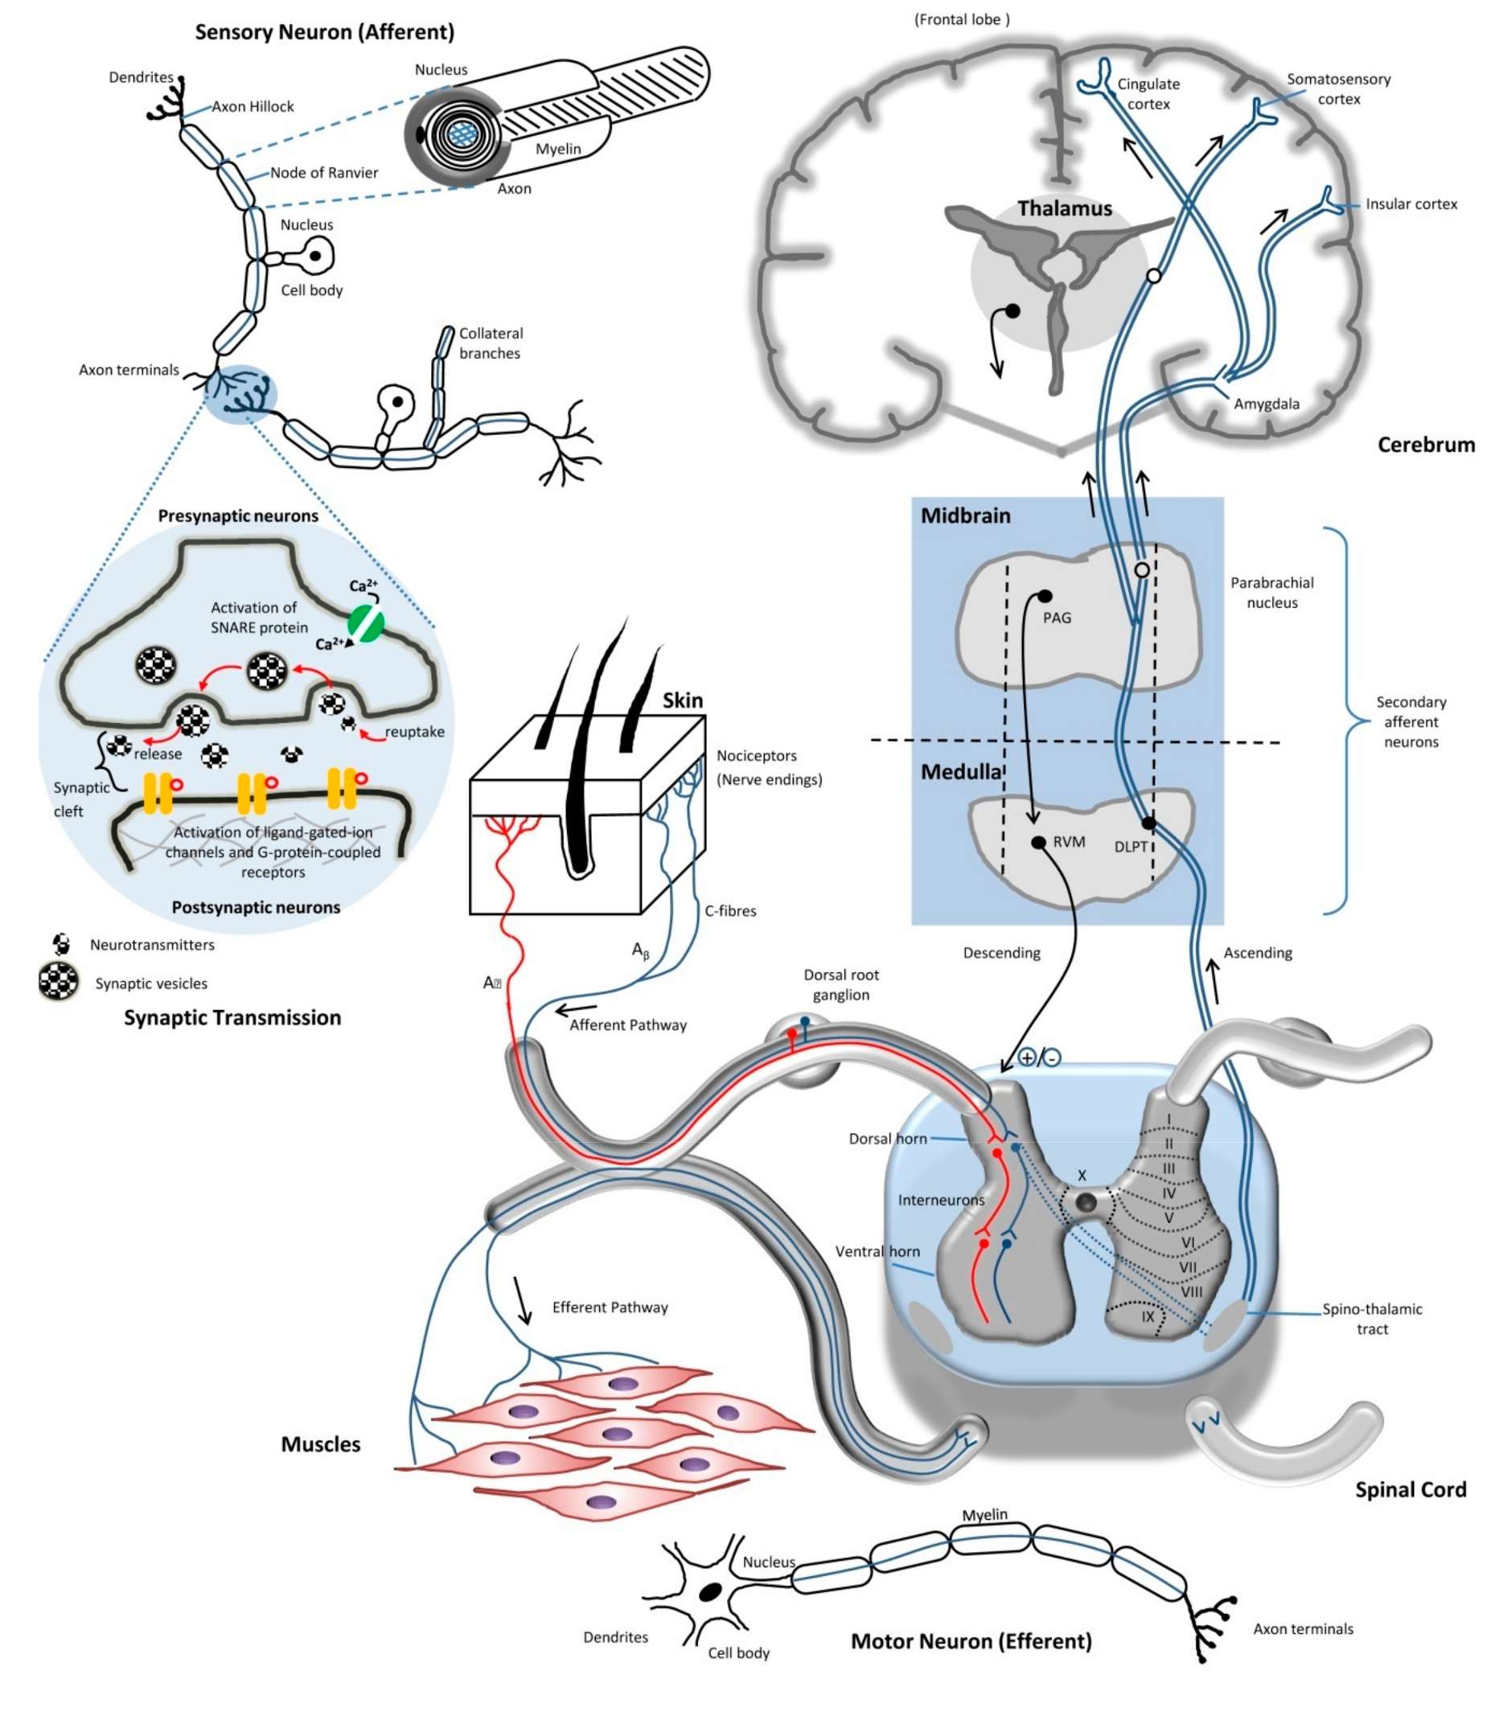
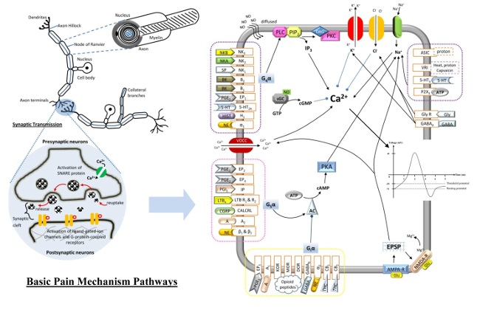
Nociplastic Pain
Yam et al 2018
Marco JL | 2023
7
Notes:
The idea with nociplastic pain is that diagrams like this do not explain all pain. despite all the work pain scientists did in the 20th century to painstakingly describe every cell, every molecule, every neurologic pathway in the experience of pain, they were still missing something. If you recall from one of the first slides, pain is defined as an unpleasant sensory AND emotional experience. Do these diagrams look like they are addressing the emotional side of pain?

Slide 8
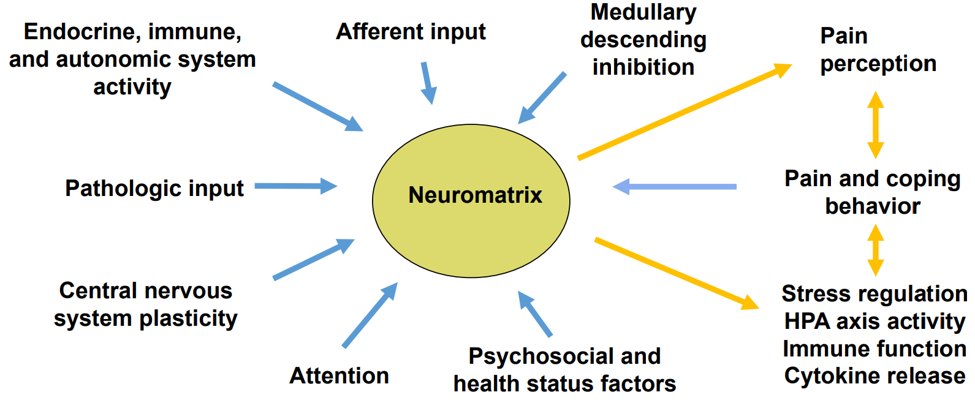
Factors that Increase or Decrease Pain Perception
PAIN
Mease 2023
Marco JL | 2023
8

Slide 9
Nociplastic Pain
“Pain that arises from altered nociception despite no clear evidence for disease or lesion of the somatosensory system causing the pain”
Neural plasticity allows the brain to “learn” to be in pain even when the noxious stimulus is removed
Influenced by prior experiences, expectations, emotion/mood
Allodynia
Hyperalgesia
Fatigue
Sleep Disturbance
Marco JL | 2023
9
Notes:
Normally certain stimuli wouldn’t hit the threshold to register in the brain as pain, but when someone’s brain is in this pain mode, every little stimulus can register as pain

Slide 10
Pain Classification
Nociceptive
Neuropathic
Nociplastic
Inflammation or mechanical damage
Classic examples
Osteoarthritis (OA)
Rheumatoid arthritis (RA)
Damage or entrapment of nerves
Classic examples
Diabetic neuropathy
Postherpetic neuralgia
Central disturbance in pain processing
Classic examples
Fibromyalgia
Irritable bowel syndrome
Chronic migraine
Chronic pelvic pain
Idiopathic low back pain
Acute injuries
Carpal tunnel syndrome
Marco JL | 2023
10

Slide 11
Pain Classification
Nociceptive
Neuropathic
Nociplastic
Inflammation or mechanical damage
Classic examples
Osteoarthritis (OA)
Rheumatoid arthritis (RA)
Damage or entrapment of nerves
Classic examples
Diabetic neuropathy
Postherpetic neuralgia
Central disturbance in pain processing
Classic examples
Fibromyalgia
Irritable bowel syndrome
Chronic migraine
Chronic pelvic pain
Idiopathic low back pain
Acute injuries
Carpal tunnel syndrome
Marco JL | 2023
11

Slide 12
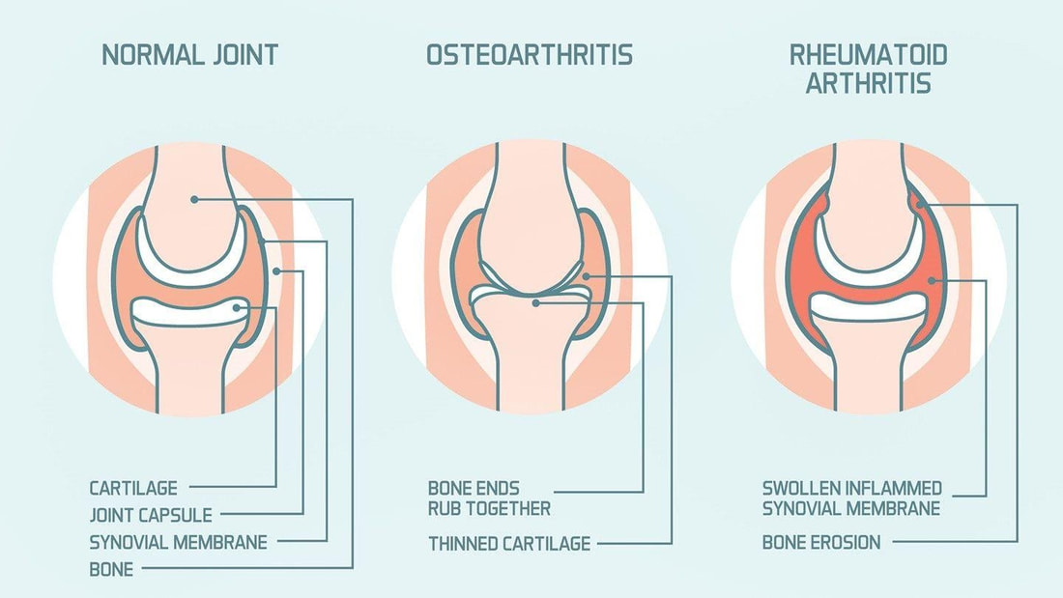
Inflammatory vs mechanical joint pain
Marco JL | 2023
12
Notes:
You could replace OA in this diagram with a torn rotator cuff, or an ankle sprain. You could replace RA with PsA or lupus
Osteoarthritis pain: driven mostly by mechanical factors. Literally loss of cartilage and the ends of the bones rub and scrape, and that hurts
Rheumatoid arthritis pain: driven mostly by inflammation of the synovium and joint capsule

Slide 13
Inflammatory vs mechanical joint pain
Mechanical
AM stiffness: <15 min
Activity: worsens symptoms
Rest: improves or resolves symptoms
Exam: Crepitus, loss of ROM, instability
Nocturnal pain: rare
Response to steroids: minimal
Inflammatory
AM stiffness: 30+ min
Activity: improves symptoms
Rest: worsens symptoms (especially stiffness)
Nocturnal pain: common
Response to steroids: +++
Exam: Significant swelling, warmth, tenderness, sometimes redness
Marco JL | 2023
13
Notes:
When you’re thinking mechanical, it’s not just OA, it’s also torn rotator cuff, ankle sprain, broken wrist

Slide 14

Now that you’re thinking like a rheumatologist…
Inflammatory arthritis
Osteoarthritis
Fibromyalgia
Marco JL | 2023
14
Notes:
At this point, you’re thinking like a rheumatologist, you’re thinking about whether pain is neuropathic, or nociplastic, or nociceptive, and if it’s nociceptive joint pain, you’re thinking about inflammatory vs mechanical.
Let’s talk about some specific conditions

Slide 15
Inflammatory arthritis
Broad category of arthritides characterized by significant inflammation in the joints
Autoimmune inflammatory arthritis
  Rheumatoid arthritis
  PMR
  Psoriatic arthritis
  Axial spondyloarthritis (ankylosing spondylitis)
  Sjogren’s, lupus, vasculitis, and many more
Crystal arthritis
  Gout
  CPPD
Septic arthritis
Marco JL | 2023
15
Notes:
There are a lot of things under this umbrella

Slide 16
Inflammatory arthritis: history
Provoking factors: inactivity, time of day
Palliating factors: exercise/movement, steroids, NSAIDs
Quality: May be deep aching, throbbing, or sharp
Region/radiation: different with different causes
Severity: wide range
Timing: Typically chronic/subacute for autoimmune causes, acute for crystal or septic arthritis
Other factors: Other symptoms of systemic inflammation (psoriasis or rash, constitutional symptoms, pleurisy, Raynaud’s, etc), family history
Marco JL | 2023
16

Slide 17
Inflammatory arthritis: physical
Objective signs of joint swelling, tenderness, and/or warmth
In some cases there may be erythema (especially gout)
Arthrocentesis: >2k WBCs
Marco JL | 2023
17

Slide 18
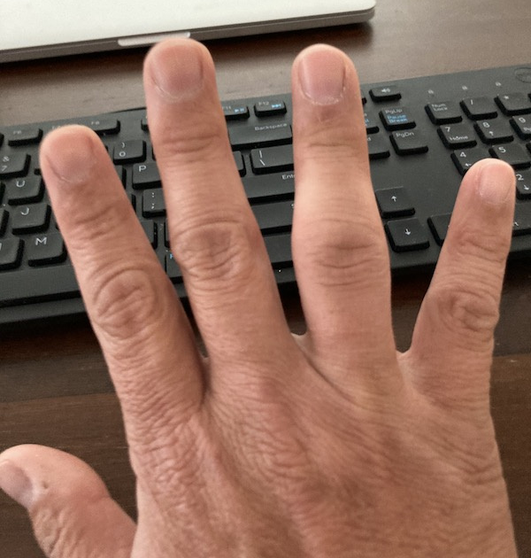
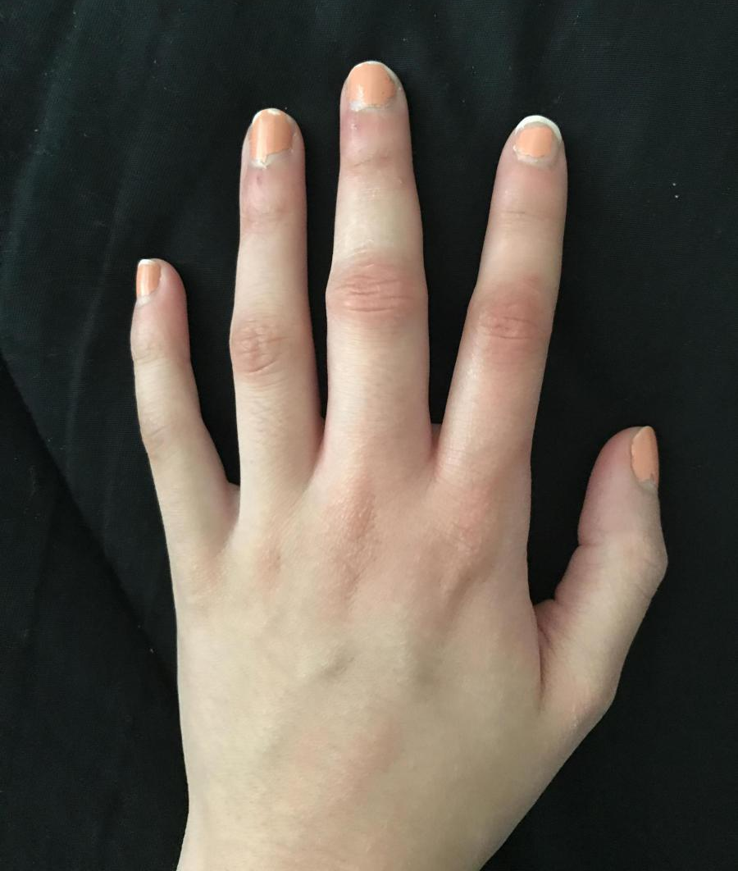
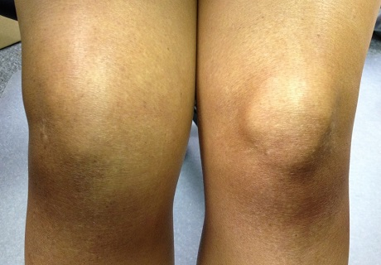
Tips on detecting joint inflammation
Inspect: Compare contralateral joint looking for subtle swelling, asymmetry, loss of knuckle wrinkles, or loss of bony anatomy
Marco JL | 2023
18

Slide 19
Tips on detecting joint inflammation
Test ROM: assess AROM as well as stiffness
  ROM is diminished in swollen joints
Palpate:
  First feel lightly for warmth. Generally joints should be cooler than the surrounding limbs (or at least not warmer)
  Then press more firmly, feeling for fluid or squishiness
  Unless a patient is morbidly obese, joints should feel bony, not squishy
Marco JL | 2023
19
Notes:
ROM: examples of how stiffness looks on shoulder ROM, fist formation in RA, etc

Slide 20
Inflammatory arthritis: management
These patients should see a rheumatologist
Workup prior to referral: Rheumatoid factor, CCP (cyclic citrullinated protein Ab), ESR, CRP
ANA ONLY if young (<40) and/or if other systemic features are present like rash, interstitial lung disease, or Raynaud’s
Lyme if any tick exposure or if large joint involvement
Don’t need XR unless you need to rule out fracture or there is significant bony deformity
Primary care management
  Risk factor modification
  Appropriate dosing of NSAID/prednisone for acute flares
  Gout/crystalline arthritis
Marco JL | 2023
20

Slide 21
Inflammatory arthritis: primary care management
Risk factor management
  Obesity
  Smoking
  CVD
  Steroid-induced osteoporosis or DM
Arthritis flare management
  Prescription strength NSAIDs for mild flares
  Low dose prednisone
    10 mg daily x 10 days
    Try 10 mg x 3 days. If highly effective, take 5 mg daily x 3 days. If not effective, take 20 mg x 3-5 days
Marco JL | 2023
21

Slide 22
Gout: Diagnosis
Hyperuricemia
Monosodium urate crystal deposition throughout the body
Highly inflammatory in the joints
Recurrent gout attacks
Chronic gouty arthritis
Marco JL | 2023
22
Notes:
Hyperuricemia might occur due to someone’s high purine diet, genetic factors like being an under-excreter, medications (hctz), high cell turnover state, CKD

Slide 23
Gout: Diagnosis
Acute onset
Pronounced redness, warmth, and swelling
Early gout attacks: feet and ankles
After many gout attacks: knees, hands, elbows
Look for tophi: hands, olecranon bursae, ears
Podagra (acute 1st MTP inflammation) is adequate for a clinical gout diagnosis
Or, diagnosis can be confirmed with joint aspiration
Marco JL | 2023
23

Slide 24
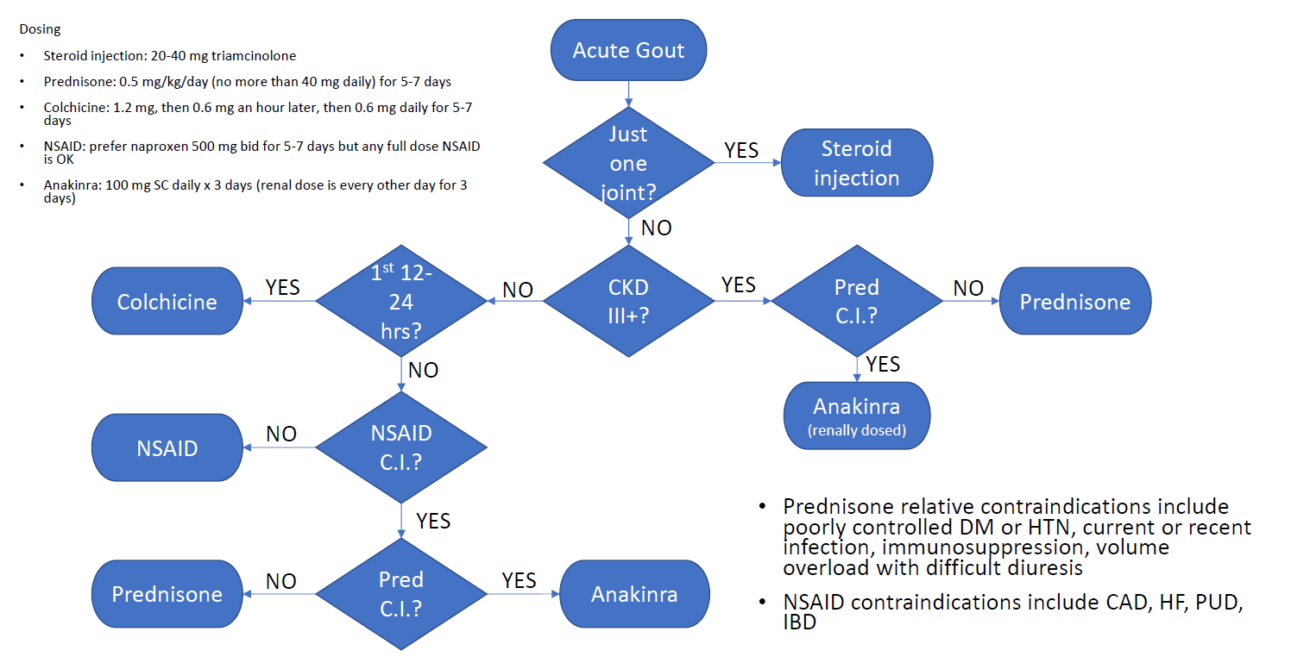
Gout: Treatment (acute)
Marco JL | 2023
24
Notes:
This is based on the ACR gout guidelines

Slide 25
Gout: Treatment (chronic)
Urate Lowering Therapy (ULT) is advised for:
Tophi or bony erosions
Recurrent flares (even if infrequent)
First flare if:
  CKD III or worse
  Urolithiasis
  Serum uric acid is >9
Marco JL | 2023
25

Slide 26
Gout: Treatment (chronic)
Urate Lowering Therapy (ULT)
Uric acid goal: <6, or <5 if tophi present
Allopurinol
  If SE Asian or African-American heritage, check HLA-B2801 (gene for allopurinol hypersensitivity reaction)
  Normal renal function: 100 mg daily, uptitrate by 100 mg every 3-4 weeks until uric acid is at goal
  CKD III+: 50 mg daily, uptitrate by 50 mg every 3-4 weeks until uric acid is at goal
Allopurinol is NOT nephrotoxic
Do NOT hold while hospitalized
If someone needs febuxostat, pegloticase, etc, refer to Rheum
Marco JL | 2023
26

Slide 27
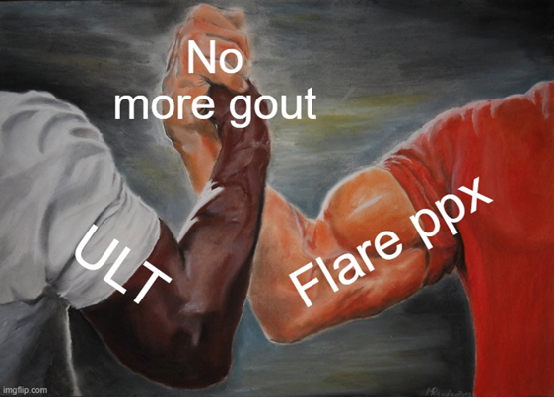
Gout: Treatment (chronic)
Flare prophylaxis
Never start ULT without it
  Colchicine 0.6 mg daily
  Prescription strength NSAID
    Naproxen 500 mg once or twice daily
    Meloxicam 7.5-15 mg daily
  Prednisone 5 mg daily
Marco JL | 2023
27

Slide 28
Osteoarthritis
Marco JL | 2023
28

Slide 29
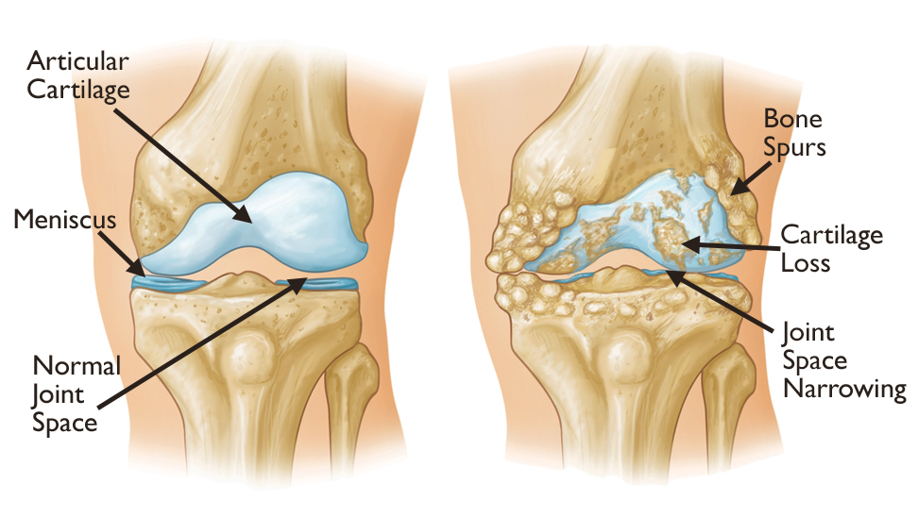
Osteoarthritis
Degenerative Joint Disease
Related to aging, overuse, injuries
Loss of articular cartilage leads to joint friction, loss of ROM, altered biomechanics
“Wear and Tear”
Healing mechanisms < Injury mechanisms
  Injury mechanisms:
    Obesity
    Trauma
    Repetitive micro-injuries
    Anatomic abnormalities
  Decreased healing mechanisms:
    Aging
    Metabolic disease
    Inflammatory disease
Marco JL | 2023
29
Notes:
I personally don’t like the phrase “wear and tear” because as we’ll get to in a few slides, it can make people think “I better not walk or exercise” so they don’t build up more wear and tear, whereas those are the most helpful treatments
Aging-type arthritis

Slide 30
Osteoarthritis: Diagnosis
Clinical diagnosis: Does not require labs or X-rays!
Lifetime risk of developing symptomatic OA is 40-50% (compared to 1-2% for RA, <1% for AS or SLE)
Usually age 55+ unless particular risk factors like trauma or morbid obesity
Gradual onset
Pain worse with exercise/movement, relieved by rest
Mild AM stiffness or after exertion (a few minutes)
May be locking, creaking, crepitus
Marco JL | 2023
30

Slide 31
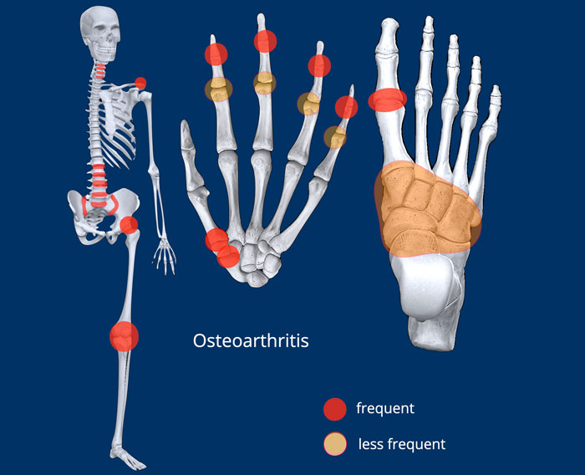
Osteoarthritis: Diagnosis
Joints involved:
Knee
L spine
DIPs
1st CMC
C spine
Hip
PIPs
Feet
Marco JL | 2023
31

Slide 32
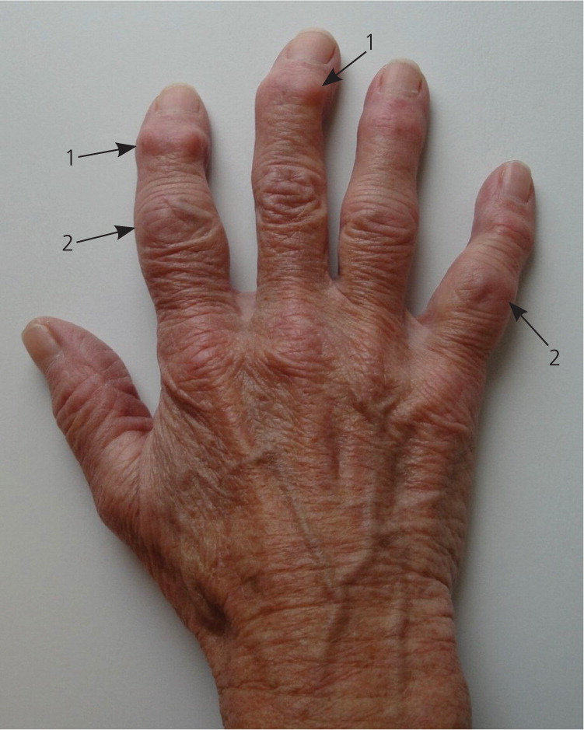
Osteoarthritis: Diagnosis
Physical exam:
Bony swelling/osteophytosis
Minimal or no effusion
Loss of ROM or painful ROM
Crepitus, especially in large joints
No significant warmth or soft tissue swelling
Imaging:
Not needed 90+% of the time
When obtained, expect to see joint space narrowing, osteophytosis, subchondral sclerosis, and/or subchondral cysts
Marco JL | 2023
32

Slide 33
Osteoarthritis: Treatment
Education, education, education
Direct joint treatments:
-Physical therapy or occupational therapy
-Wearing a splint or brace (check with your doctor to find out if this would be helpful for you)
-Arthritis gloves (stretchy compression gloves) if your hands are involved
-Soothing heat: paraffin wax dips, heated arthritis mittens, etc
-Ice after activity
-Over the counter creams and lotions:
-Voltaren gel (anti-inflammatory that works best when applied 3-4 times every day)
-Lidocaine (numbing)
-Capsaicin (hot pepper cream that burns at first, but then causes numbing)
-Biofreeze, Icy Hot, or Tiger Balm (cooling/warming sensations that distract nerves from pain)
Over the counter medicines:
-Tylenol (can be taken every day)
-Ibuprofen, naproxen, or other anti-inflammatories (check with your doctor before taking these every day)
Prescription treatments:
-Prescription-strength anti-inflammatories
-Duloxetine (works on pain nerves)
-Cortisone or Euflexxa injections
-Surgery as a last resort
Marco JL | 2023
33
Notes:
Often patients have a concern that we’re missing something, or they’ve seen the commercials for RA medicines and wonder if something like that would be helpful for them
People need to understand that OA really stinks, but it’s also very common, it’s normal, and for many people it is part of the aging process

Slide 34
Osteoarthritis: Treatment
Direct joint treatments:
Physical therapy or occupational therapy
Wearing a splint or brace (check with your doctor to find out if this would be helpful for you)
Arthritis gloves (stretchy compression gloves) if your hands are involved
Soothing heat: paraffin wax dips, heated arthritis mittens, etc
Ice after activity
Over the counter creams and lotions:
  Voltaren gel (anti-inflammatory that works best when applied 3-4 times every day)
  Lidocaine (numbing)
  Capsaicin (hot pepper cream that burns at first, but then causes numbing)
  Biofreeze, Icy Hot, or Tiger Balm (cooling/warming sensations that distract nerves from pain)
Marco JL | 2023
34

Slide 35
Osteoarthritis: Treatment
Over the counter medicines:
Tylenol (can be taken every day)
Ibuprofen, naproxen, or other anti-inflammatories (check with your doctor before taking these every day)
Prescription treatments:
Prescription-strength anti-inflammatories
Duloxetine (works on pain nerves)
Cortisone or Euflexxa injections
Surgery as a last resort
Marco JL | 2023
35
Notes:
Exception to surgery as a last resort: if someone has bad knee or hip OA and they’re already limping or struggling to walk when they come to your office, just get them in to Ortho for a joint replacement

Slide 36
Fibromyalgia
Marco JL | 2023
36

Slide 37
Fibromyalgia
A Nociplastic Pain Phenomenon
Through neural plasticity responding to past experiences, emotional state, stress/autonomic activation, pain coping behaviors, the brain has “learned” to interpret normal stimuli as pain
Symptoms include:
  Widespread non-inflammatory musculoskeletal pain
  Fatigue
  Sleep disturbance
  Anxiety and/or depression
  Brain fog
Self-preservation mechanism?
Marco JL | 2023
37
Notes:
These patients as we all know, can be suffering immensely, and yet there is no tissue damage occurring, their labs are normal, they could have any number of scans or biopsies and these would only show expected age-related changes

Slide 38
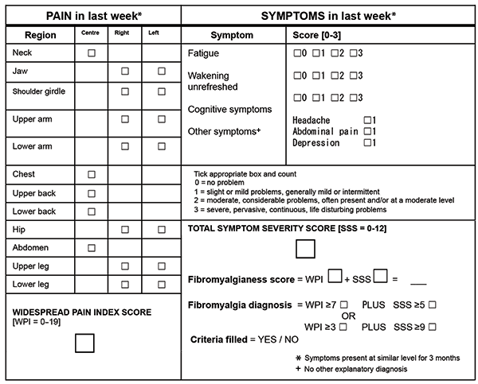
Fibromyalgia: Diagnosis
Diagnostic criteria do exist (More for research and trials than for clinical use)
Generalized pain, defined as pain in at least 4 of 5 regions, is present.
Symptoms have been present at a similar level for at least 3 months.
Widespread pain index (WPI) ≥ 7 and symptom severity scale (SSS) score ≥ 5 OR WPI of 4–6 and SSS score ≥ 9.
Marco JL | 2023
38

Slide 39
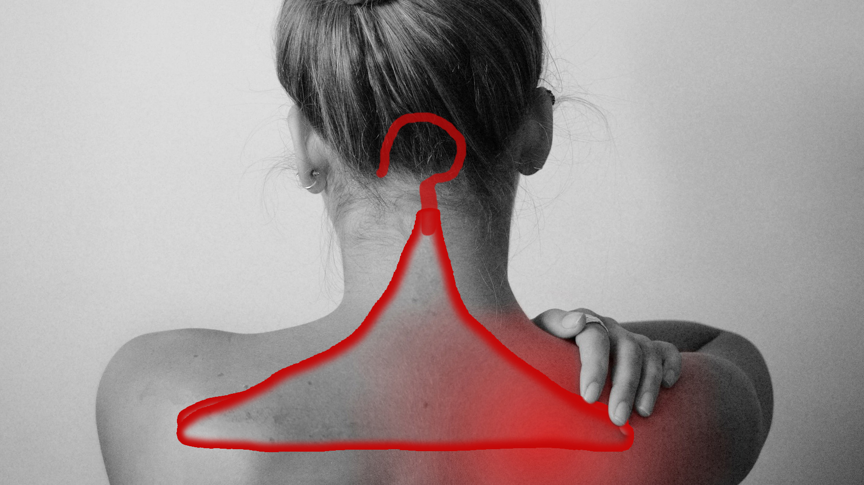
Fibromyalgia: Diagnosis
Widespread musculoskeletal pain
  Complaints tend to be severe yet somewhat vague or non-localized
  If an area is particularly worse, it tends to be the coat hanger area
Fatigue
Sleep disturbance
Mood or anxiety problems
Morning stiffness
Brain fog
Exercise intolerance
Allodynia/Hyperalgesia/Paresthesias
Minimal response to NSAID or low dose prednisone
Other nociplastic syndromes like IBS, chronic migraines, etc
Marco JL | 2023
39

Slide 40
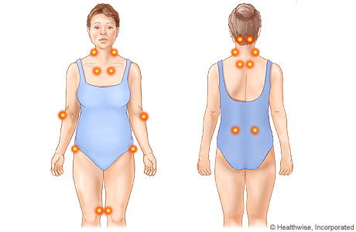
Fibromyalgia: Diagnosis
Tender points: helpful but NOT needed for diagnosis
General allodynia is common
May be significant tenderness and pain on ROM, but there should be no swelling, warmth, or loss of ROM
NOT a diagnosis of exclusion
Marco JL | 2023
40
Notes:
For patients with some clinical features that don’t make sense, or if there’s a strong family history of autoimmunity, go ahead and get a good workup. But for the vast majority of fibromyalgia patients, their symptoms are exactly as expected for fibro and you do not have to make them get exhaustive testing to make the diagnosis

Slide 41
Fibromyalgia: Treatment
Fibromyalgia is a disorder of nerve dysfunction and hypersensitivity that results in chronic pain, fatigue, difficulty exercising, and many other bothersome symptoms.
There are many different treatment options for fibromyalgia. Patients often do best when they address issues in all four categories below.
Exercise
  The goal is to work up to 30 minutes of light exercise every day. This can be anything that gets your body moving, such as walking, dancing, swimming, or stretching.
  Yoga and Tai Chi can be particularly helpful since they combine exercise with meditation.
  Start with a level of exercise that you can sustain every day, without feeling wiped out the next day.
  If an exercise you do wipes you out later that day or the next day, that's a sign your body wasn't ready for that yet. Let yourself recover, then back off a little next time, and do something shorter or less intense.
  Gradually work up to a goal of 30 minutes every single day.
Sleep
  Make sure you are getting 8 hours of sleep regularly.
  Follow tips for "sleep hygiene" found here: sleepfoundation.org/articles/sleep-hygiene
  If you snore or wake up feeling unrefreshed, talk to your doctor about whether you need to be tested for sleep apnea.
Mental Health
  Work on reducing or avoiding stressful situations in your life.
  If you have symptoms of anxiety or depression, talk to your primary care doctor about treatment options.
  Practice mindfulness and meditation in your daily life. Try apps like Insight Timer, Headspace, or Ten Percent Happier. I recommend making meditation a part of your daily routine, even if it's only for 5 minutes a day.
Medication
  Medications that can help fibromyalgia include gabapentin (Neurontin), duloxetine (Cymbalta), milnacipran (Savella), amitriptyline (Elavil), and pregabalin (Lyrica).
  Over-the-counter pain relievers such as acetaminophen (Tylenol) or ibuprofen (Motrin) can be helpful as well. Talk to your doctor before taking these on a daily basis.
  There are no supplements proven to help fibromyalgia, but some patients find relief with turmeric and/or ginger, which have anti-inflammatory effects.
Marco JL | 2023
41
Notes:
One of the reasons why we find fibromyalgia so difficult to treat or manage is because modern medicine teaches us to write a prescription or do a procedure to fix a problem. That works great for biomedical problems like an infection or a broken bone. That does not work well for “nociplastic” or “biopsychosocial” problems like fibromyalgia. As medical providers we really like to fix people and we find it frustrating when patients don’t get fixed. If you’re ever feeling frustrated by a fibro patient, don’t take it out on them

Slide 42
Fibromyalgia: Treatment
Exercise
  The goal is to work up to 30 minutes of light exercise every day. This can be anything that gets your body moving, such as walking, dancing, swimming, or stretching.
  Yoga and Tai Chi can be particularly helpful since they combine exercise with meditation.
  Start with a level of exercise that you can sustain every day, without feeling wiped out the next day.
  If an exercise you do wipes you out later that day or the next day, that's a sign your body wasn't ready for that yet. Let yourself recover, then back off a little next time, and do something shorter or less intense.
  Gradually work up to a goal of 30 minutes every single day.
Marco JL | 2023
42

Slide 43
Fibromyalgia: Treatment
Sleep
  Make sure you are getting 8 hours of sleep regularly.
  Follow tips for "sleep hygiene" found here: sleepfoundation.org/articles/sleep-hygiene
  If you snore or wake up feeling unrefreshed, talk to your doctor about whether you need to be tested for sleep apnea.
Marco JL | 2023
43

Slide 44
Fibromyalgia: Treatment
Mental Health
  Work on reducing or avoiding stressful situations in your life.
  If you have symptoms of anxiety or depression, talk to your primary care doctor about treatment options.
  Practice mindfulness and meditation in your daily life. Try apps like Insight Timer, Headspace, or Ten Percent Happier. I recommend making meditation a part of your daily routine, even if it's only for 5 minutes a day.
Marco JL | 2023
44

Slide 45
Fibromyalgia: Treatment
Medication
  Medications that can help fibromyalgia include gabapentin (Neurontin), duloxetine (Cymbalta), milnacipran (Savella), amitriptyline (Elavil), and pregabalin (Lyrica).
  Over-the-counter pain relievers such as acetaminophen (Tylenol) or ibuprofen (Motrin) can be helpful as well. Talk to your doctor before taking these on a daily basis.
  There are no supplements proven to help fibromyalgia, but some patients find relief with turmeric and/or ginger, which have anti-inflammatory effects.
Marco JL | 2023
45
Notes:
I purposely put medications last on the list of things patients should do.
Meds typically help with fibro symptoms by about 20-30%. Some patients say yes please, and some people feel like only 20% is not worth it to take a daily pill

Slide 46
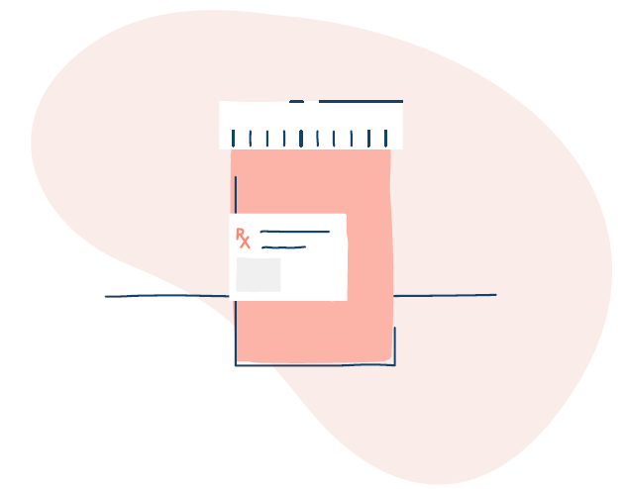
Fibromyalgia: Treatment
Gabapentin (gabapentinoid)
  Typically start 300 mg qhs→300 mg bid→300 mg tid
  Uptitrate up to 900 mg tid
  Many patients prefer bid or qhs dosing only
Pregabalin (gabapentinoid)
  Start 75 mg bid→150 mg bid
Duloxetine (SNRI)
  Start 30 mg qhs→60 mg qhs
Milnacipran (SNRI)
  Starter pack→50 mg bid→100 mg bid
Amitriptyline (TCA)
  Start 25-50 mg qhs→75 mg qhs→100 mg qhs
Low dose naltrexone (opioid antagonist)
  Can only get from compounding pharmacy
  Start 1 mg daily→increase by 0.5 mg every week until at 3-4.5 mg daily
Marco JL | 2023
46

Slide 47
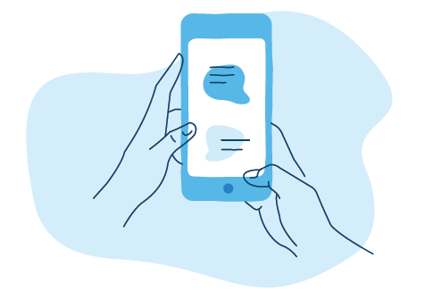
Fibromyalgia: Education
Books:
"The Mayo Clinic Guide to Fibromyalgia." This is written by MDs at the Mayo Clinic and has a lot of helpful details and advice about living with fibromyalgia. (The first chapter is a bit dry but it picks up after that.)
"The Pain Management Workbook" by Rachel Zoffness. This is written by a Stanford pain psychologist and is the same treatment program she uses for her patients, in book form.
Websites:
Tame The Beast (TameTheBeast.org) Videos, stories, and articles on strategies for taming the "beast" of chronic pain
Chronic Pain Champions (ChronicPainChampions.com) Education on living with chronic pain from a chronic pain patient, support groups
Pain Toolkit (PainToolkit.org) Specific advice and strategies for living with chronic pain, also offer coaching classes
PainHEALTH (painhealth.csse.uwa.edu.au) Information on general management of chronic pain as well as specific conditions like fibromyalgia
Pain Science (PainScience.com/articles/fibromyalgia.php) Deep dive into fibromyalgia science
Podcasts:
Mind Your Fibro
Winning at Fibromyalgia
(both hosted by MDs who treat fibromyalgia. Start at the beginning with these podcasts to get the basics before moving on to the more recent episodes that have more advanced topics)
Pain Coaching Class:
Empowered Relief (free and offered in person and online through AHN. Ask me for a referral)
Permission to Move (six week online course, effective and excellent but $$)
Mayo Clinic Pain Rehabilitation Center (3 week in person course, sometimes covered by insurance but sometimes $$$$)
Marco JL | 2023
47

Slide 48
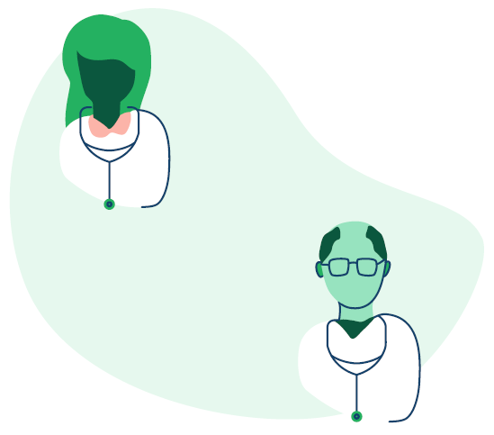
Fibromyalgia: Referrals
Who might I refer to?
Empowered Relief (Free AHN Pain Coaching Class)
Pain Medicine (If you don’t feel comfortable managing medications)
Integrative Medicine (If patient is interested in massage, medical MJ, non-Western treatments)
Psychology/Psychiatry (For patients with significant mental health issues that they want to work on)
Rheumatology (When there is suspicion for autoimmune disease)
Neurology (When there is suspicion for organic neurologic disease)
Marco JL | 2023
48

Slide 49
Questions?

