Slide 1
Patient Blood Management & Bloodless Medicine
Carey Mancuso, MSN, FNP-BC
Clinical Director
Allegheny Health Network

Slide 2
Agenda
Patient Blood Management
Bloodless Medicine
Anemia
Consults/Support
Questions?

Slide 3
AHN PBM Team
Kathy Gephart, BS, MT, CCRC, Program Coordinator
Molly Kosoglow, RN, MBA, Transfusion Safety Director
Carey Mancuso, MSN, FNP-BC, Clinical Director
Erin Suydam, MD, FACS, Medical Director
AGH PBM Nurses

Slide 4
Patient Blood Management
Evidence based medical and surgical approaches to decrease blood loss and to enhance blood production. This approach reduces morbidity and mortality risks, reduces or eliminates the need for blood transfusions, and improves patient outcomes.
Standard of Care

Slide 5
Patient Blood Management Goals
Improved clinical outcomes
Early anemia evaluation and management
Use of evidence-based transfusion guidelines
Minimizing iatrogenic blood loss
Intraoperative strategies for hemostasis and blood salvage
Staff education and monitoring
Decreased blood waste
Decreased cost

Slide 6
Bleeding and Surgical Adjuncts
Thromboelastographic guided resuscitation
Reversal of anticoagulant/antiplatelet drugs
Minimally invasive surgical techniques
Electrocautery
Hemostatic agents
Intra-operative cell salvage
Normovolemic Hemodilution
Hemopure (bovine hemoglobin)

Slide 7
AHN PBM Team
Monitoring Blood Waste
Vitalant Blood Drives
Inpatient and Outpatient Consults
Transfusion Safety
Education
Quality Improvement

Slide 8
Blood: A Life Saving Resource
High surgical estimated blood loss
Liver transplant recipients
Trauma patients

Slide 9
A Limited Resource
~ 38% of the US population eligible to donate blood (red cross)
Only about 3% donate blood each year (red cross)
Cancellations due to illness, weather, and staffing
Pandemic, flu season
Low donor turn out
Climate disasters

Slide 10
Allogeneic Blood Transfusion Risks
Prolonged hospital LOS
Respiratory and urinary tract infections (immunomodulation)
Increased 90-day mortality
TACO
TRALI
Hemolytic Reactions
Surgical-site infection in total knee and hip arthroplasties

Slide 11
Intraoperative Transfusions
American College of Surgeons: National Surgical Quality Improvement Program
121 hospitals, 125,177 patients
4,788 received transfusions
Patients receiving a single unit of PRBC’s had higher rates of surgical site infections, urinary tract infections, pneumonia, sepsis/shock, composite morbidity, and 30-day mortality

Slide 12
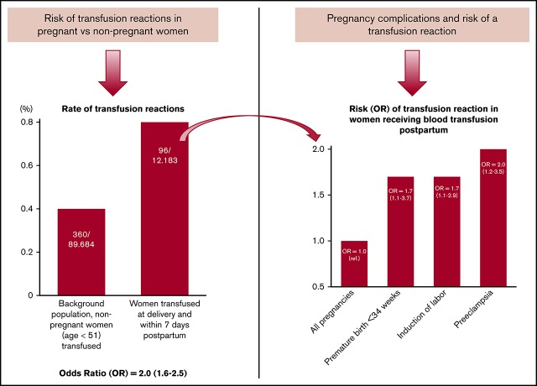
Pregnancy Related Risks
Notes:
Antibodies toward HLA are seen in 10% to 50% of all pregnant women and increase with the number of pregnancies
Incidence of TR in postpartum transfusion: 79 per 100,000 and in non pregnant women 40 per 100,000
Preeclampsia single most independent risk factor for transfusion reaction

Slide 13
Why Reduce Transfusions?
Red cell transfusion is given to increase oxygen delivery to tissues
Once this clinical target is met, additional blood increases risk/cost without added benefit
Managing transfusions appropriately benefits patient safety and cost, the community blood supply and the financial resources of the hospital

Slide 14
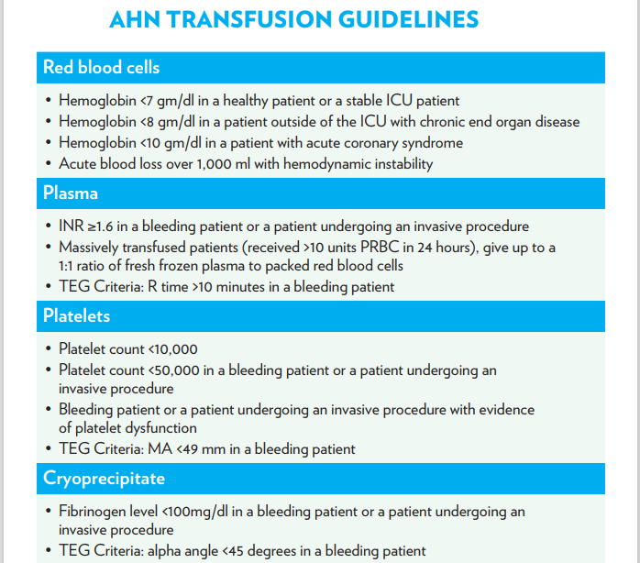

Slide 15
Bloodless Medicine and Surgery
Surgical and medical techniques without the use of blood products
Religious wishes instigated the need for research and new techniques, which resulted in the reduction of mortality rates directly related to blood transfusions

Slide 16
Who Refuses Blood?
Jehovah’s Witnesses
Organ transplant recipients
Family/personal history of blood transfusion reaction or infection
Those who do not want to receive COVID 19 vaccinated blood products

Slide 17
Religious Refusal of Blood
Jehovah’s Witnesses decline red cells, platelets, plasma and white cells
May accept minor blood fractions (substances taken out of the four major components) based on their own conscience around these products
Procedures and equipment that take the blood from their body can be a conscience matter for these patients

Slide 18
Religious Refusal of Blood
Minor blood fractions include albumin, immunoglobulins, interleukins, interferons, antithymoglobulin (horse/rat minor fraction)
Conscience matters surrounding procedures/equipment such as cell tagging, autologous platelet gel, epidural blood patch, hemodialysis, ECMO, normovolemic hemodilution and intraoperative cell salvage
Spiritual support through the Hospital Liaison Committee

Slide 19
Treatment Strategies
Anemia Vitamins: B12, Folic Acid, Vitamin C
Iron tablets and infusions
Erythropoiesis Stimulating agents
Hyperbaric Therapy
Bleeding/Surgical adjuncts
Bloodless Surgery – surgical techniques that may take more time, but significantly limit blood loss during procedures

Slide 20
Anemia in Pregnancy
Most common cause is iron deficiency due to significant increase in iron demand
Associated with:
Preterm birth
Low for birth weight infants
Post-partum hemorrhage
Post-partum depression
Low IQ/developmental delays
Maternal and fetal morbidity and mortality

Slide 21
Iron Deficiency risks to Fetus
Decreased iron supply to fetus when maternal iron is < 13.4
Decreased placental iron transport when hemoglobin < 10
Can create fetal hippocampal dysfunction which results in deficient memory recognition and altered speed of processing
Low maternal iron intake in 2nd trimester associated with 30% increased risk of schizophrenia (gene activation with iron deficiency in preclinical trials)
Link between low 1st trimester iron intake and risk of autism
Up to 30% of child with ASD are iron deficient
Symptoms of autism are more severe if child is iron deficient

Slide 22
Preoperative Anemia
Common
Majority is iron deficiency
Associated with increased perioperative morbidity and mortality
3-fold increase in death in cardiac surgery patients
Associated with a 2-6-fold increased risk of perioperative transfusion
Treatable

Slide 23
Inpatient Consults
Available remotely at every AHN hospital (epic order)
Referral:
Blood Transfusion Refusal – will not accept blood to preserve life
Blood Transfusion Avoidance – will not accept blood unless to save life
Blood conservation strategies

Slide 24
Iron Deficiency Anemia Clinic
Available network wide
Telemedicine Only (including telephone)
Referral for IV iron to cancer centers, medical short stays, Jefferson infusion center
Anemic Pregnant, Anemic Preoperative and all Bloodless Medicine Patients
Utilize “Ambulatory Referral to Bloodless medicine/Patient Blood Management”

Slide 25
Preoperative Referral
EBL > 500 mL/High risk; hemoglobin < 13 in both men and women
Ferritin < 30 and/or transferrin saturation < 20%
EBL 50 - 500 mL; hemoglobin < 11
Ferritin < 30 and/or transferrin saturation < 20%
Jehovah’s Witness/Blood Transfusion Refusal

Slide 26
Treatment Approach
ASA, ASH, SABM recommendations
Surgery within 8 weeks: Iron infusions +/- oral iron
Otherwise, treatment per evaluation and discussion
Repeat labs 2 weeks after iron infusions to ensure improvement
Most significant benefit expected after 4 weeks
If possible, delay surgery to achieve maximum benefit
Goal hemoglobin is > 13 or at-least 1 gm increase in hemoglobin

Slide 27
Pregnancy Referral
Women’s Institute Protocol
Hemoglobin < 11 and ferritin < 30 – consider IV iron
Normal hemoglobin with ferritin < 30
Ferritin > 30 with findings of iron deficiency on iron panel
Possible future changes to ferritin threshold

Slide 28
Treatment Approach
Oral iron in first trimester
Consider IV iron in second trimester if failing oral iron treatment/poor tolerance/poor compliance
Likely IV iron in third trimester
Close follow up to evaluate response to therapy
6-week post partum labs

Slide 29
Additional Pregnancy Considerations
Treat iron deficiency ASAP
Draw B12, Folate and Copper Levels
Hemoglobin electrophoresis for MCV < 80
Education on an iron rich diet
Intraoperative Cell Salvage for scheduled cesarean sections
Identify your pre-conception patients
2015 Cochrane review found that early iron supplementation reduced maternal anemia at term by 70%

Slide 30
Blood Transfusion Refusal Form

Slide 31
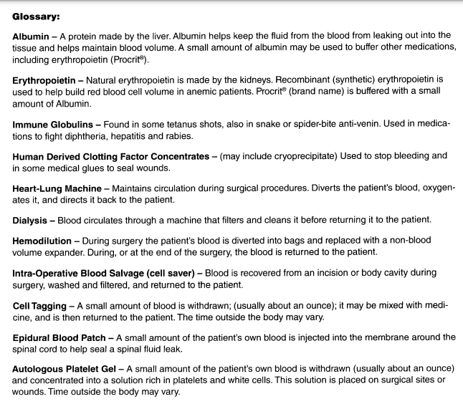

Slide 32
In Conclusion
Every Patient is a Transfusion Avoidance Patient
Refer Bloodless Medicine Patients Early
Evaluate and Treat Anemia Early – add it to your problem list
Treat Iron Deficiency in Pregnancy
Limit Phlebotomy
Know the Evidence-based Transfusion Guidelines to advocate for your patients (PBM website)
Notes:
Managing anemia proactively can prevent your patient from needing a transfusion even years from now

Slide 33
Get Involved
PBM Committee
SABM Patient Blood Management Certification Course
Partnership
Reach out to me anytime through Epic

Slide 34
Contacting the AHN Office of Patient Blood Management and Bloodless Medicine
412-359-8787
1-877-284-2100
Kathy.Gephart@ahn.org
Program Coordinator
Molly.Kosoglow@ahn.org
Transfusion Safety Director
Carey.Mancuso@ahn.org
Clinical Director
Erin.Suydam@ahn.org
Medical Director

Slide 35
Resources
Society for the Advancement of Blood Management https://sabm.org/
Bloodless Medicine and Surgery Society https://bmssociety.org/#!/pages/home/index
American Association of Blood Banks https://www.aabb.org
World Health Organization https://www.who.int/publications/i/item/9789240035744
Choosing Wisely Campaign https://www.choosingwisely.org/
https://highmarkhealth.sharepoint.com/sites/AHN-PatientBloodManagement/

Slide 36
References
Beverina, I., Aloni, A., & Brando, B. (2021). Impact of gender parity on preoperative anaemia prevalence and Patient Blood Management practice. Blood transfusion = Trasfusione del sangue, 19(5), 396–402. https://doi.org/10.2450/2020.0158-20
Georgieff M. K. (2017). Iron assessment to protect the developing brain. The American journal of clinical nutrition, 106(Suppl 6), 1588S–1593S. https://doi.org/10.3945/ajcn.117.155846
Govindappagari S, Burwick RM. Treatment of Iron Deficiency Anemia in Pregnancy with Intravenous versus Oral Iron: Systematic Review and Meta-Analysis. Am J Perinatol. 2019 Mar;36(4):366-376. doi: 10.1055/s-0038-1668555 Epub 2018 Aug 19. PMID: 30121943
Hofmann, A., Shander, A., Blumberg, N., Hamdorf, J. M., Isbister, J. P., & Gross, I. (2022). Patient Blood Management: Improving Outcomes for Millions While Saving Billions. What Is Holding It Up?. Anesthesia and analgesia, 135(3), 511–523. https://doi.org/10.1213/ANE.0000000000006138

Slide 37
References
https://www.facs.org/quality-programs/data-and-registries/acs-nsqip/
Jadunandan, S., Tano, R., Vicus, D., Callum, J., & Lin, Y. (2022). The incidence of perioperative anemia and iron deficiency in patients undergoing gyne-oncology surgery. Canadian oncology nursing journal = Revue canadienne de nursing oncologique, 32(1), 75–80. https://doi.org/10.5737/236880763217580
Juul, S. E., Derman, R. J., & Auerbach, M. (2019). Perinatal Iron Deficiency: Implications for Mothers and Infants. Neonatology, 115(3), 269–274. https://doi.org/10.1159/000495978
Shao, J., Lou, J., Rao, R., Georgieff, M. K., Kaciroti, N., Felt, B. T., Zhao, Z. Y., & Lozoff, B. (2012). Maternal serum ferritin concentration is positively associated with newborn iron stores in women with low ferritin status in late pregnancy. The Journal of nutrition, 142(11), 2004–2009. https://doi.org/10.3945/jn.112.162362
Stanley, A. Y., Wallace, J. B., Hernandez, A. M., & Spell, J. L. (2022). Anemia in Pregnancy: Screening and Clinical Management Strategies. MCN. The American journal of maternal child nursing, 47(1), 25–32. https://doi.org/10.1097/NM
Thurn, L., Wikman, A., Westgren, M., & Lindqvist, P. G. (2019). Incidence and risk factors of transfusion reactions in postpartum blood transfusions. Blood advances, 3(15), 2298–2306. https://doi.org/10.1182/bloodadvances.2019000074

Slide 38
References
Shao, J., Lou, J., Rao, R., Georgieff, M. K., Kaciroti, N., Felt, B. T., Zhao, Z. Y., & Lozoff, B. (2012). Maternal serum ferritin concentration is positively associated with newborn iron stores in women with low ferritin status in late pregnancy. The Journal of nutrition, 142(11), 2004–2009. https://doi.org/10.3945/jn.112.162362
Stanley, A. Y., Wallace, J. B., Hernandez, A. M., & Spell, J. L. (2022). Anemia in Pregnancy: Screening and Clinical Management Strategies. MCN. The American journal of maternal child nursing, 47(1), 25–32. https://doi.org/10.1097/NM
Thurn, L., Wikman, A., Westgren, M., & Lindqvist, P. G. (2019). Incidence and risk factors of transfusion reactions in postpartum blood transfusions. Blood advances, 3(15), 2298–2306. https://doi.org/10.1182/bloodadvances.2019000074

Slide 39
Questions?

