Slide 1
Effective Stewardship Leadership Reflecting on my experience as IDSA President during start of COVID
Thomas M File Jr. MD, MSc, MACP, FIDSA, FCCP
Chair, Infectious Disease Division
Summa Health System, Akron, Ohio;
Professor of Internal Medicine, Chair ID Section
Northeast Ohio Medical University
Rootstown, Ohio
Past President, Infectious Diseases Society of America

Slide 2
Disclosures
Industry:
While a member of IDSA Exec Committee no monetary relationship
Past: Nabriva Therapeutics-consultant, research grant; Pfizer-research grant
Editor-in-Chief:
Infectious Diseases in Clinical Practice
Author/Section Editor: UpToDate
Respiratory Infections

Slide 3
LEARNING OBJECTIVES
At the end of this lecture, the learner will be able to:
Describe key skills and practices of effective leaders.
Discuss ways to apply leadership skills to improve the antimicrobial stewardship team.
Reflect on impact of leadership during COVID-19
Will review some of mine.

Slide 4
What is a Leader?
Variety of images:
A political leader pursuing a personal cause
An explorer, cutting a path through a jungle for the rest of a group
A company executive developing a strategy to “beat” the competition
A superhero: Wonder Woman; Superman
Mind Tools Ltd

Slide 5
Leadership
Leadership is practical skill regarding the ability of an individual or organization to “lead” or guide other individuals, teams, or entire organizations .
From “free encyclopedia”

Slide 6
LEADERS ESTABLISH ANTIMICROBIAL STEWARDSHIP AS AN
ORGANIZATIONAL PRIORITY
As emphasized by TJC standards and IDSA guidelines, strong leadership commitment is critical to the success of an ASP.
Achieved via identifying healthcare leaders and promoting ASP as a patient care, safety, and quality issue.
The physician and pharmacist co-leading ASP requires strong leadership skills, including trust, confidence, and willingness to stand on principles. Simply appointing a person to lead ASP does not qualify the individual as a leader.
Clin Infect Dis. 2017

Slide 7
The ASP (Co)Director needs to be able to:
engage
motivate
inspire
influence others
not fear confrontation.

Slide 8
Attributes of an Effective Leader
Commands respect of peers
Inspires trust
Motivates the team
Maintains long-range perspective
Aligns and Improves systems or develops new ones
Creates, anticipates, and recognizes opportunity
Ostrowsky B et al. Clin Infect Dis. 2018; DOI: 10.1093/cid/cix1093

Slide 9
The purpose of this guidance document is to outline the knowledge and skills that are needed to lead an antimicrobial stewardship program.
Society for Healthcare Epidemiology of America has partnered with other leaders in advancing the field of antimicrobial stewardship, including:
Infectious Diseases Society of America,
Making-A-Difference in Infectious Diseases,
National Foundation of Infectious Diseases,
Pediatric Infectious Diseases Society,
Society of Infectious Disease Pharmacists
Infection Control and Hospital Epidemiology. 2014; 35:1444-1451

Slide 10
Category | Knowledge | Skill
General Principle of ASP | Understand goals of ASP, linkage between ABX use and resistance, Roles of Stakeholders | State goals; Describe ABX use and Resistance; list persons/disciplines
Approached to ASP interventions | Describe common methods of intervention; how to educate | Determine best approach for intervention and education on the basis of different scenarios within different healthcare settings
Antimicrobials | Understand spectrum, dosing, AEs, and allergies to different classes of ABX | Assess for AEs, true allergy; Understand PD and dosing of vancomycin, aminoglycosides, colistin

Slide 11
Category | Knowledge | Skill
Program Building and Leadership | Understand the complex interpersonal and interprofessional needs to best develop and sustain an ASP Understand how your ASP intersects with the institution’s mission and strategic plan Understand how to write and present a plan and business case to institutional leadership for ASP for initial establishment of a program | Develop and maintain communication and conflict resolution skills to assist in communication with a variety of stakeholders Adapt stewardship to mission and strategic initiatives within institution; reflect how the ASP helped in meeting local goals Develop and present a report detailing rationale for ASP and proposed benefits, including financial and improvement in patient safety and justification, for funding of proposed team members; list roles of each member

Slide 12
Category | Knowledge | Skill
Program Building and Leadership | Understand how to obtain physician and pharmacists buy in for a program or intervention Understand basic theories regarding patient safety, quality Understand the medical-legal implications of a stewardship program at your institution Understand unique challenges for implementing and ASP across multiple institutions or within a health system | Develop/present educational material regarding benefits of ASP; roles of members of team; approach for outliers Effectively communicate benefit of ASP for patient safety and quality Work with the risk management and legal depart to know the medical-legal ramifications of institutional stewardship Assess use and needs of each separate institution and identify common strategies for implementation

Slide 13
Habits of highly effective people
8. From Effectiveness to Greatness
Great achievers expressing their voice through the use of their intelligences. Achievers for example
develop their mental energy into vision
develop their physical energy into discipline
develop their emotional energy into passion
develop their spiritual energy into conscience – their inward moral sense of what is right and wrong and their drive towards meaning and contribution.[
"5 Cancerous Behaviors” that inhibit people's greatness:
Criticism
Complaining
Comparing
Competing
Contending
Covey SR. The 8th Habit: from Effectiveness to Greatness. Free Press, 2004. NY

Slide 14
Qualities of a Good Leader
Credibility
Honesty (Know what you don’t know)
Evidence
Communication
Accuracy and Transparency
Conciliation
Collaboration; Consensus Building
Source: File T

Slide 15
Chloe Chong

Slide 16
COMPREHENSIVE RESPONSE TO COVID-19
Rapid Guidelines
Media Briefings
Seminal Research
A Remarkable Time for the ID Field
Notes:
The past year-and-a-half has been a remarkable time for the infectious diseases community. IDSA and HIVMA – and the entire nation – are eternally grateful to you for your selfless work, for your commitment to science, and for your compassion for patients. While you are working in your respective roles, IDSA and HIVMA have been here, supporting you, building programs to assist you in your fight against not only COVID-19, but also the HIV epidemic and future pandemics as well. Here’s a short overview of some of the programs and initiatives to address the COVID crisis that could not have been possible over the past year-and-a-half without the support of our members.

Slide 17
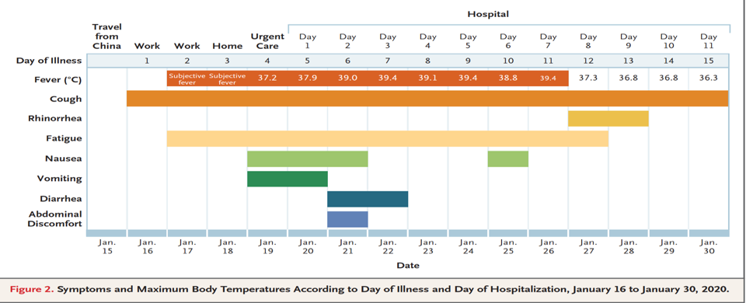
Clinical Fellows Meeting, January 16-18, 2020; Naples , Fla.
-----------------------------------------------------------------------------------------------
NEJM

Slide 18
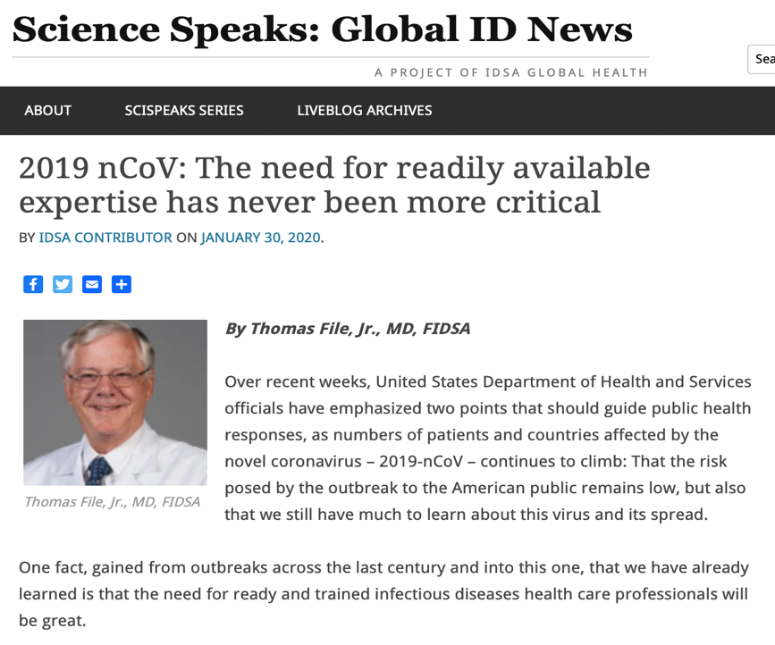

Slide 19
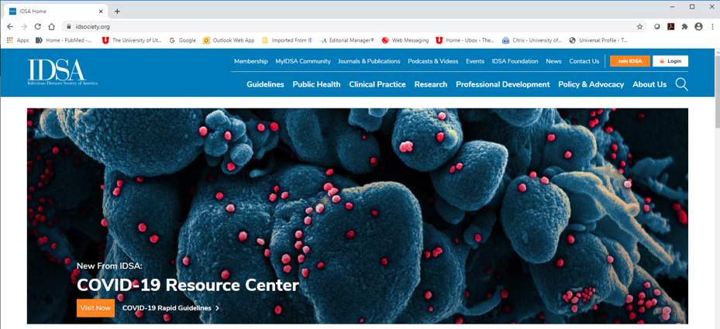
The Pivot to COVID-19

Slide 20
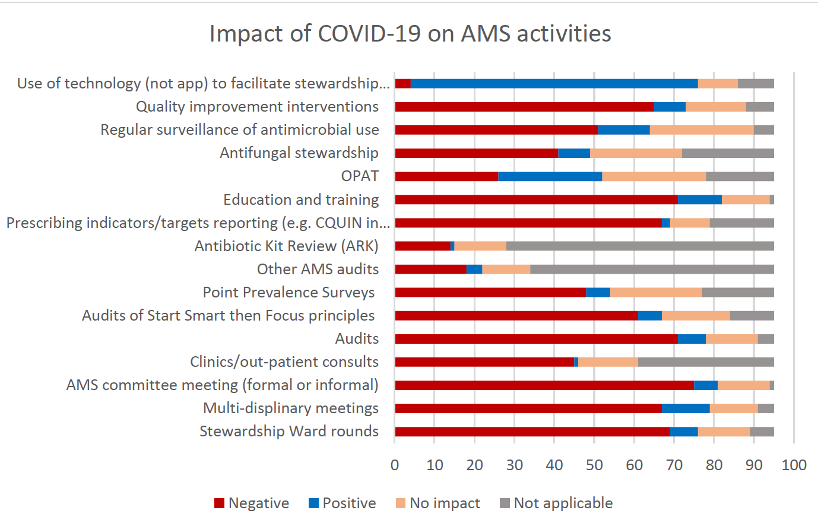
Antibiotics 2021, 10, 110. https://doi.org/10.3390/antibiotics10020110

Slide 21
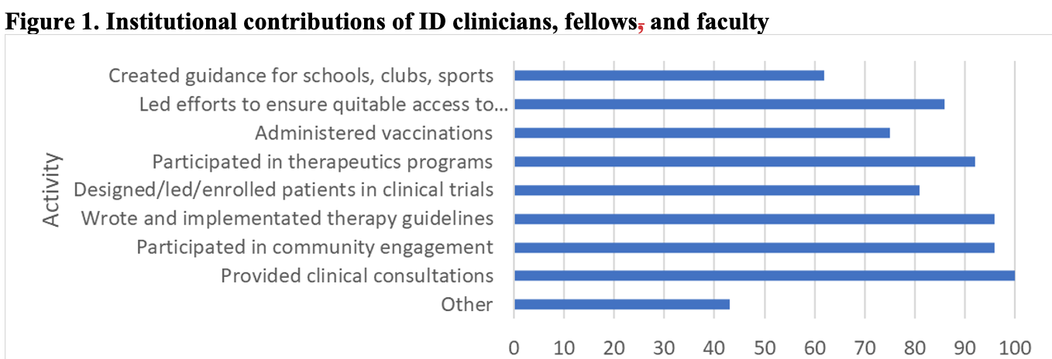
IDSA Survey 2022

Slide 22
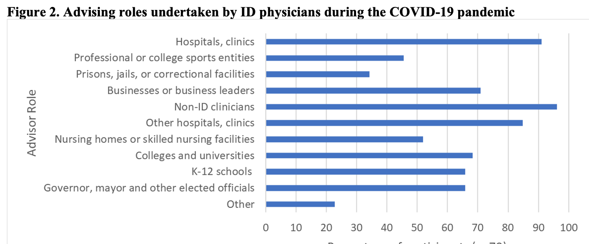
IDSA Survey 2022
“We [ID practitioners] are part of the public health infrastructure without working for public health. We are part of the safety net of public health. Public health and clinical medicine overlap during a pandemic. That overlap is where we sit.” IDSA Colleague

Slide 23
Habits of highly effective people
Put First Things First
What is important what is urgent
Important and urgent
Important and not Urgent
Not important and Not Urgent
Covey SR. The 7 Habits Of Highly Effective People. Free Press, 1989. NY.

Slide 24
Habits of highly effective people
Put First Things First
What is important what is urgent
Important and urgent
Important and not Urgent
Not important and Not Urgent
CAPACITY MANAGEMENT
Covey SR. The 7 Habits Of Highly Effective People. Free Press, 1989. NY.

Slide 25
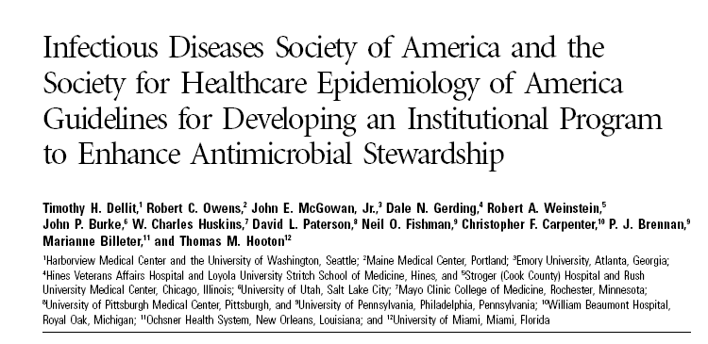
Antimicrobial Stewardship: Credibility
Definition
“An ongoing effort…to optimize antimicrobial use in order to improve patient outcomes, ensure cost-effective therapy, and reduce adverse sequelae of antimicrobial use (including antimicrobial resistance)”
Dellit T, et al. Clin Infect Dis. 2007;44:159-177.

Slide 26
….refers to selecting the most obtainable targets rather than confronting more complicated management issues.
intravenous-to-oral conversions,
batching of intravenous antimicrobials,
Therapeutic substitutions,
formulary restriction.
….require fewer resources and less effort than other ASP activities; are applicable to a variety of healthcare settings, including limited resource hospitals
… have demonstrated significant financial savings.
($832 590 at OSU)
Clin Infect Dis. 2012; 55: 587-92

Slide 27
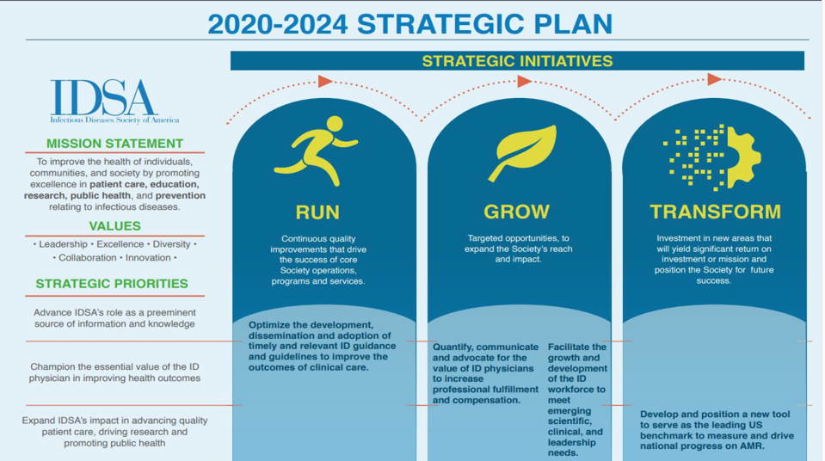
Guidelines ID Compensation AMR
ID Workforce
Inclusion; Diversity; Equity; Access
Strategic Planning Retreat: Compensation; AMR

Slide 28
2021; 113: 103-8

Slide 29
2021; 113: 103-8
Use of Procalcitonin and Antimicrobial Stewardship Intervention to Limit Antibiotic Utilization in Patients admitted to a Community Teaching Hospital with SARS-CoV-2 Infection
Paula A Politis, PharmD BCPS, BCIDP: Michael Oravec, MPH, PhD; Lisa Hoisington, PharmD, BCPS; Michael Tan, MD, FACP, FIDSA; Shanu Agarwal, MD, FIDSA; Thomas M File Jr. MD MSc MACP FIDSA FCCP

Slide 30
“Leadership and learning are indispensable to each other.”
John F Kennedy
“True leaders are the first to admit they don’t know everything and that they need help.”
Bill Byrd

Slide 31
COMPREHENSIVE RESPONSE TO COVID-19
Rapid Guidelines
Media Briefings
Seminal Research
Rapid Guidelines
Media Outreach
Seminal Research
Strategic Partnerships
Notes:
With the pandemic hitting at the very heart of our mission, IDSA immediately began directing staff, volunteer and financial resources to a comprehensive society-wide response to COVID-19.
Rapid guidelines, produced by member experts in a matter of weeks based on available evidence, have informed COVID-19 treatment and management, infection prevention and diagnostics.
Regular telebriefings with major media outlets and a rapid response to current events have ensured our experts are interviewed daily to share science and combat misinformation.
Our scientific journals have fast-tracked publication for papers submitted and accepted on COVID-19 and have published seminal research that has influenced the response to the pandemic around the world.
In addition, we’ve leveraged partnerships and collaborations with a variety of non-profit organizations and government agencies, such as CDC, to address the COVID-19 pandemic, provide tools and resources to our members and other health care providers, and further our strategic priorities.
I’ll go into a little more detail in all of these areas next.

Slide 32
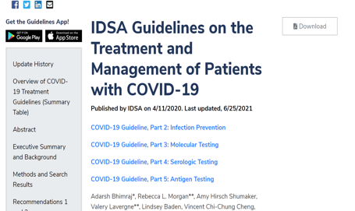
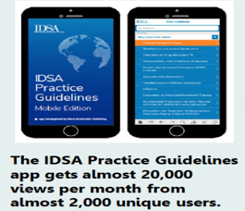
RAPID COVID-19 GUIDELINES TO IMPACT PATIENT CARE
Treatment & Management
Infection Prevention
Molecular Diagnostic Testing
Serologic Testing
Antigen Testing
Notes:
Since the beginning of the pandemic, IDSA has been working to ensure our members and the larger infectious diseases community have the tools and resources they need to make informed decisions related to COVID-19.
To address this need, IDSA developed five rapid guidelines on COVID-19 treatment and management, infection prevention, molecular diagnostic testing, serologic testing and antigen testing. The guidelines include clear and informative summaries of the literature and expert-generated recommendations for care on the topics most pressing to the ID clinical community. They are updated on a continual basis as the literature continues to mature and recommendations require updating.
You can find the latest versions on our website at idsociety.org, or by downloading our guidelines app available for both Apple and Android.

Slide 33
Hydroxychloroquine for SARS-CoV-2 ????
Recommendation 1. Among patients who have been admitted to the hospital with COVID-19, the IDSA guideline panel recommends hydroxychloroquine/chloroquine in the context of a clinical trial. (Knowledge gap)
Recommendation 2. Among patients who have been admitted to the hospital with COVID-19, the IDSA guideline panel recommends hydroxychloroquine/chloroquine plus azithromycin only in the context of a clinical trial. (Knowledge gap)

Slide 34
Hydroxychloroquine for SARS-CoV-2 ????
Recommendation 1. Among patients who have been admitted to the hospital with COVID-19, the IDSA guideline panel recommends AGAINST hydroxychloroquine/chloroquine
(Strong recommendation,
Moderate certainty of evidence)
Recommendation 2. Among patients who have been admitted to the hospital with COVID-19, the IDSA guideline panel recommends AGAINST hydroxychloroquine/chloroquine plus azithromycin (Strong recommendation, Low certainty of evidence)

Slide 35
IVERMECTIN

Slide 36
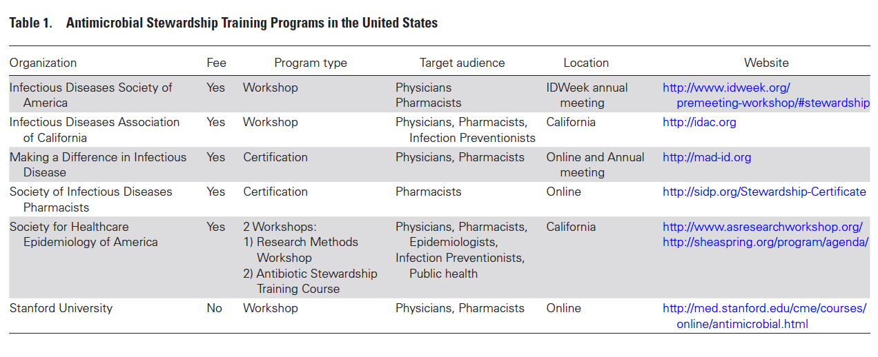
Credibility: Leading with Knowledge
From Goff et al. Clin Infect Dis 2017

Slide 37
Chloe Chong

Slide 38
Communication in an Antimicrobial Stewardship Program
One major theme across all healthcare settings is that ASPs must collaborate with facility leadership and key stakeholders at each institution in order to have an impactful benefit on patient quality of care, and safety¹
A collaborative interprofessional team environment ensures optimal patient-centered care.²
Stewards must navigate complex social and
cultural dynamics in daily work³
1. Beganovic M, LaPlante KL. Rhode Island Med J. June 2018 45-49
2. Foral PA et al. J Am Osteopathic Assoc. 2016; 116: 588-593
3. Szymczak J. IDWeek 2021

Slide 39
Communication: IDSA and the Media
IDSA Press Briefings
Held once or twice a week to assure the science and policy are share with journalists; have led to many media interviews
April 3, 2020:
IDSA Media Briefing:
How the Infectious Diseases Workforce is Preparing
Featuring
Thomas M File Jr. MD MSc FIDSA
Rochelle Wolensky MD MPH FIDSA
IDSA Media relations
Thousands of media requests and 10s of thousands articles

Slide 40
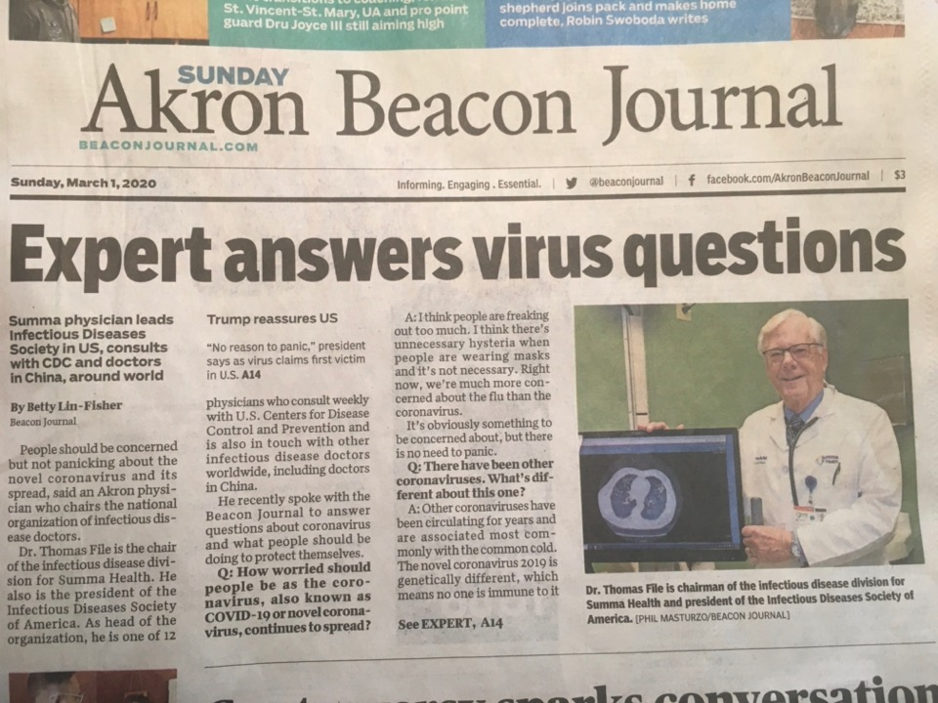

Slide 41
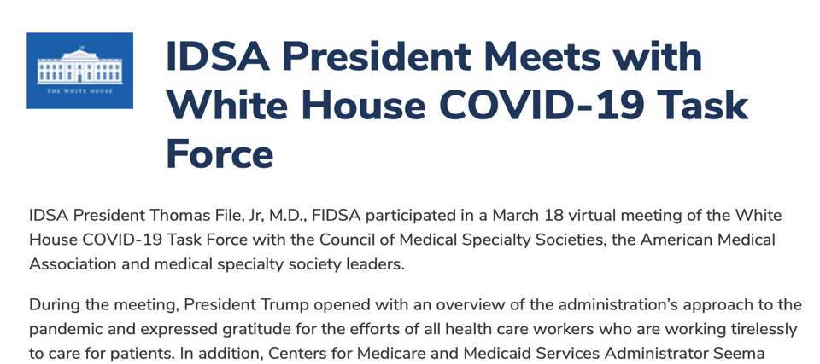
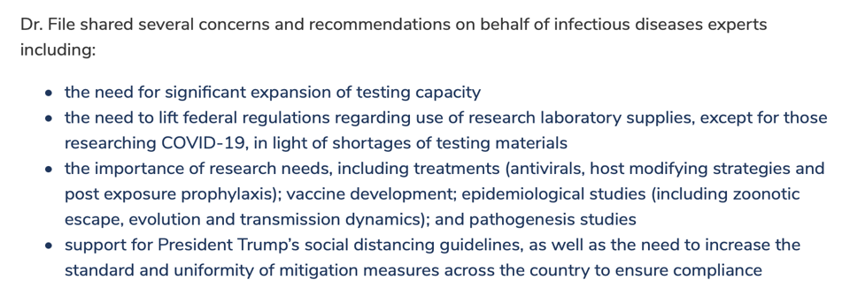

Slide 42
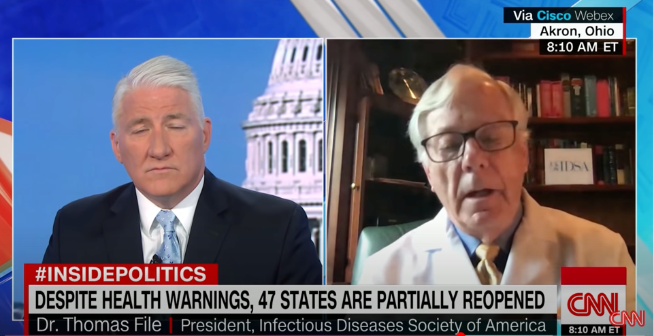
https://www.youtube.com/watch?v=xFO1JlRXHkQ
"As an infectious diseases physician, not a media person, it was actually hard, especially because you were trying to give medical information and trying to do what is medically right, but could be used to support or conflict with a politician’s statement”
IDSA Colleague

Slide 43
Means of Communication
Means
Face-to-face
Often most effective
Email
Chart notes
Part of record or not
Pager
Cell phone
Institutional secure app
Other
EMR sign in reminders
Social Media
In all cases consider Rapport

Slide 44
“A genuine leader is not a searcher for consensus but a molder of consensus.” Martin Luther King Jr

Slide 45
Establishing a successful ASP requires a plan to achieve consensus.
Having support of respected staff is extremely important .
ASP interventions are focused on changing provider prescribing Behavior.
ASP to be presented to the entire medical staff with evidence of the benefit.
Emphasize that ASP is helpful to the clinicians care of patients
Terminology such as “restricted” antibiotics viewed as controlling; can threaten colleagues. Changing the terminology to “protected” conveys a positive message.
Clin Infect Dis. 2016; 63: 532-38

Slide 46
UNDERSTANDING WHY THERE IS A PROBLEM: DUE PROCESS
Understanding is essential for effective interventions
Rejection often observed in more experienced practitioners
relying on past practices that may have had positive outcomes
felt safer.
Provide real-time face-to-face evidence-based REC
allows for understanding of rejection
possible educational resolution of disagreements
may be legitimate reasons for rejection not documented in record
If still problem: Due process
Clin Infect Dis. 2016; 63: 532-38

Slide 47
REFLECTING
THE FACES OF ID
Inclusion, Diversity, Access and Equity Roadmap and Strategies
Cultural Competence Toolkit
IDA&E Supplement in JID
Diverse Slate of New Board Members Elected
Notes:
And in the midst of a pandemic that has disproportionately affected people of color and underserved communities – and as we’re simultaneously facing the impact of our country’s history of systemic racism on the health, well-being and lives of African Americans -- IDSA continues to be resolute in its goal to ensure the principles of inclusion, diversity, access and equity are woven into the fabric of everything we do.
On the Real-Time Learning Network website, we’ve created a section that includes a collection of assessment tools, educational and learning materials, research articles and resources that are curated to help medical professionals and institutions provide culturally competent care and reduce health disparities.
We recently published a second supplement in JID about diversity in the ID field.
And in 2020, we elected the most diverse slate of Board members in the history of the society.
We are committed to building a society based on the principles of inclusion, diversity, access and equity, and this will be reflected in our actions, our processes and policies, and the transparency in which we promote fair treatment and access to opportunities for all members within all levels of the organization.

Slide 48
Qualities of a Good Leader
Credibility
Honesty (Know what you don’t know)
Evidence
Communication
Accuracy and Transparency
Conciliation
Collaboration; Consensus Building
Capacity Management
Source: File T

Slide 49
Assessment Question #1 Which of the following roles or priorities is most important to be an effective leader of stewardship?
Considers all potential actions of the stewardship program of equal priority
Instills a competitive approach to stewardship
Stratifies stewardship decisions based solely on cost
Is a good communicator to the stewardship team, other healthcare providers and the administration
E. Unilaterally decides all questions regarding stewardship issues

Slide 50
Assessment Question #2 Which of the following leadership skill(s) improves the effectiveness of a multidisciplinary antimicrobial stewardship team?
Ability to determine the best approach for communicating intervention recommendations within different healthcare settings
Ability to address conflict resolution
Ability to communicate effectively the overall benefit of stewardship towards patient safety and quality of care Has the respect of administrators and healthcare providers of the institution
All above

