Slide 1
Who said this is my job? The infection preventionist asked to be the antimicrobial steward.
Brooke Decker, M.D.
Deputy, Chief of Staff VA Pittsburgh
VISN 4 Hospital Epidemiologist

Slide 2
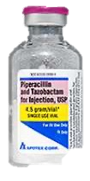
Talk objectives
Describe the unique advantages and opportunities for the Infection Preventionist approaching antimicrobial stewardship.
Discuss strategies and resources to navigate a non-traditional team to accomplish antimicrobial stewardship goals.

Slide 3
In plain language:
You can do this. You are actually at an advantage.
You’re doing it already.
Some strategies to get you energized

Slide 4
But.. Why?
Joint Commission Standards
Need stewardship leaders
Stewardship goal
Implement evidence-based practice
Educational Resources
Collect and analyze data related to goal

Slide 5
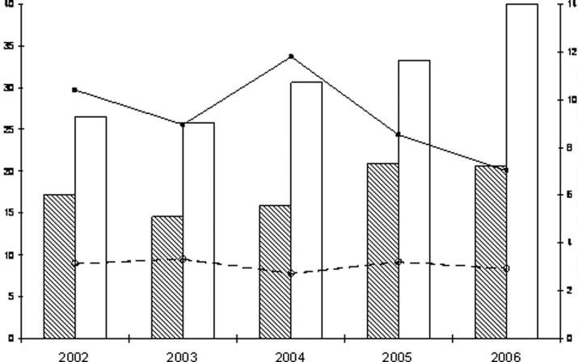
Stewardship reduces MDRO
Mean Resistance Rate
(# isolates/1,000 discharges)
Carbapenem DOT/1,000 Patient-Days
White bars, solid line – Hospitals Without Carbapenem Restriction
Hatched bars, dashed line – Hospitals With Carbapenem Restriction
Pakyz AAC 2009

Slide 6
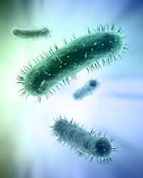
IP – Incredibly Productive
Perform HAI surveillance
Implement isolation precautions
Manage outbreaks
Provide education
Monitor compliance

Slide 7
HAI Surveillance
Monitor/trend incidence over time
First to recognize concerning trends
Already involved with Quality, leadership, and all other forums for getting things done

Slide 8
Controlling outbreaks
Implement best practices
Tell hard truths, help with hard decisions (closing units is much more alarming than restricting antibiotics!)
Not shy about conflict (“Please wash your hands” isn’t much different than “please reconsider 28 days of doxycycline for that mosquito bite”)

Slide 9
Education
Already provide education on complex topics
Adept at communicating with a variety of staff, including licensed independent practitioner
Can emphasize the need for stewardship with data and clinical experience (Cdiff, MDRO…)

Slide 10
The IP advantage
Familiar with MDRO consequences
Frequently underestimated, potentially less-threatening to prescribers
Fluent in statistics and accustomed to gathering and analyzing data
Connected, confident
Communicate, Collaborate, Cooperate

Slide 11
The Stewardship Team
Infection Prevention!
Prescriber (Infectious Diseases?)
Pharmacist (ID PharmD)
Advocate for appropriate expertise!
Enthusiasm and persistence are critical to any endeavor

Slide 12
Stewardship Strategies (IDSA)
Prospective audit
Antibiotic restriction
Education
Guidelines
Descalation/optimizing
IV to PO
Dellit Clin Infect Dis 2007

Slide 13
Stewardship Strategies (IDSA)
Prospective audit
Antibiotic restriction
Education
Guidelines
Descalation/optimizing
IV to PO
Potentially easier for non-prescribers?
Dellit Clin Infect Dis 2007

Slide 14
Restriction, Guidelines
Develop with subject matter experts and implement once fully vetted
IP works as a connector, bringing the deciders together
Approval/Exception process managed by ID/Pharmacy

Slide 15
Treatment Duration
Eas(ier) target for the non-prescriber
Objective, concrete, easy to track
Guidelines exist for major infection types that IP may already be tracking (pneumonia, UTI, SSI, CLABSI)

Slide 16
Education
Natural environment of the IP!
Rely on SME to vet materials – ensure they are frequently reviewed for compliance with updated guidelines
Connect HAI and unnecessary antibiotics for providers – Aha moment!

Slide 17
Teamwork makes the dream work
Infection Control ’s Stewardship
No one does Stewardship alone
Leverage your resources
KNOWLEDGE
CONTACTS
DATA

Slide 18
Which of the following make an Infection Preventionist an ideal advocate for antimicrobial stewardship?
Familiar with the risk and consequences of multidrug resistant bacteria selection
Potentially less-threatening to prescribers who may more readily receive feedback in comparison to another physician.
Fluent in statistics and accustomed to gathering and following data trends over time.
All of the above

Slide 19
Which of the following individuals should be part of an antimicrobial stewardship team?
Infectious Diseases Provider
ID Pharmacist
Infection Preventionist
All of the above

Slide 20
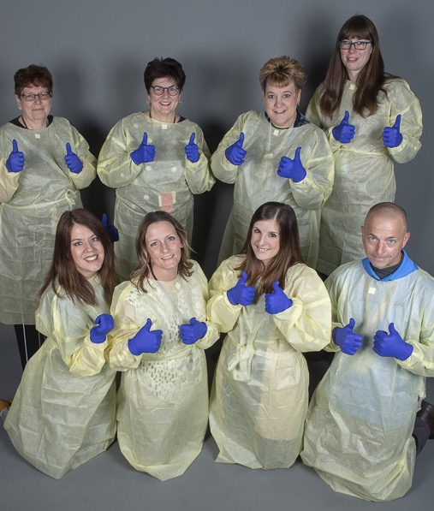
Questions
(Picture from the before times)

