Slide 1


Dustin Carr, PharmD, BCPS, BCIDP
Clinical Pharmacy Specialist, Infectious Diseases
Allegheny General Hospital
9/17/2022
Life in the fAST Lane: Impact of Accelerate PhenoTM System on Management of Gram-Negative Bacilli Bacteremia
AST: antimicrobial susceptibility testing

Slide 2

Disclosures
No disclosures as it relates to the content of this presentation
Other disclosures: Merck (Speaker’s Bureau)
2

Slide 3
Objective
Discuss the impact of Accelerate Pheno™ system as part of a gram-negative bacilli (GNB) bacteremia clinical management initiative

Slide 4
Usual Limitations of GNB Rapid Diagnostics
Focus on genotypic drug resistance
Gene is not always expressed, especially in GNB
Helps to escalate therapy, but not helpful for de-escalation until susceptibilities are resulted
More impactful for areas with high GNB resistance rates
4
Van Camp PJ, et al. Front Microbiol. 2020.

Slide 5
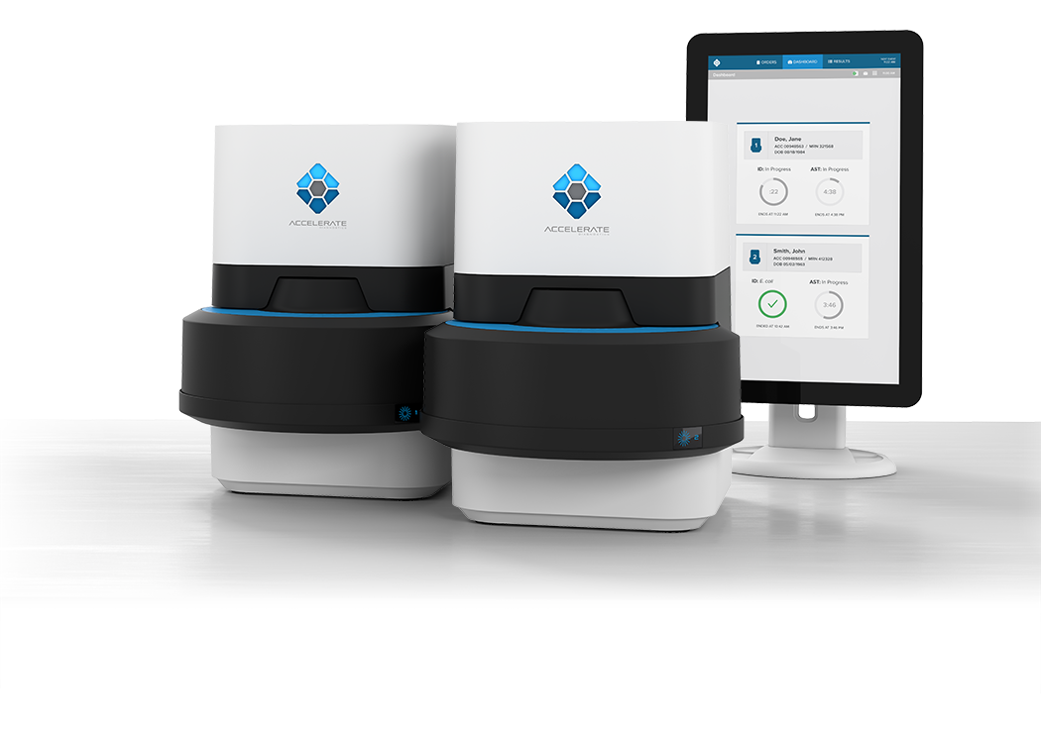
Accelerate Pheno™ System
FDA cleared for in vitro diagnostic use
MIC-based susceptibility results directly from positive blood culture
Identification in ~2 hours and susceptibilities in ~7 hours
Blood culture
flagged positive
Gram stain
performed &
results called to nursing unit
VITEK® 2 utilized for ID and susceptibility
Traditional Microbiology Workflow
Time to ID: 22-72h
Time to AST: 36-96h
Blood culture flagged positive
Gram stain performed & results called to nursing unit
If GNB visualized secure page sent to ASP
Accelerate Pheno™ utilized for ID and susceptibility
Accelerate Microbiology Workflow
Time to ID: 1.5-2h
Time to AST: 7h
ASP: antimicrobial stewardship program
https://acceleratediagnostics.com/products/accelerate-pheno-system/
5

Slide 6
ASP Bundle
Stable, floor patient with low inoculum source (e.g. pyelonephritis)
  Obtain early renal ultrasound/CT imaging to exclude complicated disease (e.g. abscess, nephrolithiasis, choledocholithiasis)
  Promote early IV to PO conversion if susceptible to fluoroquinolone (FQ)
  Promote early midline/PICC for home IV ceftriaxone if FQ/TMP-SMX resistant
  No need for repeat blood cultures in uncomplicated GNR bacteremia
  7 days total therapy for uncomplicated Enterobacterales bacteremia
  Aim for discharge within 48 hours (taking PO, normal mental status)
  ASP check-up phone call 24 hours after discharge
  ID clinic follow-up visit 48 hours after discharge
ASP: antimicrobial stewardship program
TMP/SMX: trimethoprim/sulfamethoxazole

Slide 7
ASP Bundle
Critically-ill patients
Ensure optimal agent(s) administered ASAP & optimize dosing based on MIC/CrCl
Encourage formal ID consultation
ASP: antimicrobial stewardship program
MIC: minimum inhibitory concentration
CrCl: creatinine clearance

Slide 8
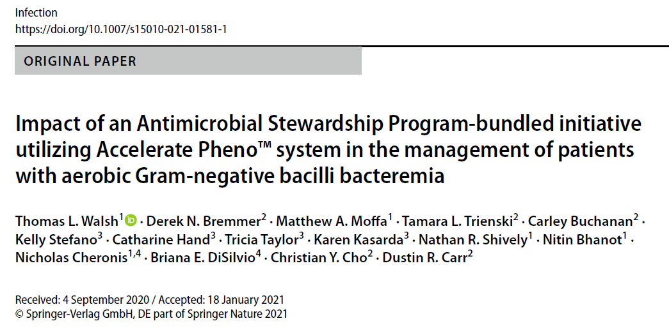
Walsh TL, et al. Infection. 2021.

Slide 9
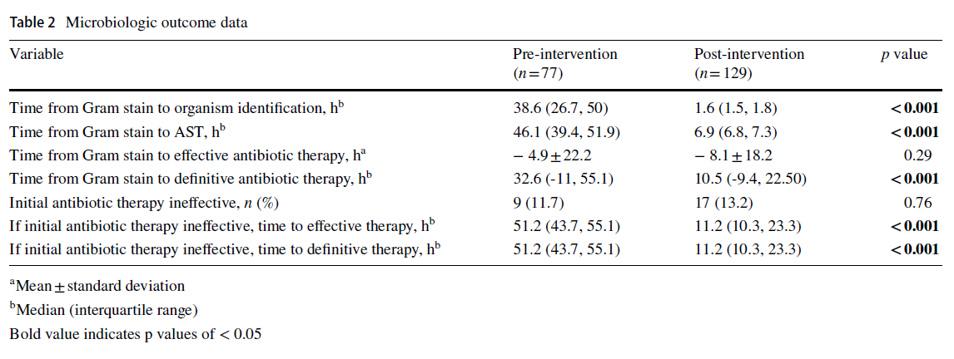
Walsh TL, et al. Infection. 2021.

Slide 10
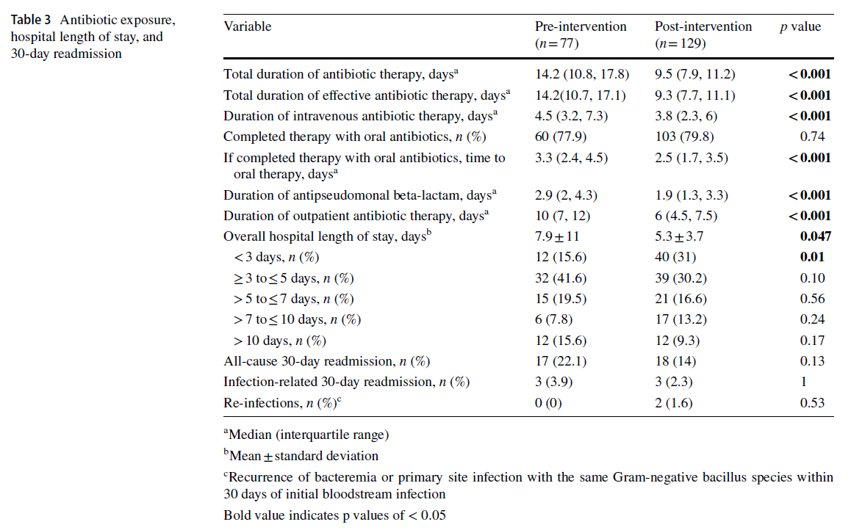
Walsh TL, et al. Infection. 2021.

Slide 11
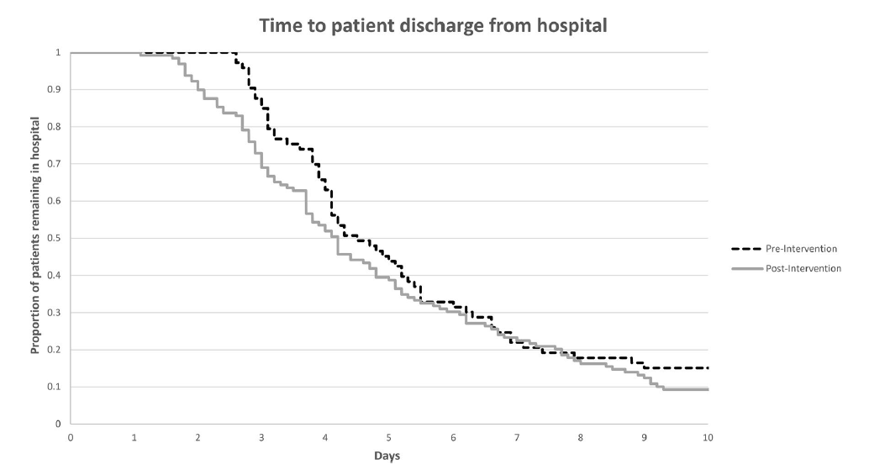
Walsh TL, et al. Infection. 2021.

Slide 12
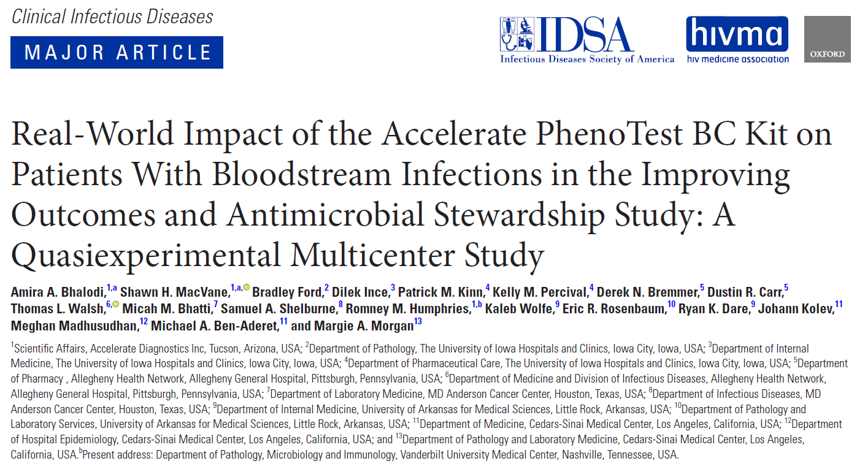
Bhalodi AA, et al. Clin Infect Dis. 2021.

Slide 13
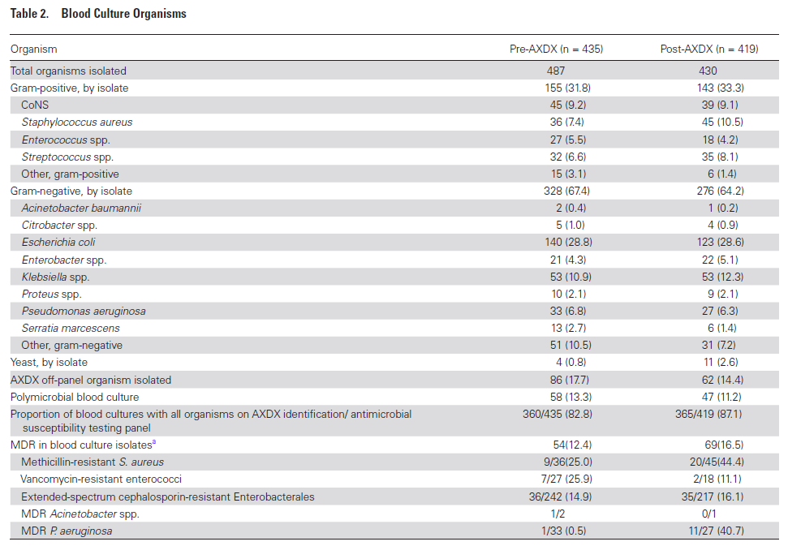
Bhalodi AA, et al. Clin Infect Dis. 2021.

Slide 14
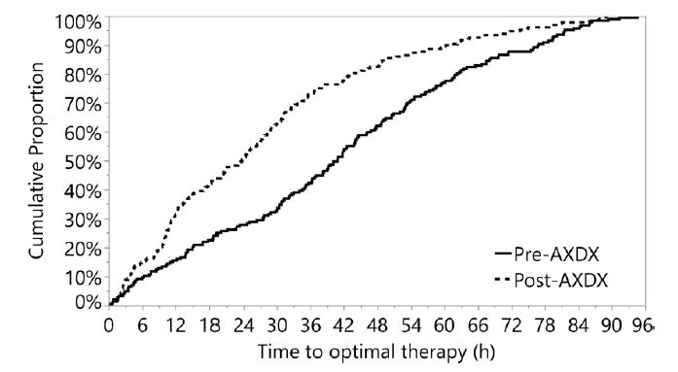
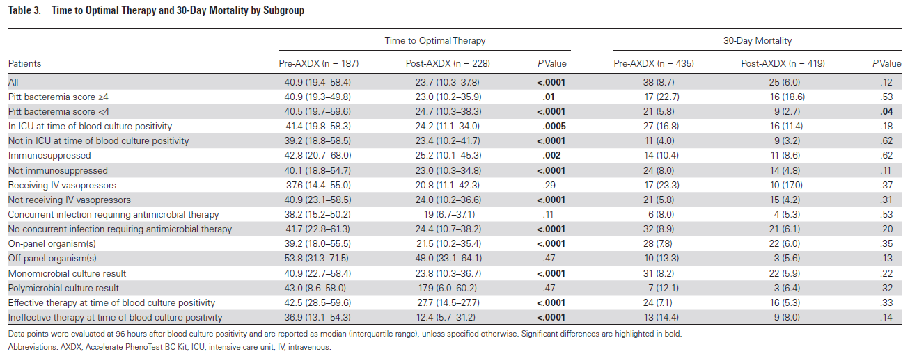
Bhalodi AA, et al. Clin Infect Dis. 2021.

Slide 15
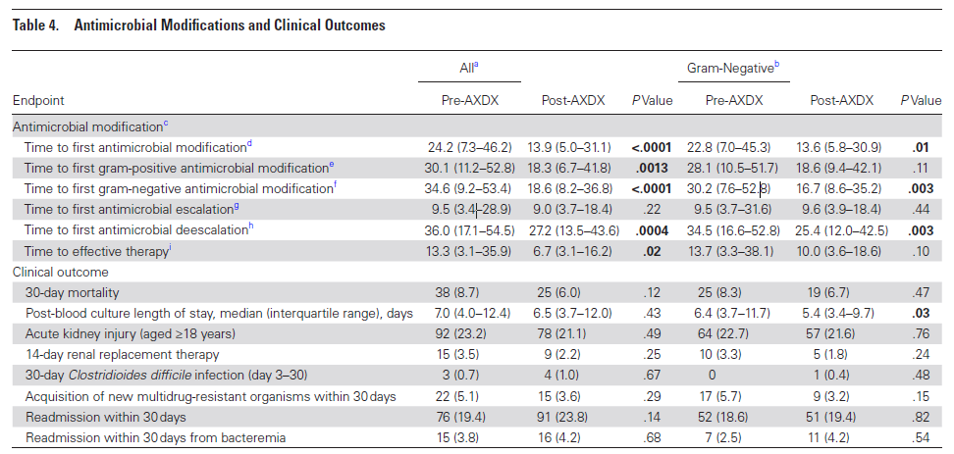
Bhalodi AA, et al. Clin Infect Dis. 2021.

Slide 16
Assessment Question
As part of AHN’s gram-negative bacteremia initiative, Accelerate Pheno™ system had the following impact
Improved time to identification and susceptibilities for on-panel GNB
Improved time to effective therapy for those on inadequate empiric therapy
Improved time to definitive therapy
Shortened hospital length of stay for patients not admitted to an ICU
All of the above
16
ASP: antimicrobial stewardship program

Slide 17
Conclusion
Accelerate Pheno™ system can have a significant impact for GNB bacteremia
If high rates of GNB resistance → may assist with ESCALATION
If low rates of GNB resistance → may assist with DE-ESCALATION
ASP intervention is crucial
A test is useless if you don’t know how to interpret the result and appropriately act on it
17
ASP: antimicrobial stewardship program

Slide 18
Dustin Carr, PharmD, BCPS, BCIDP
Clinical Pharmacy Specialist, Infectious Diseases
Allegheny General Hospital
9/17/2022
Life in the fAST Lane: Impact of Accelerate PhenoTM System on Management of Gram-Negative Bacilli Bacteremia
AST: antimicrobial susceptibility testing

