Slide 1

PRESENTED BY HUMAN RESOURCES
2021
Health Care & Retirement Programs

Slide 2
Agenda
Health Care Benefits
Other Benefits & Services
Retirement Plan Benefits
HR Services Online & New Hire Enrollment
Next Steps
Physician Orientation | 2021
2

Slide 3

Health Care Benefits
Physician Orientation | 2020
3

Slide 4

Eligibility & Effective Dates
Employee Eligibility
Full-time (FTE 8.75-1.0); 70 – 80 hours bi-weekly
Part-time (FTE .4 - .874); 32 – 69.99 hours bi-weekly
Dependent Eligibility
Spouse
Domestic Partner
Child(ren) up to age 26
Dependent Certification – 30 days!
Benefits are effective 1st of the month on or after your hire date
Physician Orientation | 2020
4

Slide 5


Medical Coverage
Each plan option has enhanced and standard built into the plan – it is not an election
Two levels of in-network coverage – Enhanced and Standard
  Enhanced provides you with
  highest level of coverage, lowest
  out of pocket expense
  Standard provides you with coverage,
  but more out of pocket expense
No out of network coverage, except for emergency care
All plans include Prescription Drug coverage
 | 90% PLAN |  | 80% PLAN |  | CONSUMER CHOICE HSA
 | Enhanced Level | Standard Level | Enhanced Level | Standard Level | Enhanced Level | Standard Level
Deductible Individual Family | $300 $600 | $750 $1,500 | $600 $1,200 | $1,200 $2,400 | $1,500 $3,000 | $3,000 $6,000
Coinsurance (plan pays after deductible) | 90% | 60% | 80% | 50% | 80% | 50%
Preventive Care | 100% no deductible |  | 100% no deductible |  | 100% no deductible
Copay Services
PCP | $20 | $50 | $30 | $50 | 80% after deductible
Specialist | $40 | $75 | $50 | $75
Urgent Care | $40 |  | $50
Physician Orientation | 2021
5

Slide 6
Wellness Rewards
Lower your out of pocket expenses!
  $500 deductible credit for individual coverage
  $1,000 deductible credit for employee +1 or more coverage
Employee Steps
  Complete a biometric screening
  Complete the Sharecare RealAge Test
Spouse/Domestic Partner Step
  Complete the Sharecare RealAge Test
Physician Orientation | 2021
6

Slide 7


Dental & Vision Coverage
Dental
Two dental PPO plan options
Preventive Care covered at 100%
Vision
One vision plan
Eye exam and frames/contact lenses once per calendar year
Physician Orientation | 2021
7

Slide 8
Life & AD&D Insurance
Basic Life & AD&D
Full-time employees only
1x’s salary up to $1M maximum
Supplemental Life & AD&D*
Full-time & part-time employees
1 to 8x’s annual salary up to $1.5M maximum
Spouse & Child Life
Full-time & part-time employees
Spouse coverage $10K - $100K
Child Coverage $10K or $20K
Paid by AHN;
Automatically enrolled
Paid by employee
Paid by Employee
*Evidence of insurability may be required for supplemental life elections
Physician Orientation | 2021
8

Slide 9

Disability
Short Term Disability
60% weekly base salary up to $2,000 maximum
Long Term Disability
Full-time employees
Part-time Short Term Disability
Part-time employees
Elimination period: 14 days
Duration: Up to 24 weeks
Full-time employees
60% of monthly base salary up to a $25,000 maximum
Elimination period: 180 days or end of STD
Employer paid; automatically enrolled
Employer paid; automatically enrolled
60% of monthly base salary up to a $1,150 maximum
Elimination period: 15 days
Duration: Up to 24 weeks
Employee paid; must elect
Physician Orientation | 2021
9

Slide 10
Spending Accounts
Health Savings Account
Only available with Consumer Choice HSA (HDHP) plan
Triple tax advantage
Health Care Flex Spending Account
Available with 80% or 90% EPO or waive coverage
Tax advantage
Dependent Care Flex Spending Account
Child/dependent care expenses only (up to age 13) – NOT medical
“Use it or lose it”
Always yours; no “use it or lose it”
Carryover of up to $500 year to year
Tax advantage
**All spending account options subject to IRS annual contribution limits**
Physician Orientation | 2021
10

Slide 11


Ask Alex® - Your own personal benefits counselor
ALEX®, the official Highmark Health benefits counselor, walks you through the process of picking your best benefits, and provides easy-to-understand explanations for any questions you might have along the way.
Personalized
Fun to Use
Confidential
Meet ALEX at
https://review.myalex.com/highmark/2020/ahn
Physician Orientation | 2021
11

Slide 12
Other Benefits & Services
Highmark Health Employee Advantage (voluntary lifestyle benefits)
  Includes Hospital Indemnity, Accident, Critical Illness, ID Theft Monitoring, Legal Insurance, Pet Insurance and more!
  Some benefits must be elected during your new hire election period
Magellan Employee Assistance
  Available to you, your dependents and household members
  Accessible 24/7/365 via phone or website
Tuition & Education Benefits
  Tuition Reimbursement
  Tuition Discounts & Deferrals
  Student Loan Refinancing (through Highmark Health Employee Advantage)
Commuter Benefits
  Pre-tax transit passes
  Parking programs (at certain locations)
Physician Orientation | 2021
12

Slide 13
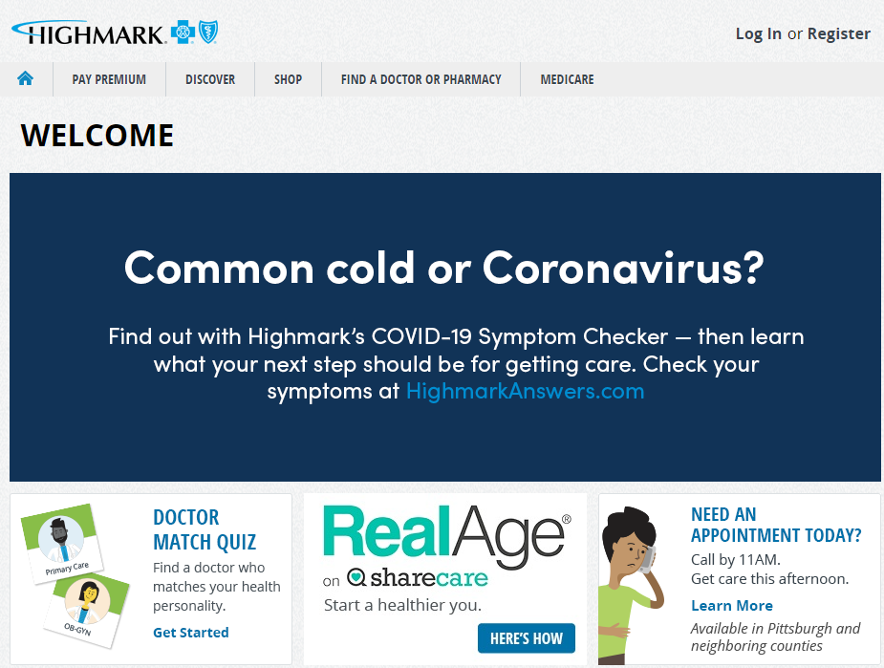
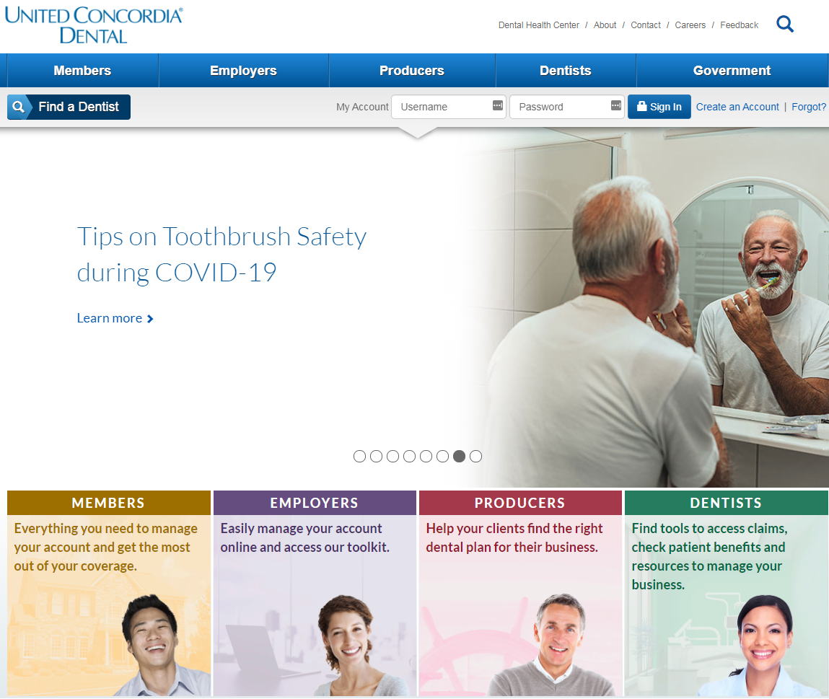


Resources
Member Websites & Apps
For Medical & Vision: www.highmarkbcbs.com For Dental: www.unitedconcordia.com
Or download the Highmark and United Concordia Mobile Apps for immediate
access to virtual ID cards, finding a provider, claims management and more!
Physician Orientation | 2021
13

Slide 14

AHN Retirement Benefits
Physician Orientation | 2021
14

Slide 15
AHN 401(k) Plan - Transamerica
Who is Eligible?
All employees of AHN who are at least age 21 after 30 consecutive days of employment
What is the benefit?
100% match on employee contributions of up to 4% of eligible pay PLUS
1% annual non-elective contribution
      Must be paid for 1,000 hours in a calendar year
      Must be employed on 12/31 (exceptions – death, disability, retirement)
Total Opportunity:
5% employer contribution on 4% employee contribution
Physician Orientation | 2021
15

Slide 16
AHN 401(k) Plan - Transamerica
How do I enroll?
You are automatically enrolled at a 4% pre-tax contribution rate.
You can change the contribution rate or opt out of the plan altogether at any time via the Transamerica website – transamerica.com/portal/highmark
How do I make changes to my contribution %, name my beneficiary or change my asset allocations?
Logon to the Transamerica website – transamerica.com/portal/highmark (or later use single sign on through HR Services Online)
Physician Orientation | 2021
16

Slide 17
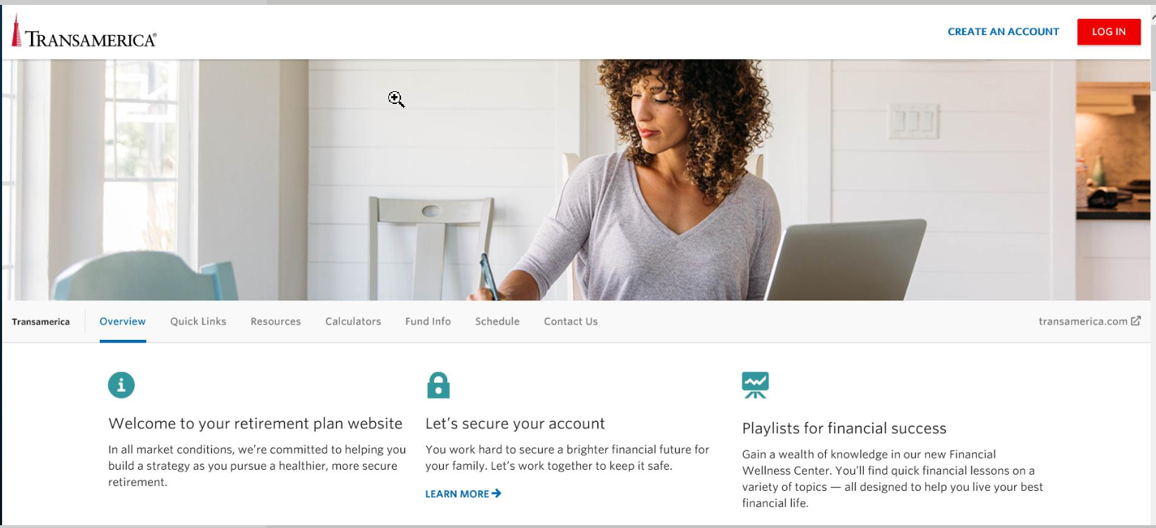
AHN 401(k) Plan - Transamerica
Physician Orientation | 2021
17

Slide 18
AHN 401(k) Plan - Investments
There are two investment options in the AHN 401(k) Plan:
    Pre-mixed portfolio (Default option) designed to provide a one-step approach to diversification
      BlackRock LifePath Index funds
      Professionally diversified and managed funds
      10 funds available based on the year you are most closely expecting to retire
    Mix your own portfolio
      Are you comfortable with investing principles, such as diversification, asset allocation, and risk?
      Will you give yourself time to monitor and rebalance your portfolio?
      If so, this option gives you the opportunity to…
        create your own combination of investments and manage your own portfolio
        select from the individual investment options available in the Plan
      Investment option information available on the Transamerica website
Physician Orientation | 2021
18

Slide 19
AHN 401(k) Plan – Vesting & Limits
Vesting
Your contributions as well as the employer match are vested immediately
1% annual non-elective contribution vests after 3 years of service.
Limits on contributions:
You can contribute between 1% and 75% of your base plus incentive pay on a pre-tax basis, Roth basis or post-tax basis (the combined contribution cannot be greater then 75%).
Pre-tax and Roth contributions are limited to $19,500 in 2021 (HCE’s may be limited on post-tax at 2%). If age 50 or older, can contribute an additional $6,500 in Pre-tax or Roth.
Physician Orientation | 2021
19

Slide 20
AHN 401(k) Plan – Important! Limits
  For 2021, contributions are made on the first $290,000 of earnings.
  IMPORTANT!!
  Once your salary exceeds $290k your 401(k) contributions will cease!
  If your compensation exceeds $290,000 and it is your goal is to maximize your contributions for the year (before you reach $290,000 and contributions stop) please carefully consider and select the amount you want to contribute!
Physician Orientation | 2021
20

Slide 21
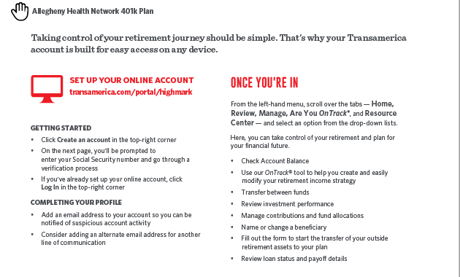
AHN 401(k) Plan - Transamerica
Physician Orientation | 2021
21

Slide 22
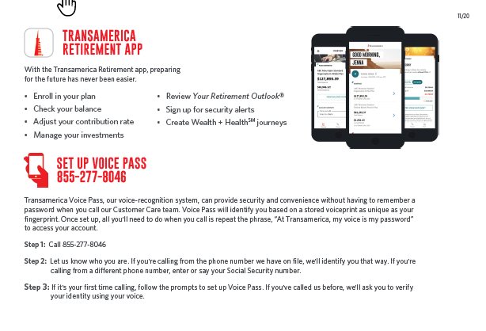
AHN 401(k) Plan - Transamerica
Physician Orientation | 2021
22

Slide 23
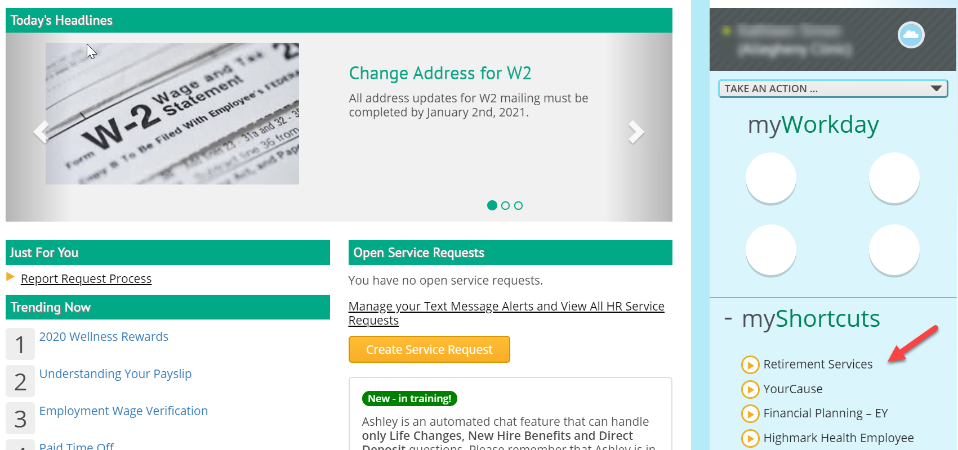
AHN 401(k) Plan - Transamerica
Single Sign On through HR Services On Line
Physician Orientation | 2021
23

Slide 24
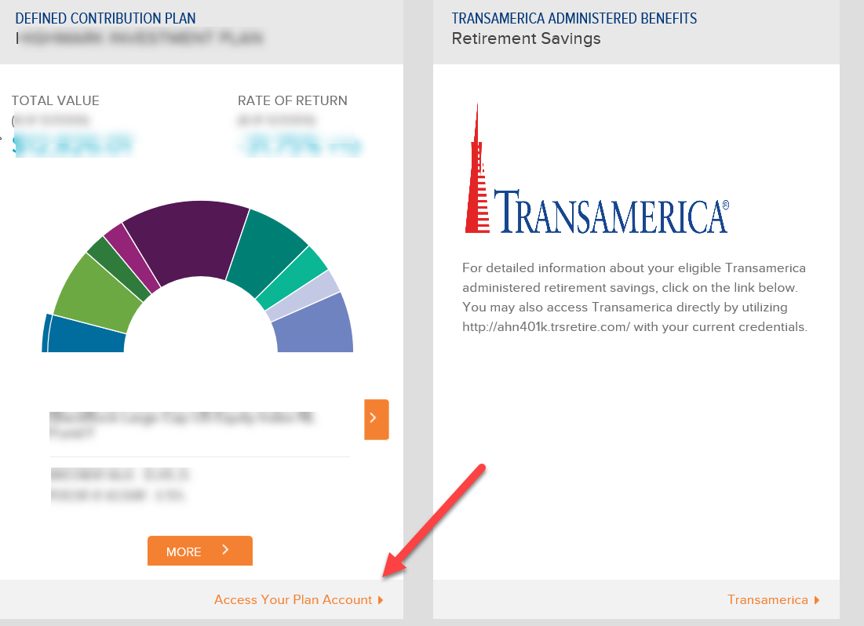
AHN 401(k) Plan - Transamerica
Single Sign On Continued…
Physician Orientation | 2021
24

Slide 25

Improve your financial health
Contact EY today:
https://highmark.eyfpc.com
EY Financial Planner Line® at 1-888-394-3578
The EY comprehensive financial wellness program is offered by Highmark Health at no cost to you.
Allegheny Health Network employees have a new financial planning benefit!
Contact EY to:
Reduce your debt
Create a financial action plan
Learn how to use your AHN benefits
Save for your future
Physician Orientation | 2021
25

Slide 26
AHN 457(b) Plan – Deferred Compensation Plan
This Plan is a non-qualified defined contribution plan administered by Transamerica
Eligibility: AHN physicians only
Benefit: No employer money; employee deferrals only beginning with first paycheck that exceeds annual compensation limit ($290k for 2021). No deferrals are taken until earnings exceed this limit.
Enrollment: Must actively enroll in plan. Annual enrollment occurs each November/December for the following year. No changes can be made until subsequent open enrollment.
Vesting: Contributions are vested immediately
Limits on contributions:
  Earnings over the compensation limit ($290k in 2021) are eligible for deferral
  Pre-tax contributions (only) - limited to $19,500 in 2021 (no catch up contribution)
Forms of Payment: Lump sum of account balance within 90 days of termination; can make one-time election to defer payment or request 10-year installments if balance exceeds $100k
Physician Orientation | 2021
26

Slide 27
HR Services Online (HRSO) & New Hire Enrollment
Physician Orientation | 2020
27

Slide 28


What is HR Services?
It’s a website: HR Services Online
It’s the HR Services Center: HR experts ready to assist you via online service requests, chats, and phone
It’s Workday: our enterprise application to manage pay, benefits and employee information
Physician Orientation | 2021
28

Slide 29
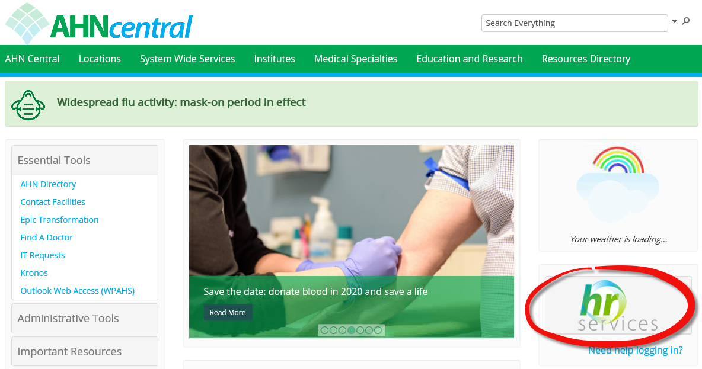
AHN Central
Physician Orientation | 2021
29

Slide 30
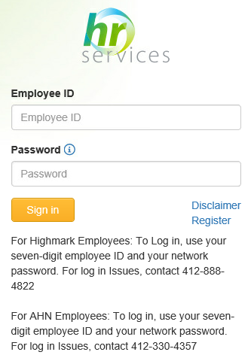
HRSO – Logging In
Logging In:
Employee ID (# found on the back of your badge)
Network Password
For log in assistance and password issues, contact:
412-330-HELP
www.hrservices.highmarkhealth.org
Physician Orientation | 2020
30

Slide 31
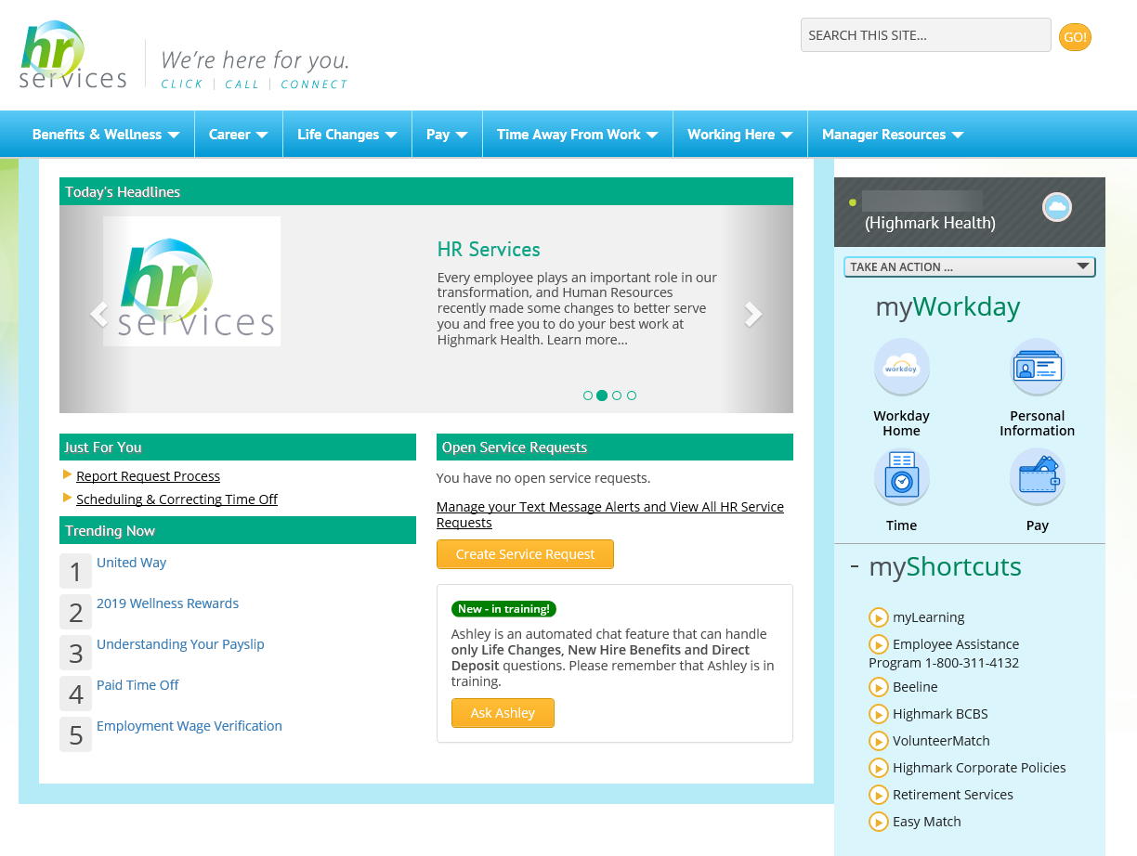
HR Services Online: Where to go
Top navigation will take you to specific articles about the topic that you can read for more information
Search articles with keywords
How to contact HR Services:
Preferred Contact Methods
Physician Express Team
  Physicianexpress@ahn.org
Optional Contact Methods
Create a Service Request online available 24/7/365
OR
Online chat – Ask Ashley
NOTE: Chat and phone are available Monday – Friday, 8 a.m. – 5 p.m.
Access Workday to take action on HR processes.
Shortcuts to get to Highmark BCBS, Kronos, myLearning, 401k, etc.
If you need additional help, select create service request or chat to submit a question to HR Services Center
Notes:
Launch 3rd polling question
Q: What topics have you reviewed on HR Services Online?

Slide 32
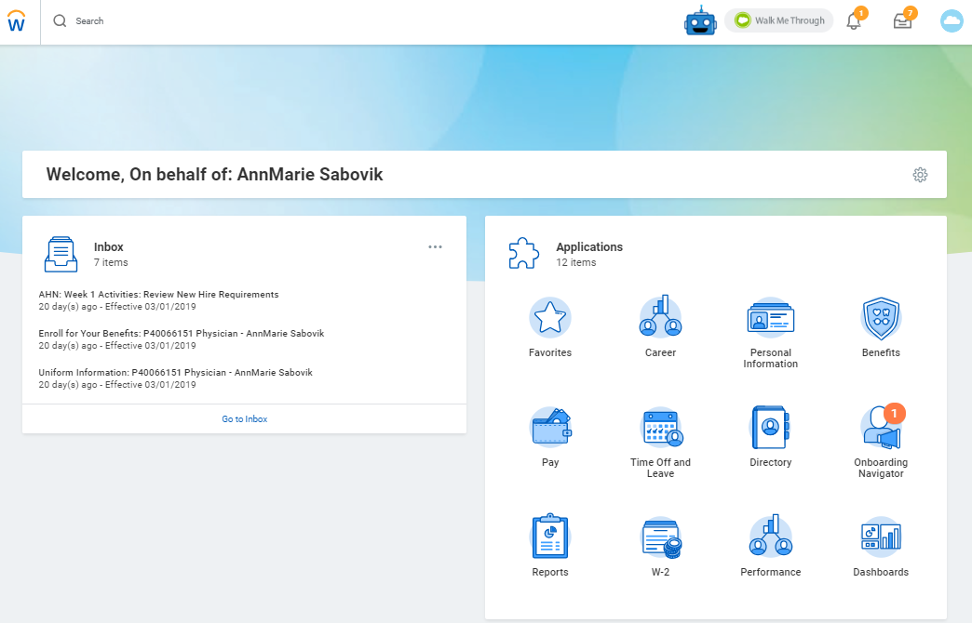
Navigating Workday
You can manage/track multiple items from your Workday homepage
All onboarding tasks completed within Workday (3 sets of tasks)
Review your inbox on a regular basis for new tasks and alerts
Welcome, on behalf of : New Employee
Physician Orientation | 2021
32

Slide 33
Getting Started in Workday
Onboarding Tasks
Three tasks sets
Must be completed in sequential order
Refresh the screen to continue to the next set
First Set | Second Set | Third Set
1. Legal Name 2. Personal Information 3. Contact Change | 1. State & Local Tax Withholdings 2. Federal Tax Withholdings | 1. Disability Self-Identification 2. Veteran Status Identification 3. Preferred Name Change 4. Emergency Contact 5. AHN: First Day on Site 6. AHN: Week 1 Activities: Review New Hire Requirements 7. Complete Form I-9 | 8. Add Payment Elections 9. Enroll for Your Benefits 10. Union Information 11. Review Documents: Policy & Procedures Acknowledgement 12. Review Documents: IT Acceptable Use and Policy Acknowledgement 13. Change Photo
Physician Orientation | 2021
33

Slide 34
Tax Withholding Elections
For assistance, go to HR Services Online>Pay>Tax Withholding, http://munstats.pa.gov/Public/FindMunicipality.aspx, or consult a tax professional. This includes both the amount of allowances on your Federal Withholding Form and which form to select for your State & Local Withholding. HR Services cannot advise on Tax Withholding Elections.
Complete State & Local Withholding Elections
Select the State in which you work.
Select the Withholding form Type. For information about withholding form types, please go to HR Services Online>Pay>Tax Withholding.
Click OK
Fill out the selected form
Click Submit
Note: If you live in a state that does not withhold income tax, please submit a service request through HR Services Online
Complete Federal Withholding
Elections
Select your Marital Status
Select the number of allowances (consult a tax professional for assistance)
Enter any additional amount you want withheld from your pay
Select the Exempt checkbox only if you meet both of these conditions:
  Last year, you had a right to a refund of all federal income tax withheld because you had no tax liability; and
  This year, you expect a refund of all federal tax withheld because you expect to have no tax liability.
  If you do not know if you meet these conditions, consult a tax professional
  Select the “I Agree” checkbox.
  Click Submit
Physician Orientation | 2021
34

Slide 35
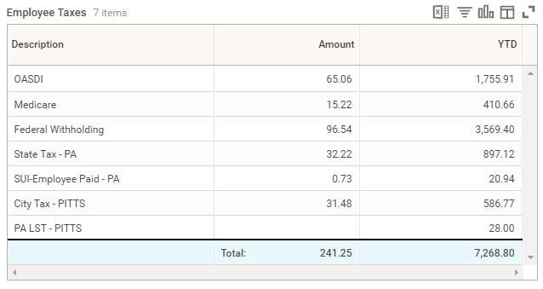
Closer Look at Taxes: Local Tax
This is the number one tax question that HRSC answers throughout the entire year.
Local taxes are withheld at the higher of 2 rates:
The rate of where you live OR
The rate of where you work
Regardless of the rate in which you are withheld at your payslip will ALWAYS display your work locality.
Physician Orientation | 2021
35

Slide 36
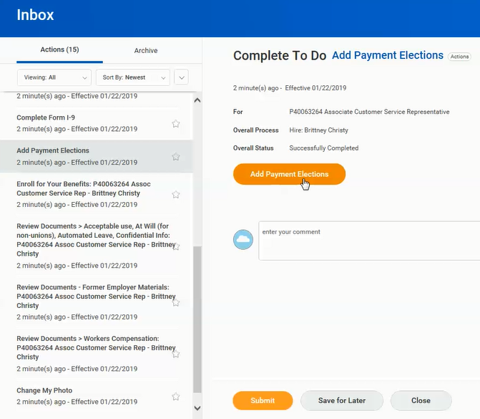
Add Payment Election (Direct Deposit)
Physician Orientation | 2021
36

Slide 37
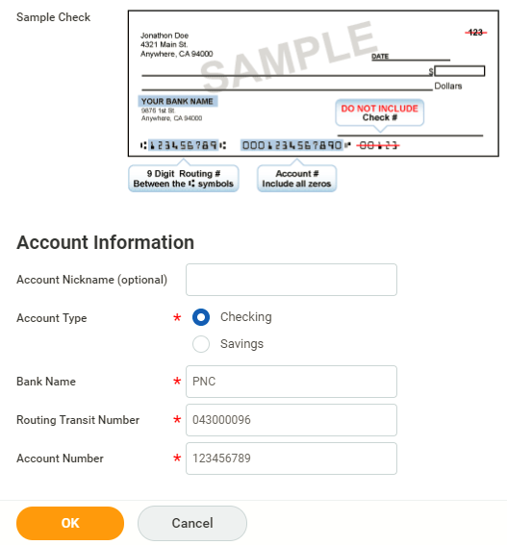
Adding a Bank Account
Be very careful to enter the correct account information. We suggest you verify it before you click OK.
Once you click OK, you have added an account.
Physician Orientation | 2021
37

Slide 38
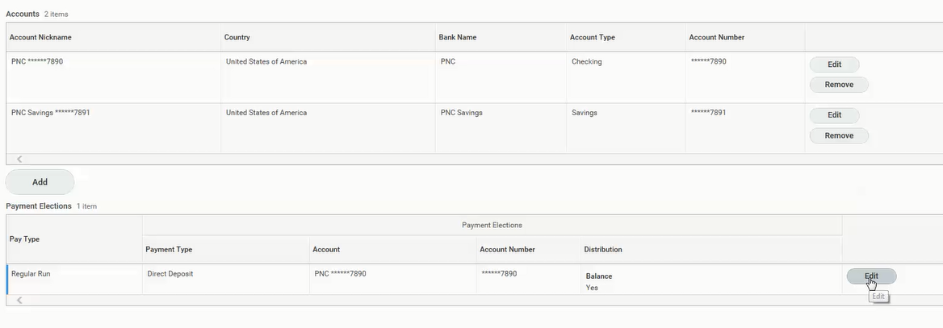
Adding a Payment Election
Accounts will populate a list of all accounts entered in Workday
Balance: If you are adding only 1 account for payment distribution from your paycheck, you are Done.
If you want to distribute your paycheck earnings to multiple accounts click edit
Physician Orientation | 2021
38

Slide 39
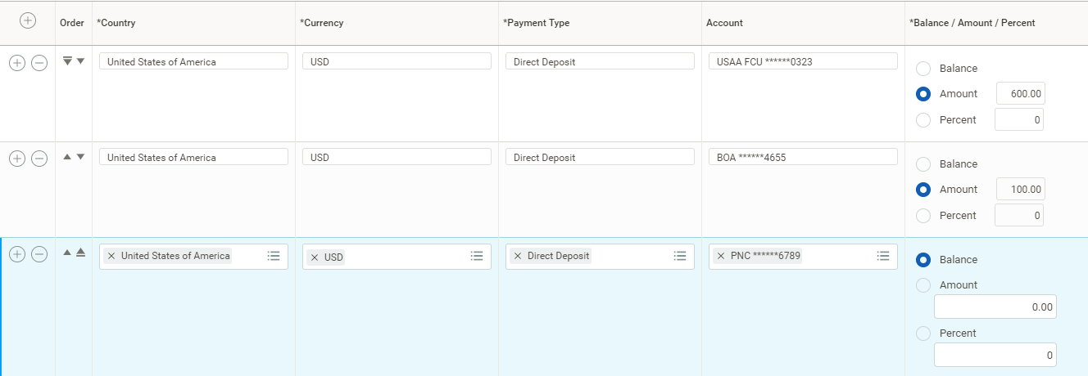
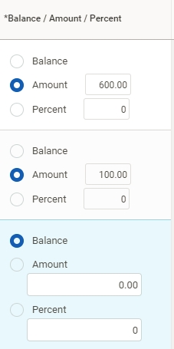
Adding a Payment Election Cont’d
Your elections will be applied in list order – top to bottom
Use the arrows in the second column to change the order of the accounts
Move your balance account to the last account in the list
Physician Orientation | 2021
39

Slide 40
New Hire Checklist & Resources
Physician Orientation | 2020
40

Slide 41
Take Action: New Hire Checklist
Complete all onboarding tasks in Workday ASAP.
Visit HR Services>Benefits & Wellness>2020 Benefits.
Review your benefit options with Alex.
Enroll in Benefit Coverage within 30 days from hire date.
Certify your dependents (birth certificates, marriage certificates, domestic partner form, etc).
Participate in the Wellness Rewards program (task in Workday)
Physician Orientation | 2021
41

Slide 42
Take Action: New Hire Checklist
Check out the voluntary benefits from Highmark Health Employee Advantage.
Review your 401(k) enrollment & investment options.
Assign beneficiaries for life insurance and retirement accounts.
Review the legal notices and other related benefit documents on HRSO. Remember to sign up for Electronic Consent!
REMINDER: Health Insurance ID cards will arrive 7 – 14 business days after coverage effective date.
Physician Orientation | 2021
42

Slide 43

Resources
HR Services (HRSO) – www.hrservices.highmarkhealth.org
Highmark Medical – www.highmarkbcbs.com
United Concordia – www.unitedconcordia.com
Davis Vision – www.davisvision.com
OR
                Download the apps for quick, personal access to your HR, health & wellness needs!
Physician Orientation | 2021
43

Slide 44

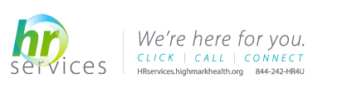
HR Questions
Contact the HR Service Center – Physician Express Team
Preferred Contact Methods
Physician Express Team
  Physicianexpress@ahn.org
Optional Contact Methods
Create a Service Request online available 24/7/365
Physician Orientation | 2021
44

Slide 45
Questions?

